Slide 1

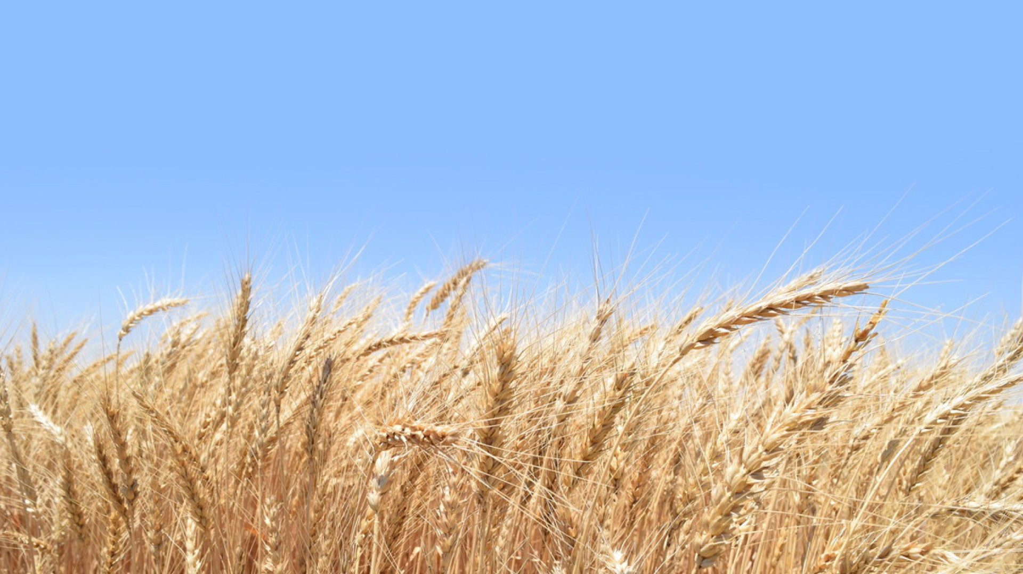
Introducing Wheat

Slide 2
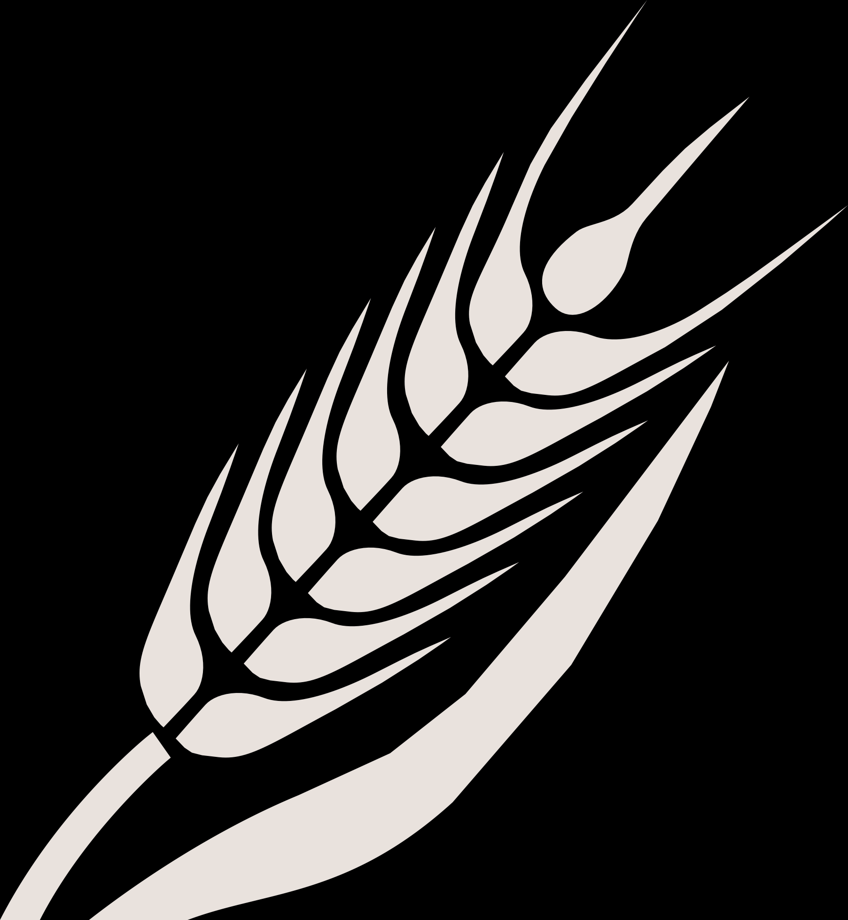
Important Vocabulary Terms
Acre: A unit of measurement that equals 4,840 square yards and is used to measure land.
    - This is roughly the size of a football field.
    - A typical crop circle is 125 acres.
Yield: The amount of grain harvested per unit acre, typically measured in bushels per acre for wheat production.
    - In 2025, the national average yield was 53.5 bushels per acre.
    - In 2025, the average yield in Texas was 37 bushels per acre.
Bushel: A unit of dry volume measurement used in agriculture to measure harvested crops.
    - One bushel of wheat is equal to 60 pounds.

Slide 3

All About Wheat

Slide 4
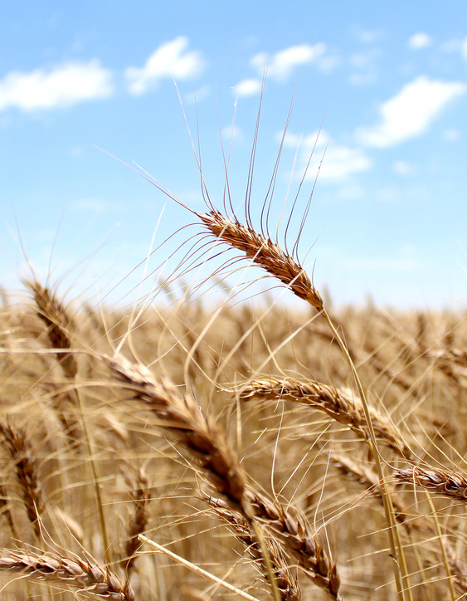
What is Wheat?
Wheat is an ancient cereal grain and is a staple food worldwide.
    - Cereal grains are edible grasses, such as wheat, rice, corn, oats, barley, rye, sorghum (milo) and millet.
Wheat is the main food grain produced in the U.S. It is grown in more than 40 states across the country.
Most of the wheat grown in the U.S. is used for flour, but wheat has many other uses, including non-food products for human use and feed for livestock.
Wheat is known as one of the most sustainable crops because of its water and nitrogen efficiency.
Mature wheat

Slide 5
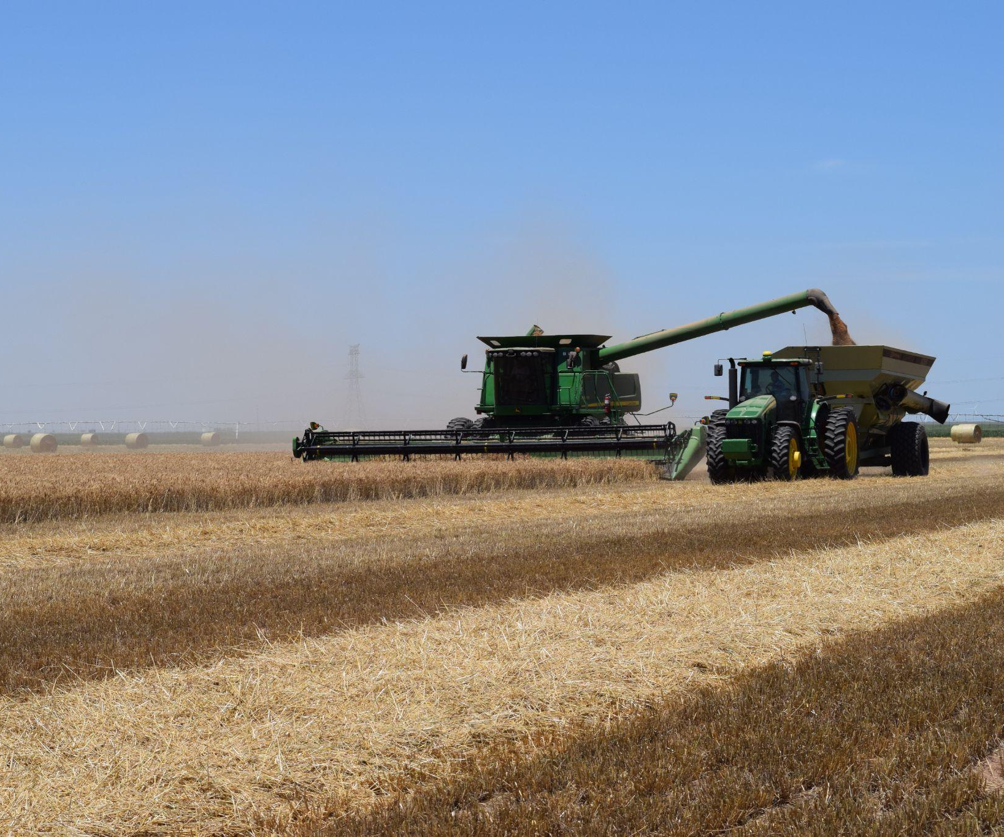
Wheat in Texas
Texas is one of the top producing wheat states in the U.S.
    - In 2025, Texas ranked 3rd in the nation for number of acres planted and 7th for bushels produced.
About 60% of the wheat grown in Texas is grazed by cattle or harvested for wheat silage (sometimes called wheatlage).
Of the other 40% of wheat grown in Texas, half is consumed in the U.S, while the other half is sold internationally.
85% of the wheat grown in Texas is hard red winter (HRW) wheat, 10% is soft red winter (SRW) wheat and 5% is other types, including hard red spring (HRS) and white wheats.
HRW wheat being harvested in Texas.

Slide 6
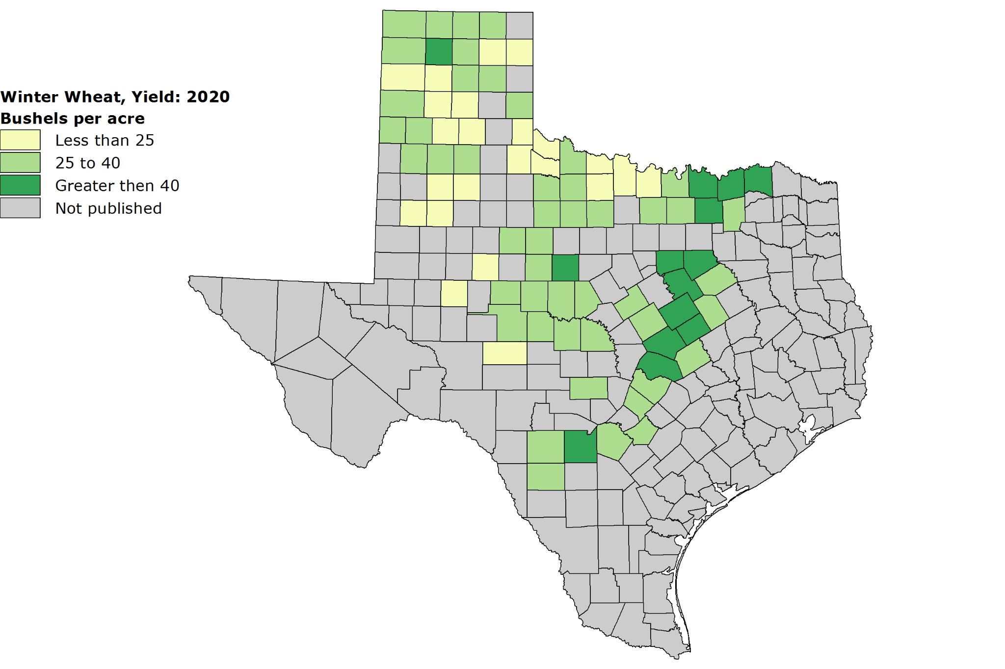
Wheat in Texas
Most wheat grown in Texas is Hard Red Winter Wheat, but farmers in the Blackland Prairies region primarily grow Soft Red Winter Wheat.
Note: 1 bushel = 60 pounds.
Image Source: USDA's National Agricultural Statistics Service
Texas Field Office

Slide 7
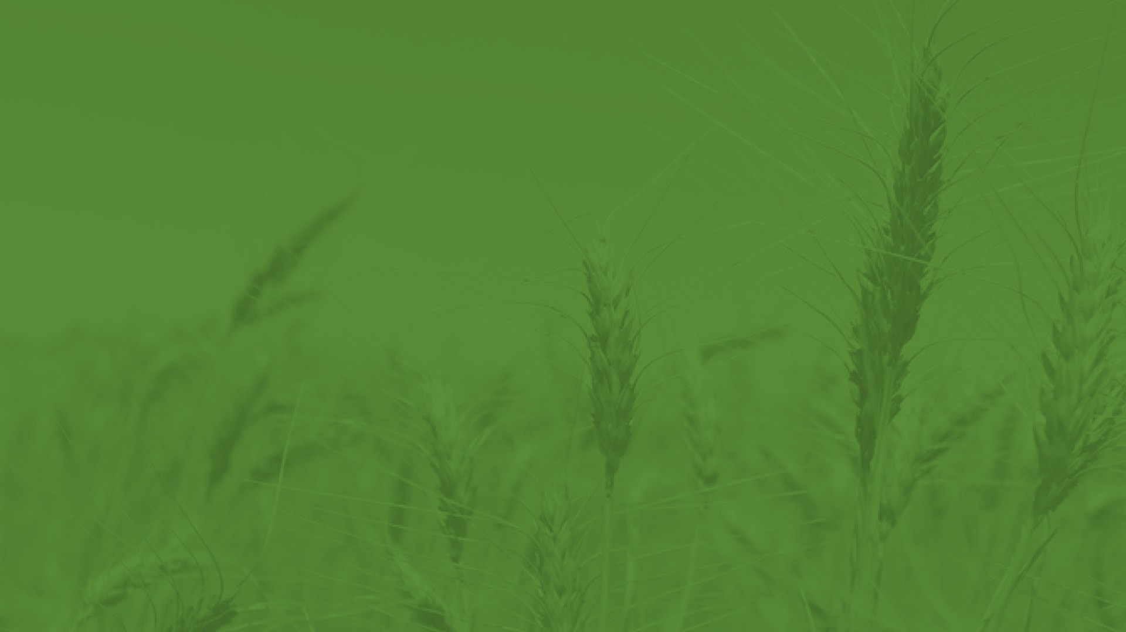
Types of Wheat

Slide 8
About Wheat Classes
There are six main types, or classes, of wheat grown in the United States.
Each type (or class) has different properties, purposes, kernel color and growing region/season.
The different classes of wheat are used to make different types of flour.
There are hundreds of varieties, but they all fit into the six classes.
A farmer chooses which variety to plant based on geography, moisture, temperature, soil type and market opportunity.

Slide 9
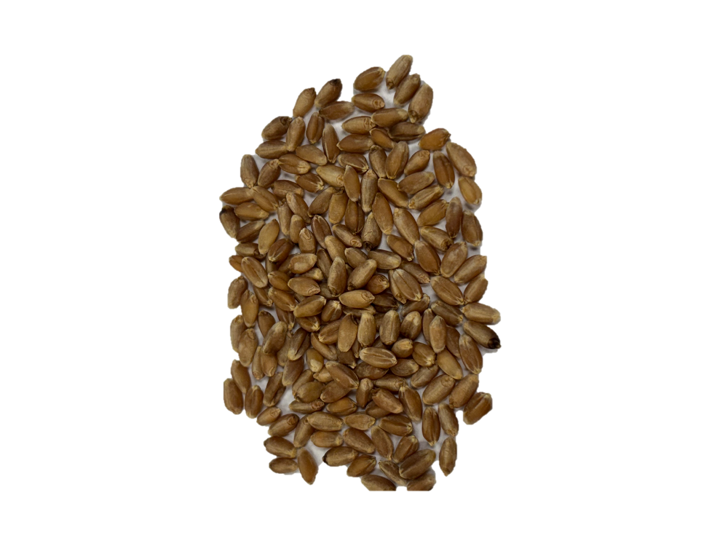
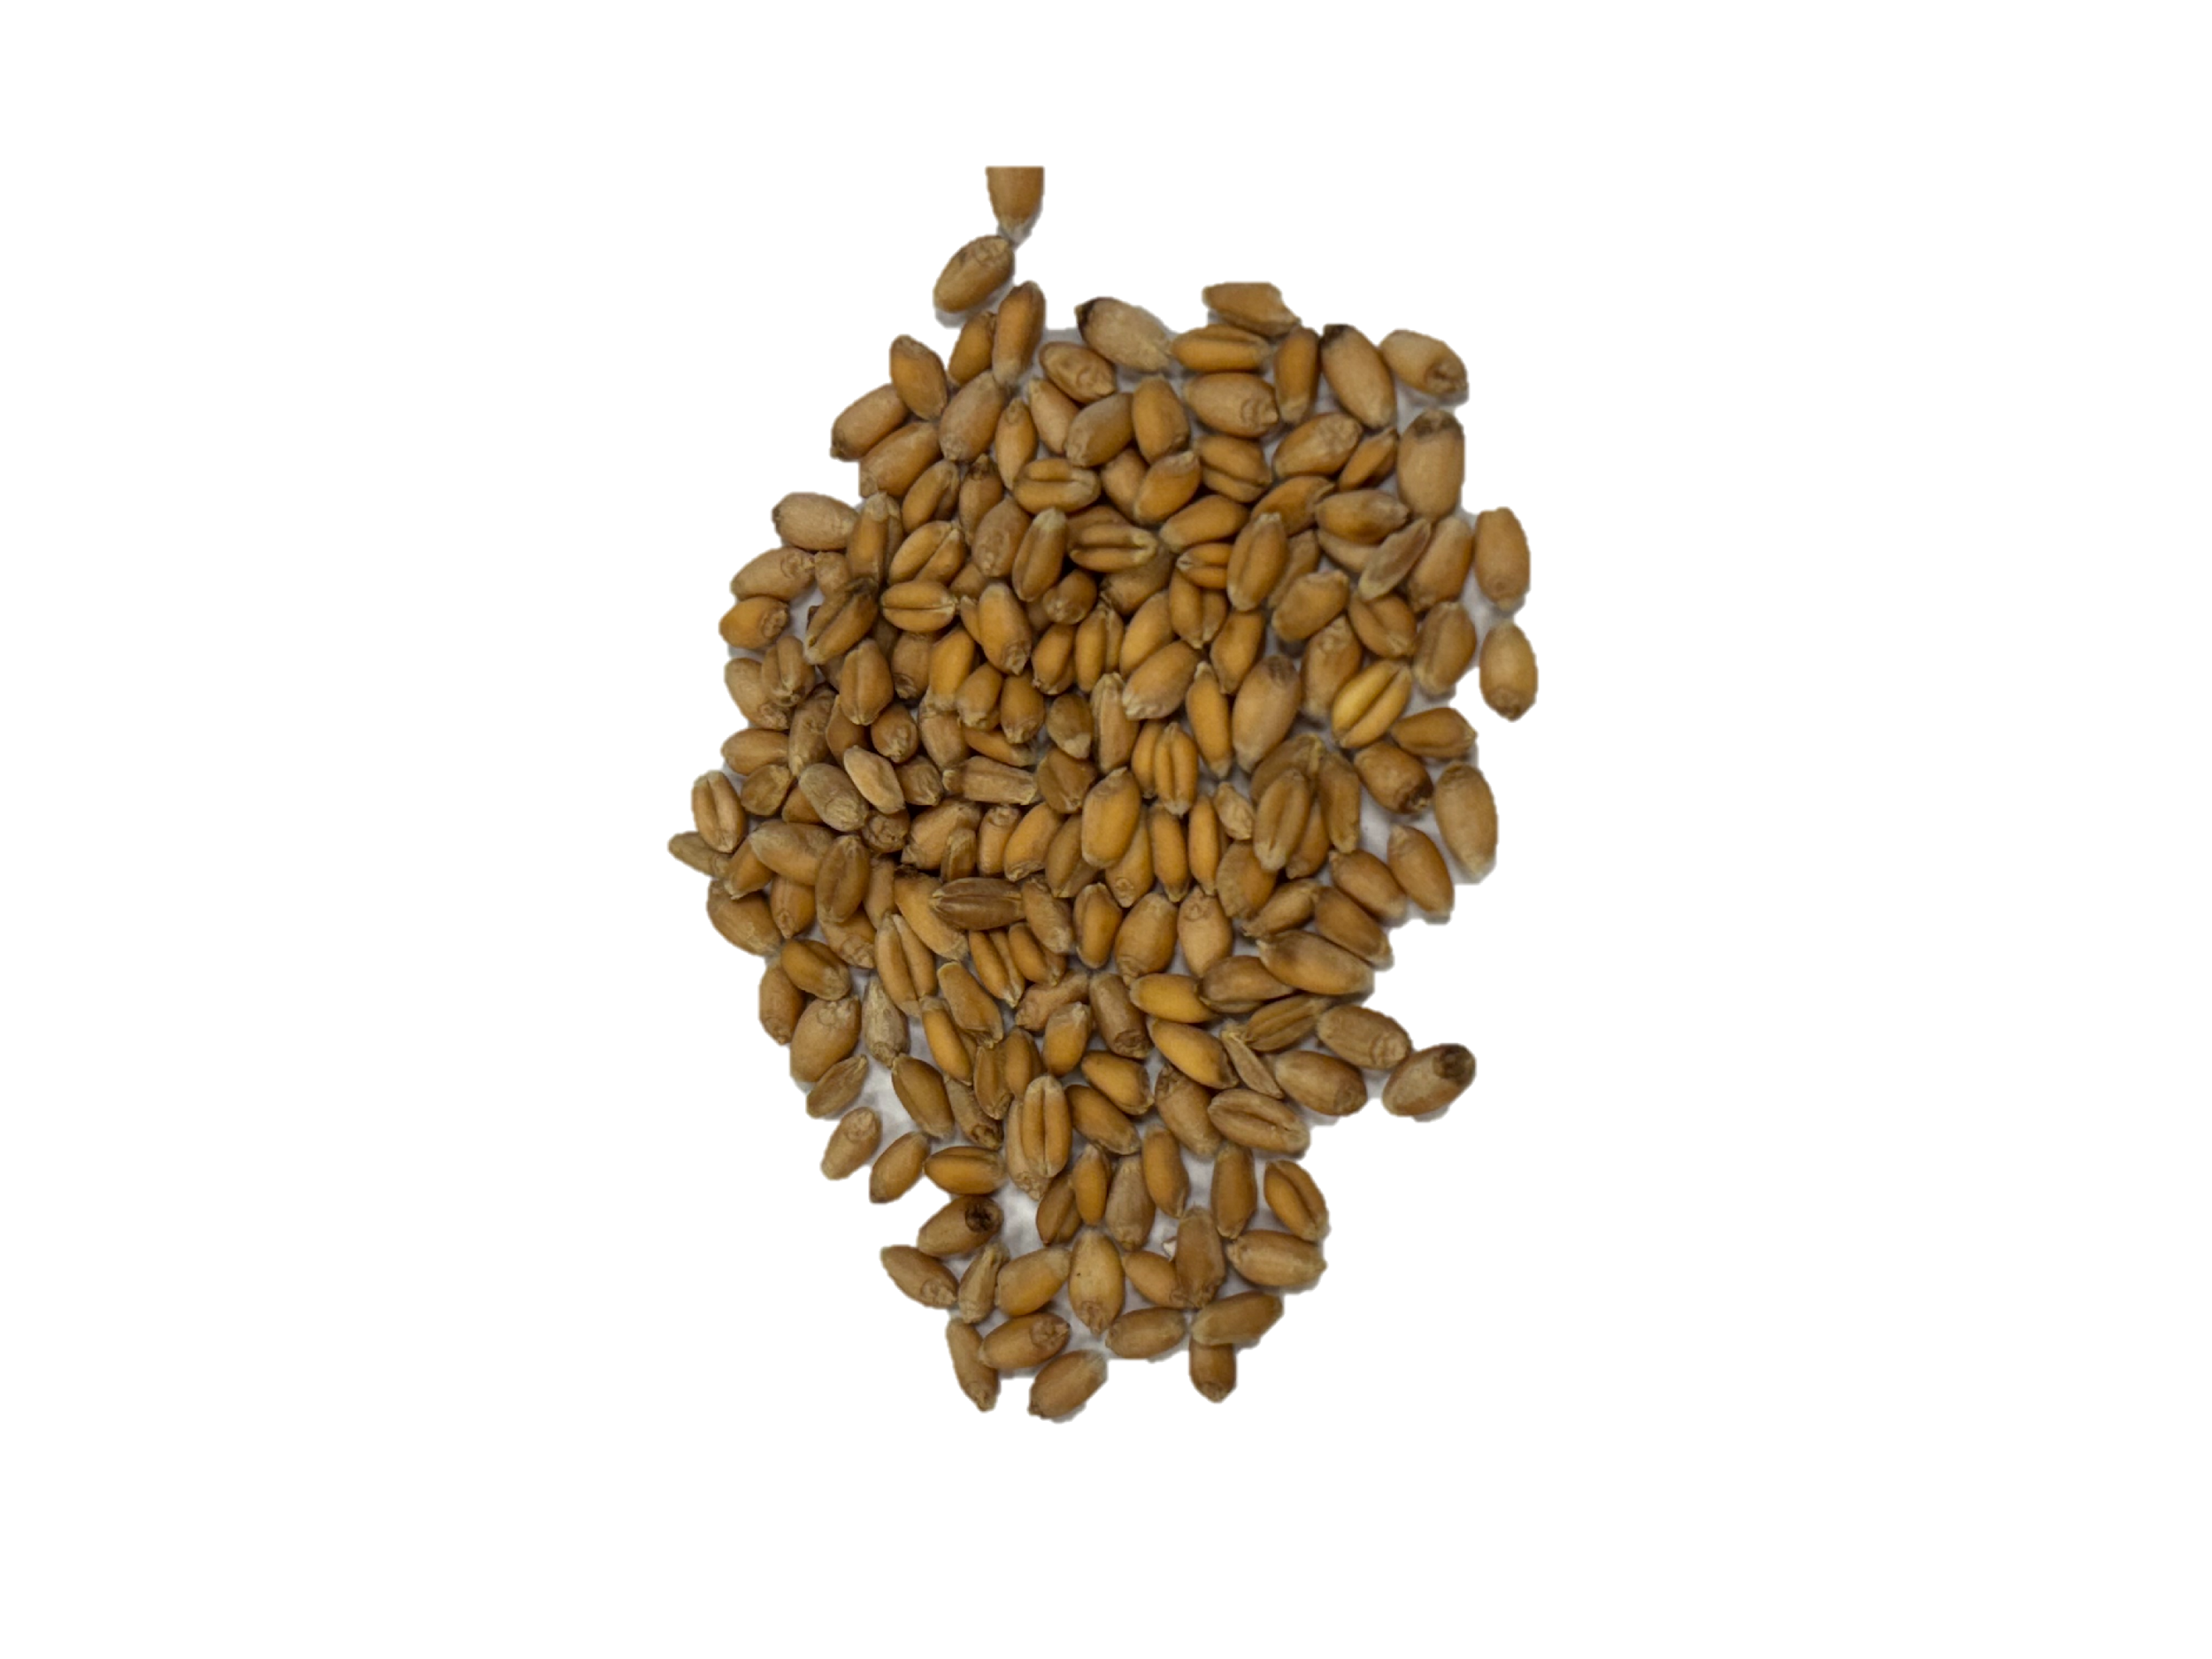
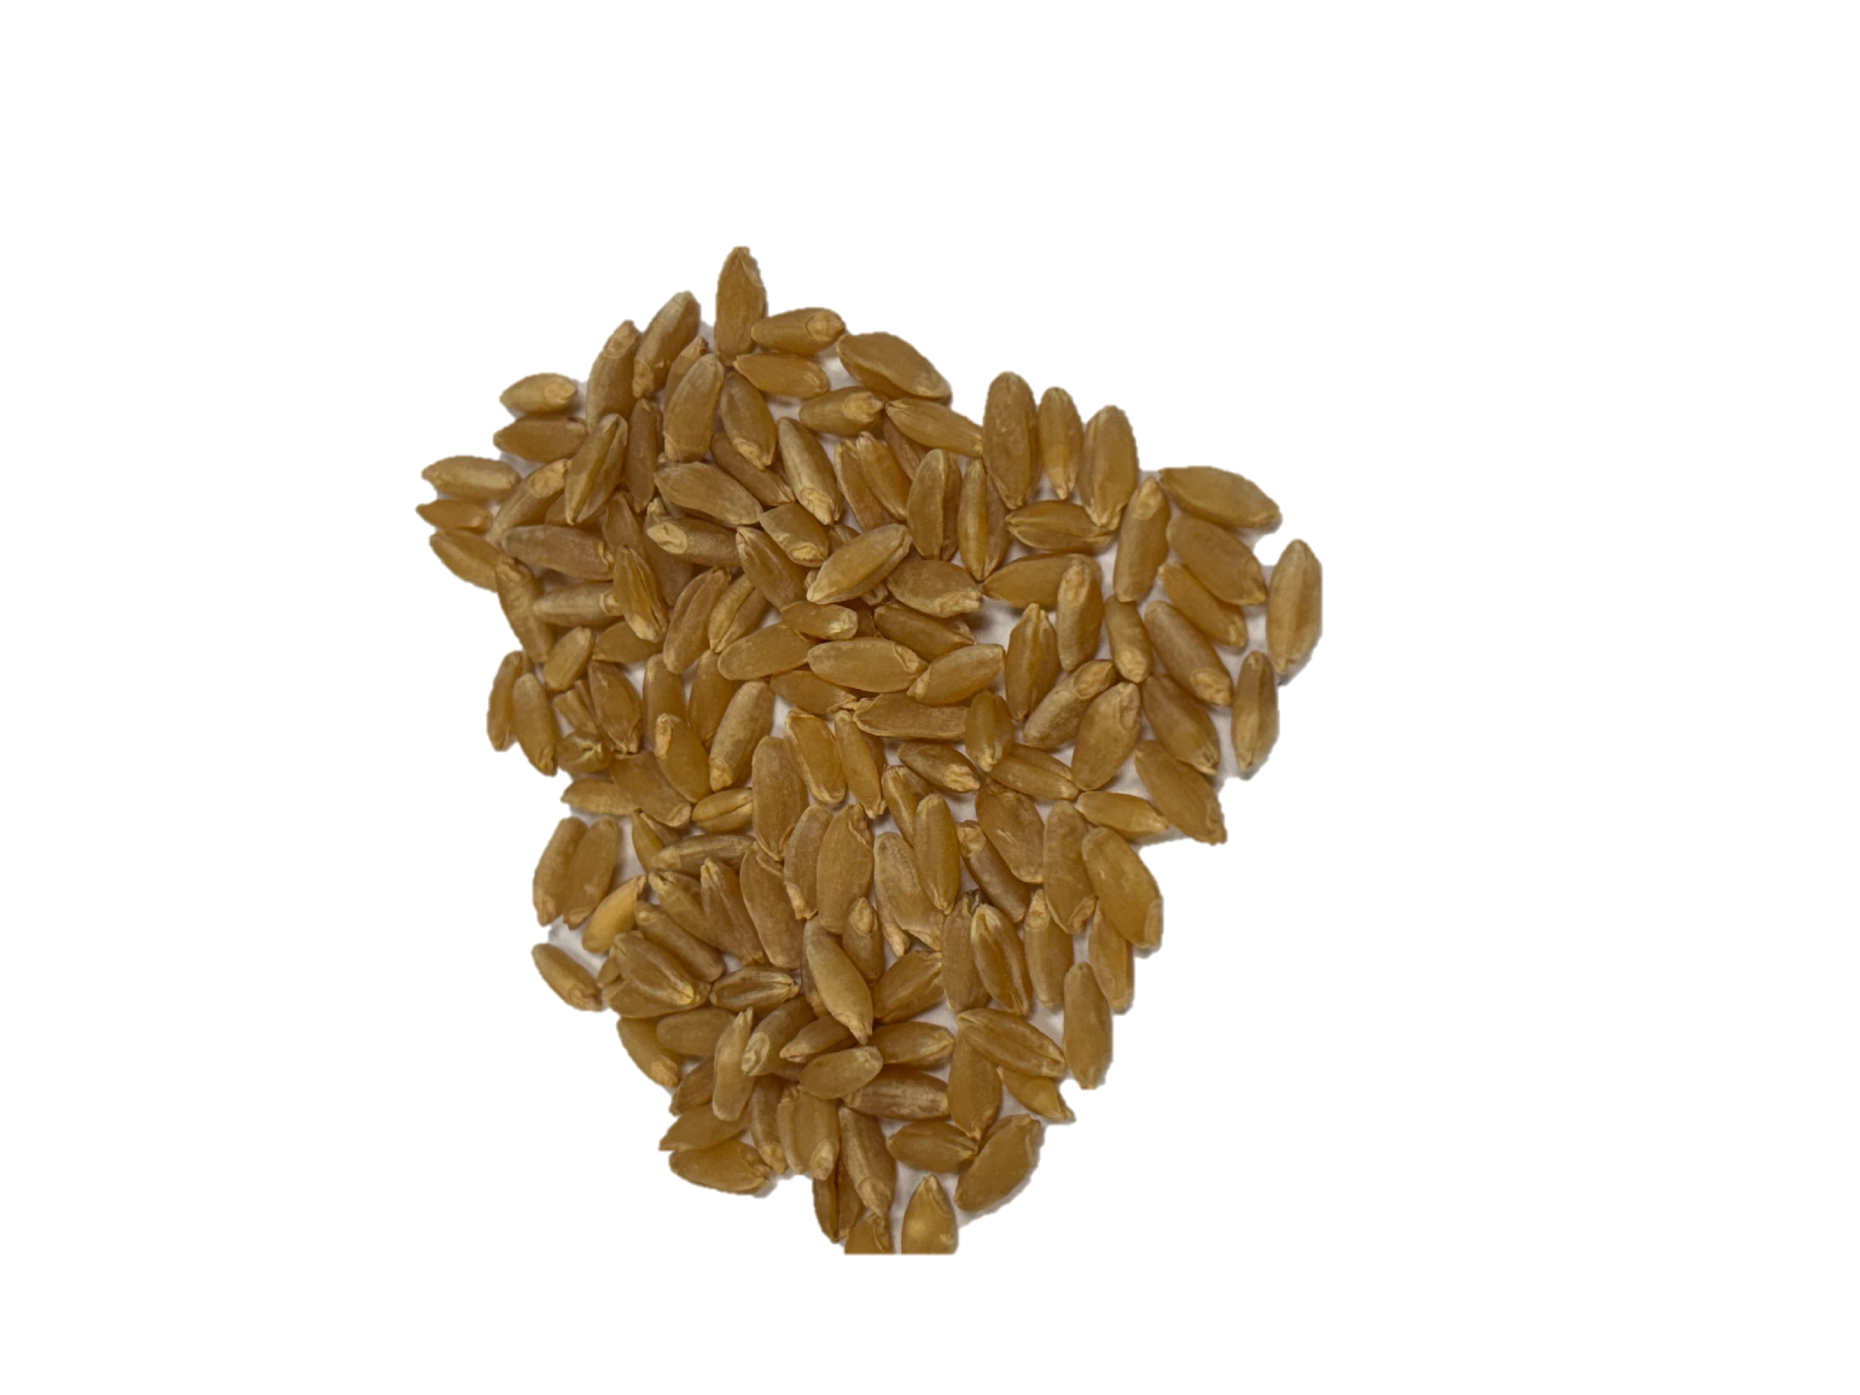
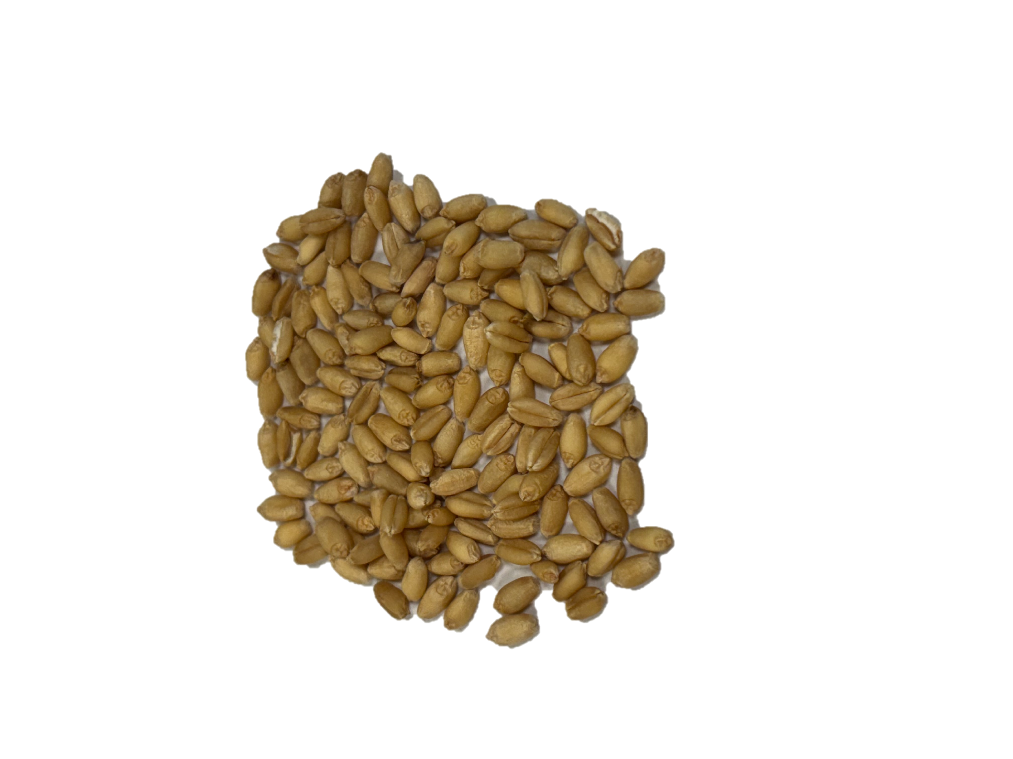
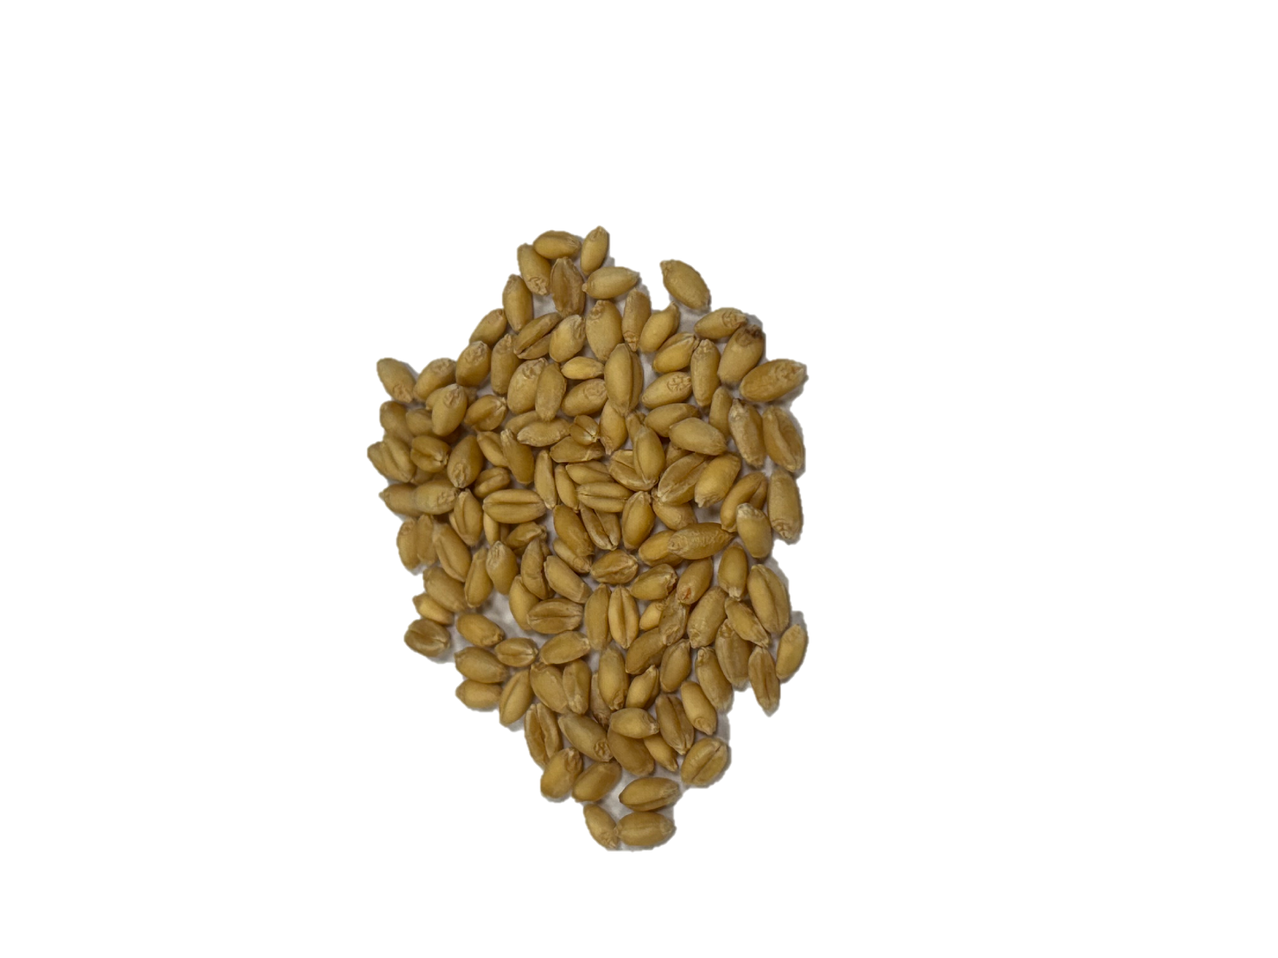
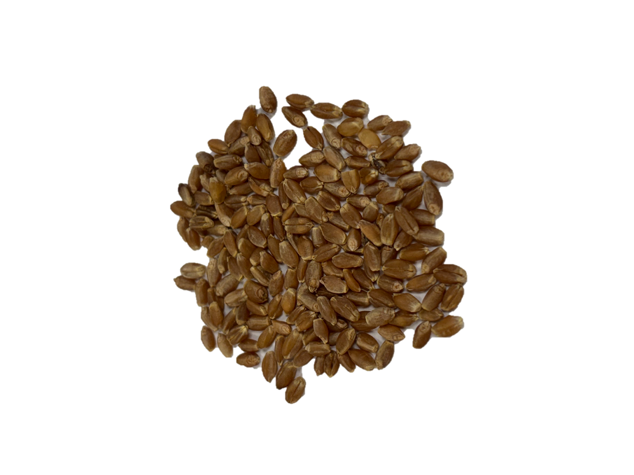
Wheat Family Tree
Wheat Class
Hard Red Winter
Soft Red Winter
Hard Red Spring
Durum
Hard White
Soft White
HRW Varieties
SRW Varieties
HRS
Varieties
Durum
Varieties
HW
Varieties
SW
Varieties

Slide 10
Why Protein Matters
Wheat, and products made from wheat, are great sources of carbohydrates, but the protein content of wheat is especially important for the baking quality of the flour.
The protein gluten gives dough its strength, elasticity and structure.
Flour made from high protein wheat has a more chewy texture (ex. bread or pasta).
Flour made from low protein wheat has a more crumbly texture (ex. cake or cookies).

Slide 11
Hard Red Winter (HRW) Wheat
Main Growing Region: Great Plains
Planting Season: Fall
Harvesting Season: Spring or summer
Characteristics: Excellent for milling and baking
Protein Level: High
HRW wheat kernels

Slide 12
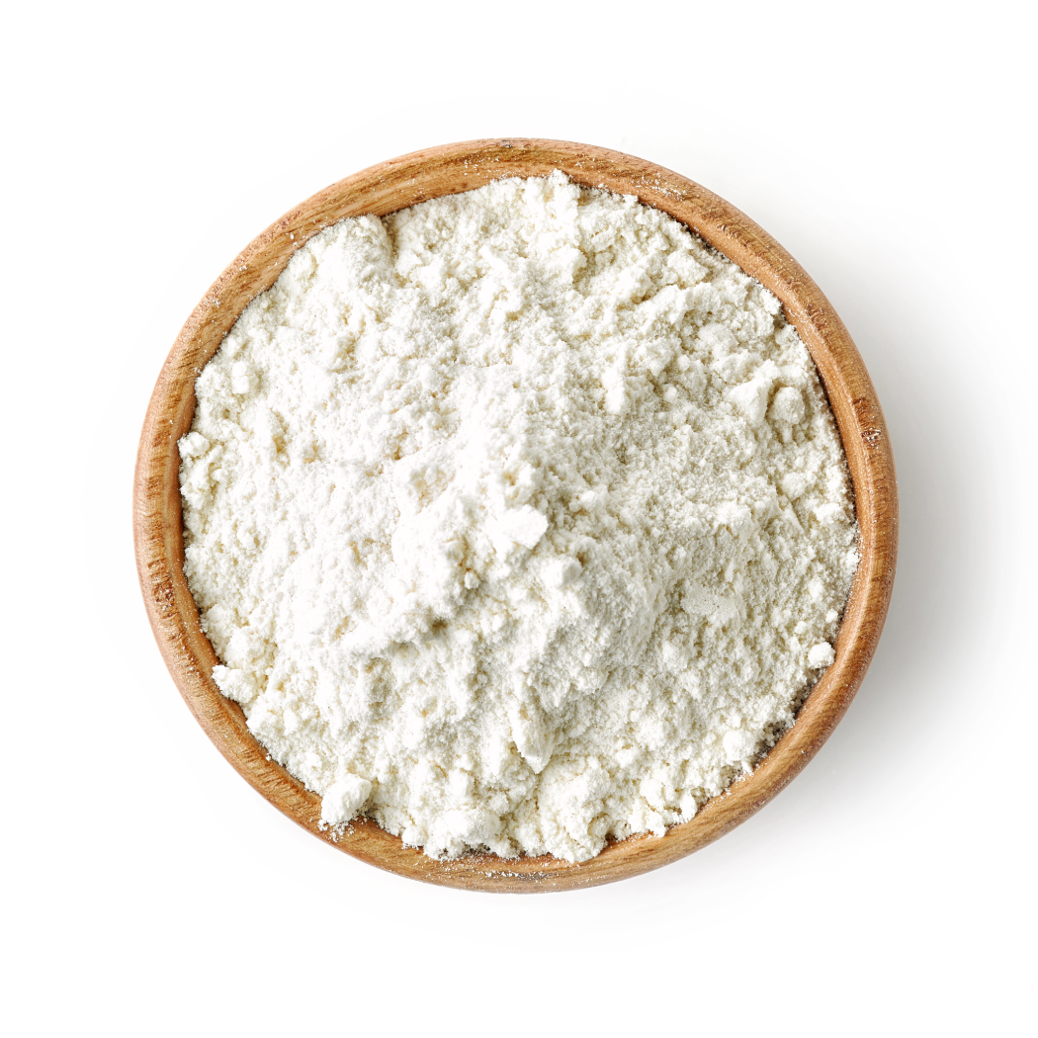
Hard Red Winter (HRW) Wheat
Used For: All-purpose flour, blending with other flours, hearth breads, croissants, hard rolls, flatbreads and Asian noodles
HRW wheat is the base of many flours due to its excellent baking qualities.

Slide 13
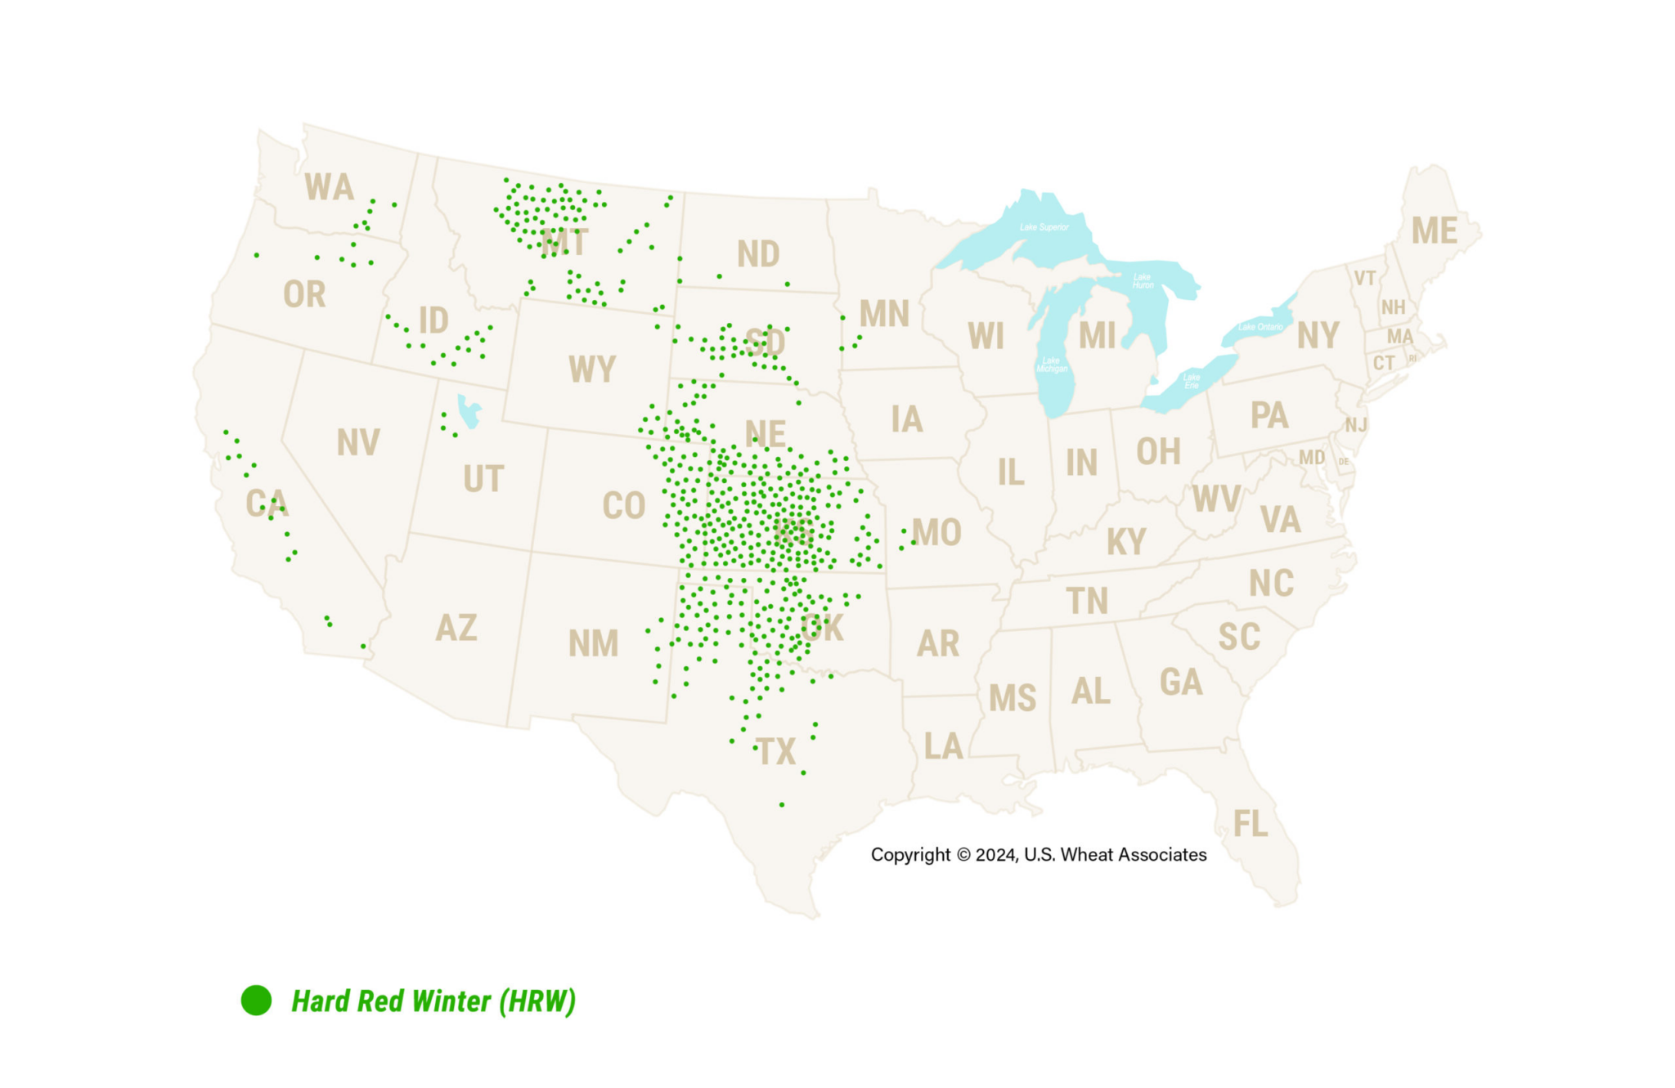
Hard Red Winter (HRW) Growing Regions
HRW is grown in other regions, but the green dots represent the main growing area.

Slide 14
Soft Red Winter (SRW) Wheat
Main Growing Region: Midwest
Planting Season: Fall
Harvesting Season: Spring or summer
Characteristics: Low gluten content
Protein Level: Low
SRW wheat kernels

Slide 15

Soft Red Winter (SRW) Wheat
Used For: Confectionery goods like cookies, crackers, cakes and blending for baguettes and other breads
SRW wheat is used for confectionery products because of its low protein (gluten) content.

Slide 16
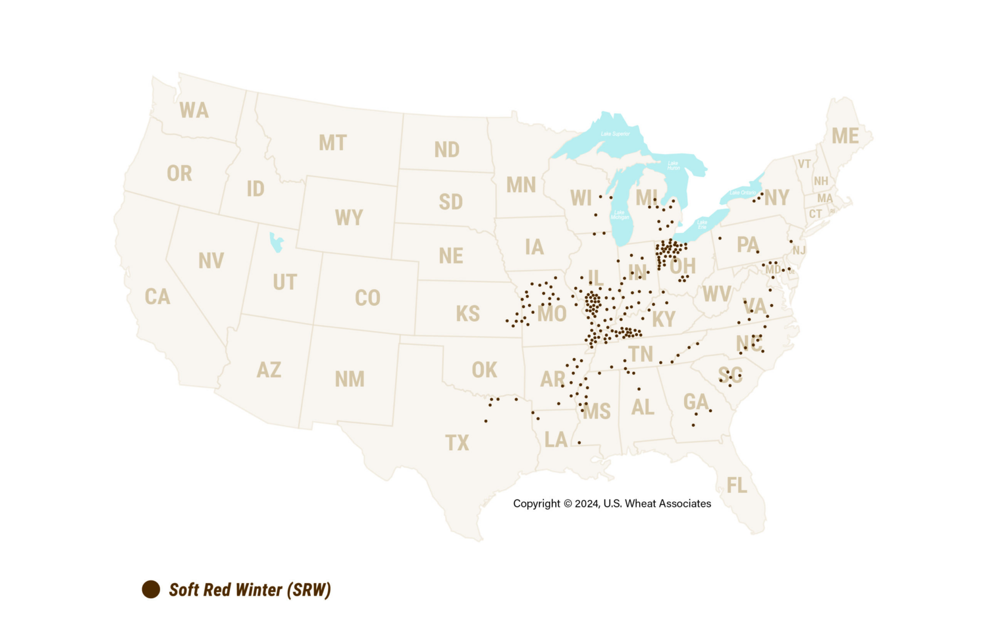
Soft Red Winter (SRW) Growing Regions
SRW is grown in other regions, but the brown dots represent the main growing area.

Slide 17
Hard Red Spring (HRS) Wheat
Main Growing Region: Northern U.S.
Planting Season: Spring
Harvesting Season: Summer or fall
Characteristics: Superior for milling and baking
Protein Level: High
HRS wheat kernels

Slide 18
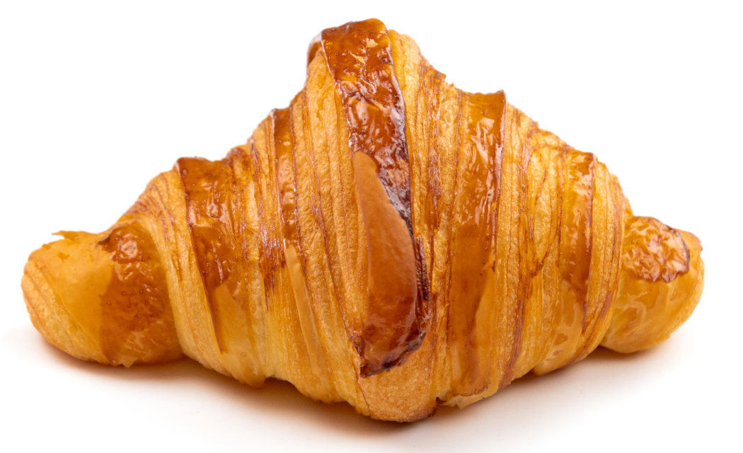
Hard Red Spring (HRS) Wheat
Used For: “Designer” breads like hearth breads, rolls, croissants, bagels, pizza crust and blending with other flours
HRS wheat is ideal for croissants and other designer breads because of its milling and baking qualities.

Slide 19
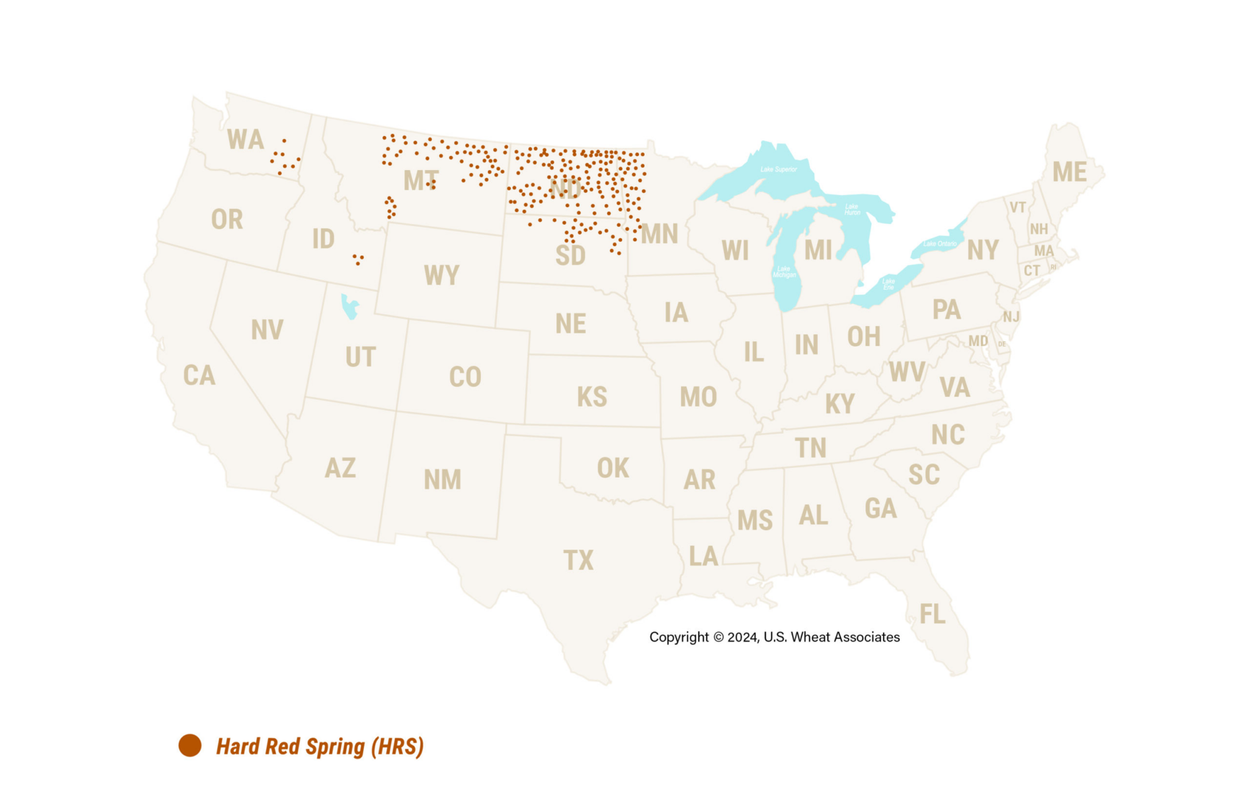
Hard Red Spring (HRS) Growing Regions
HRS is grown in other regions, but the orange dots represent the main growing area.

Slide 20
Durum Wheat
Main Growing Region: Southwest & Northern U.S.
Planting Season: Depends on growing region
Harvesting Season: Depends on growing region
Characteristics: Hardest class of all wheat with high gluten content
Protein Level: High
Durum wheat kernels

Slide 21
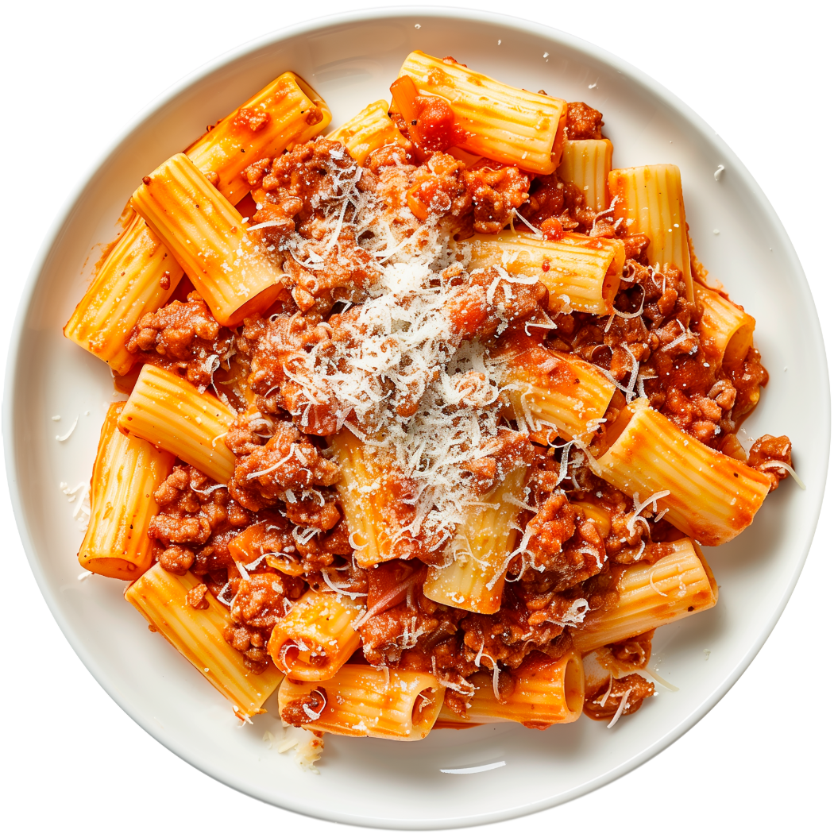
Durum Wheat
Used For: Semolina flour, pasta, couscous and some Mediterranean breads
Durum wheat is used for pasta because of its high protein (gluten) content.

Slide 22
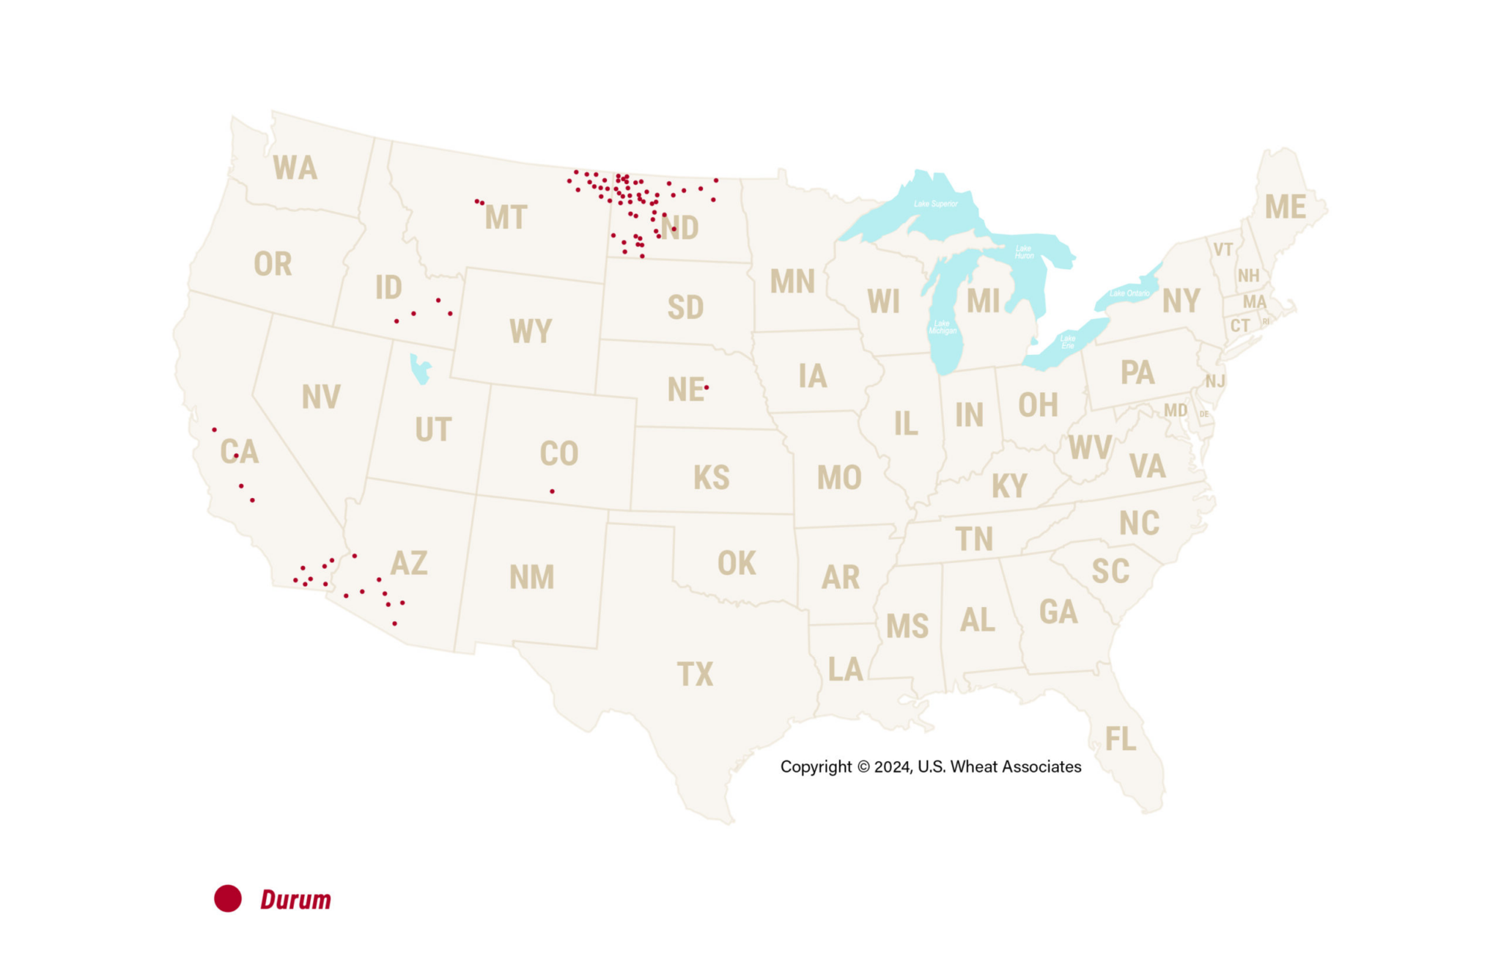
Durum Growing Regions
Durum is grown in other regions, but the red dots represent the main growing area.

Slide 23
Hard White (HW) Wheat
Main Growing Region: Diverse growing region
Planting Season: Depends on growing region
Harvesting Season: Depends on growing region
Characteristics: Milder, sweeter taste
Protein Level: High
HW wheat kernels

Slide 24
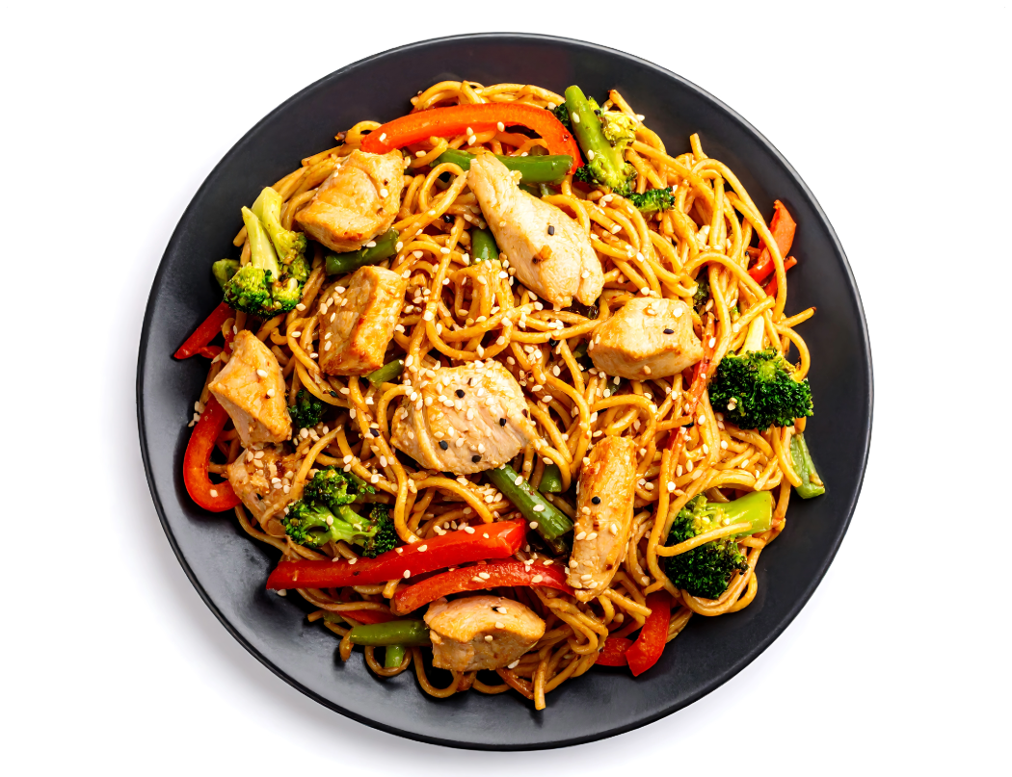
Hard White (HW) Wheat
Used For: Asian noodles, pan breads or flatbreads
HW wheat is ideal for Asian noodles because of the high protein (gluten) content and mild taste.

Slide 25
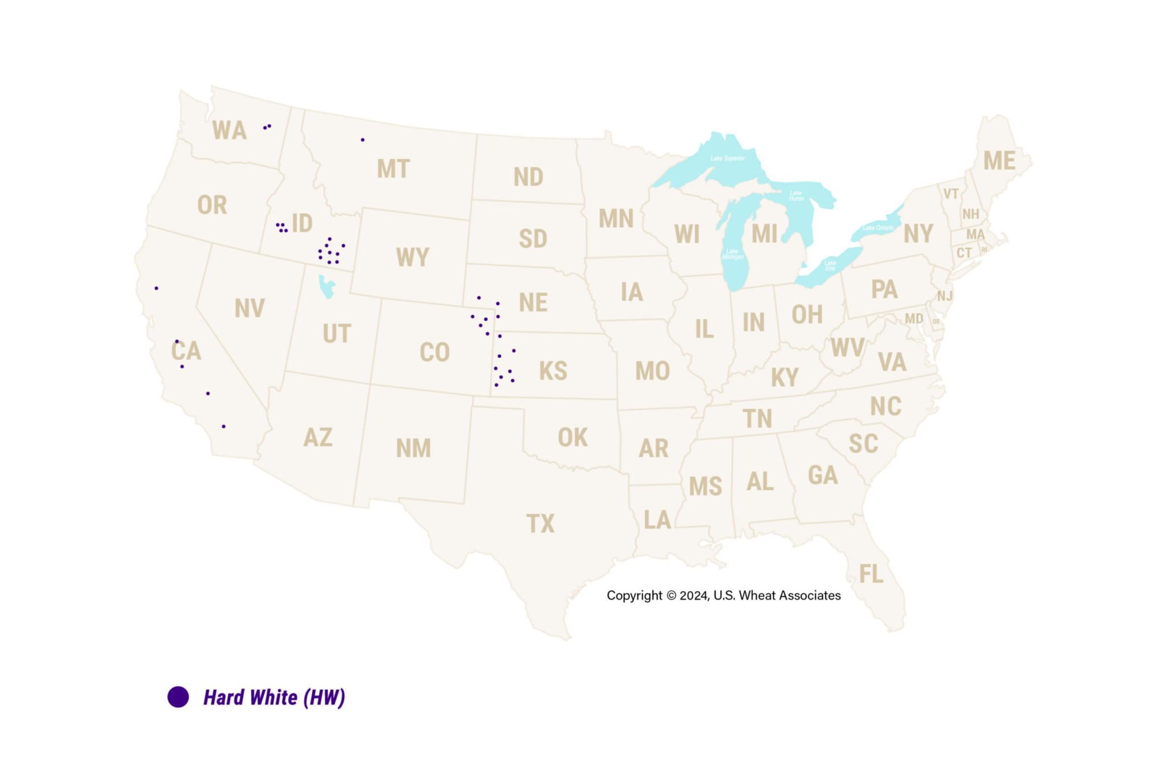
Hard White (HW) Growing Regions
HW is grown in other regions, but the purple dots represent the main growing area.

Slide 26
Soft White (SW) Wheat
Main Growing Region: Pacific Northwest
Planting Season: Depends on growing region
Harvesting Season: Depends on growing region
Characteristics: Low moisture content with excellent milling properties
Protein Level: Low
SW wheat kernels

Slide 27
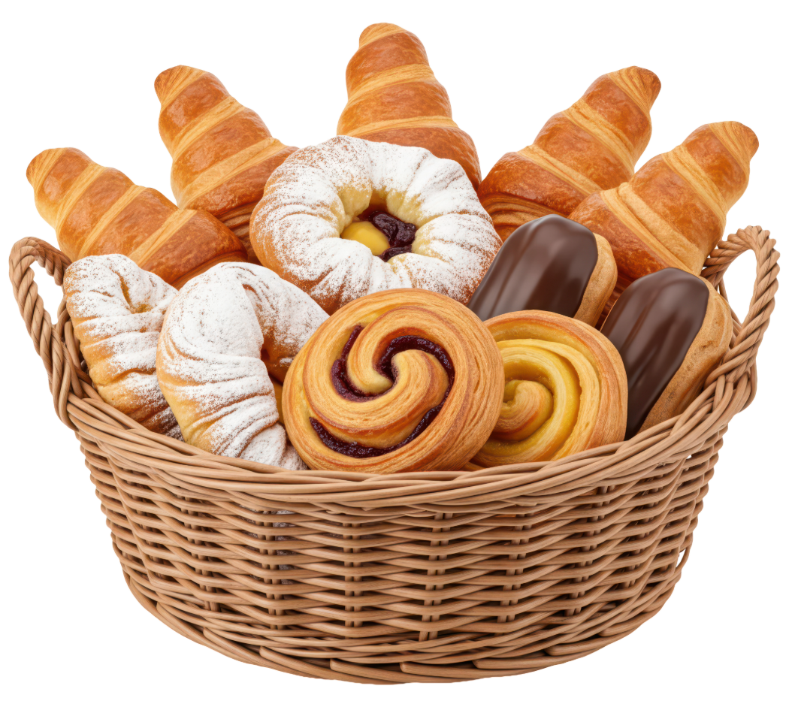
Soft White (SW) Wheat
Used For: Asian noodles, cakes and pastries
SW wheat is used for pastries because its low moisture content and low protein (gluten) levels.

Slide 28
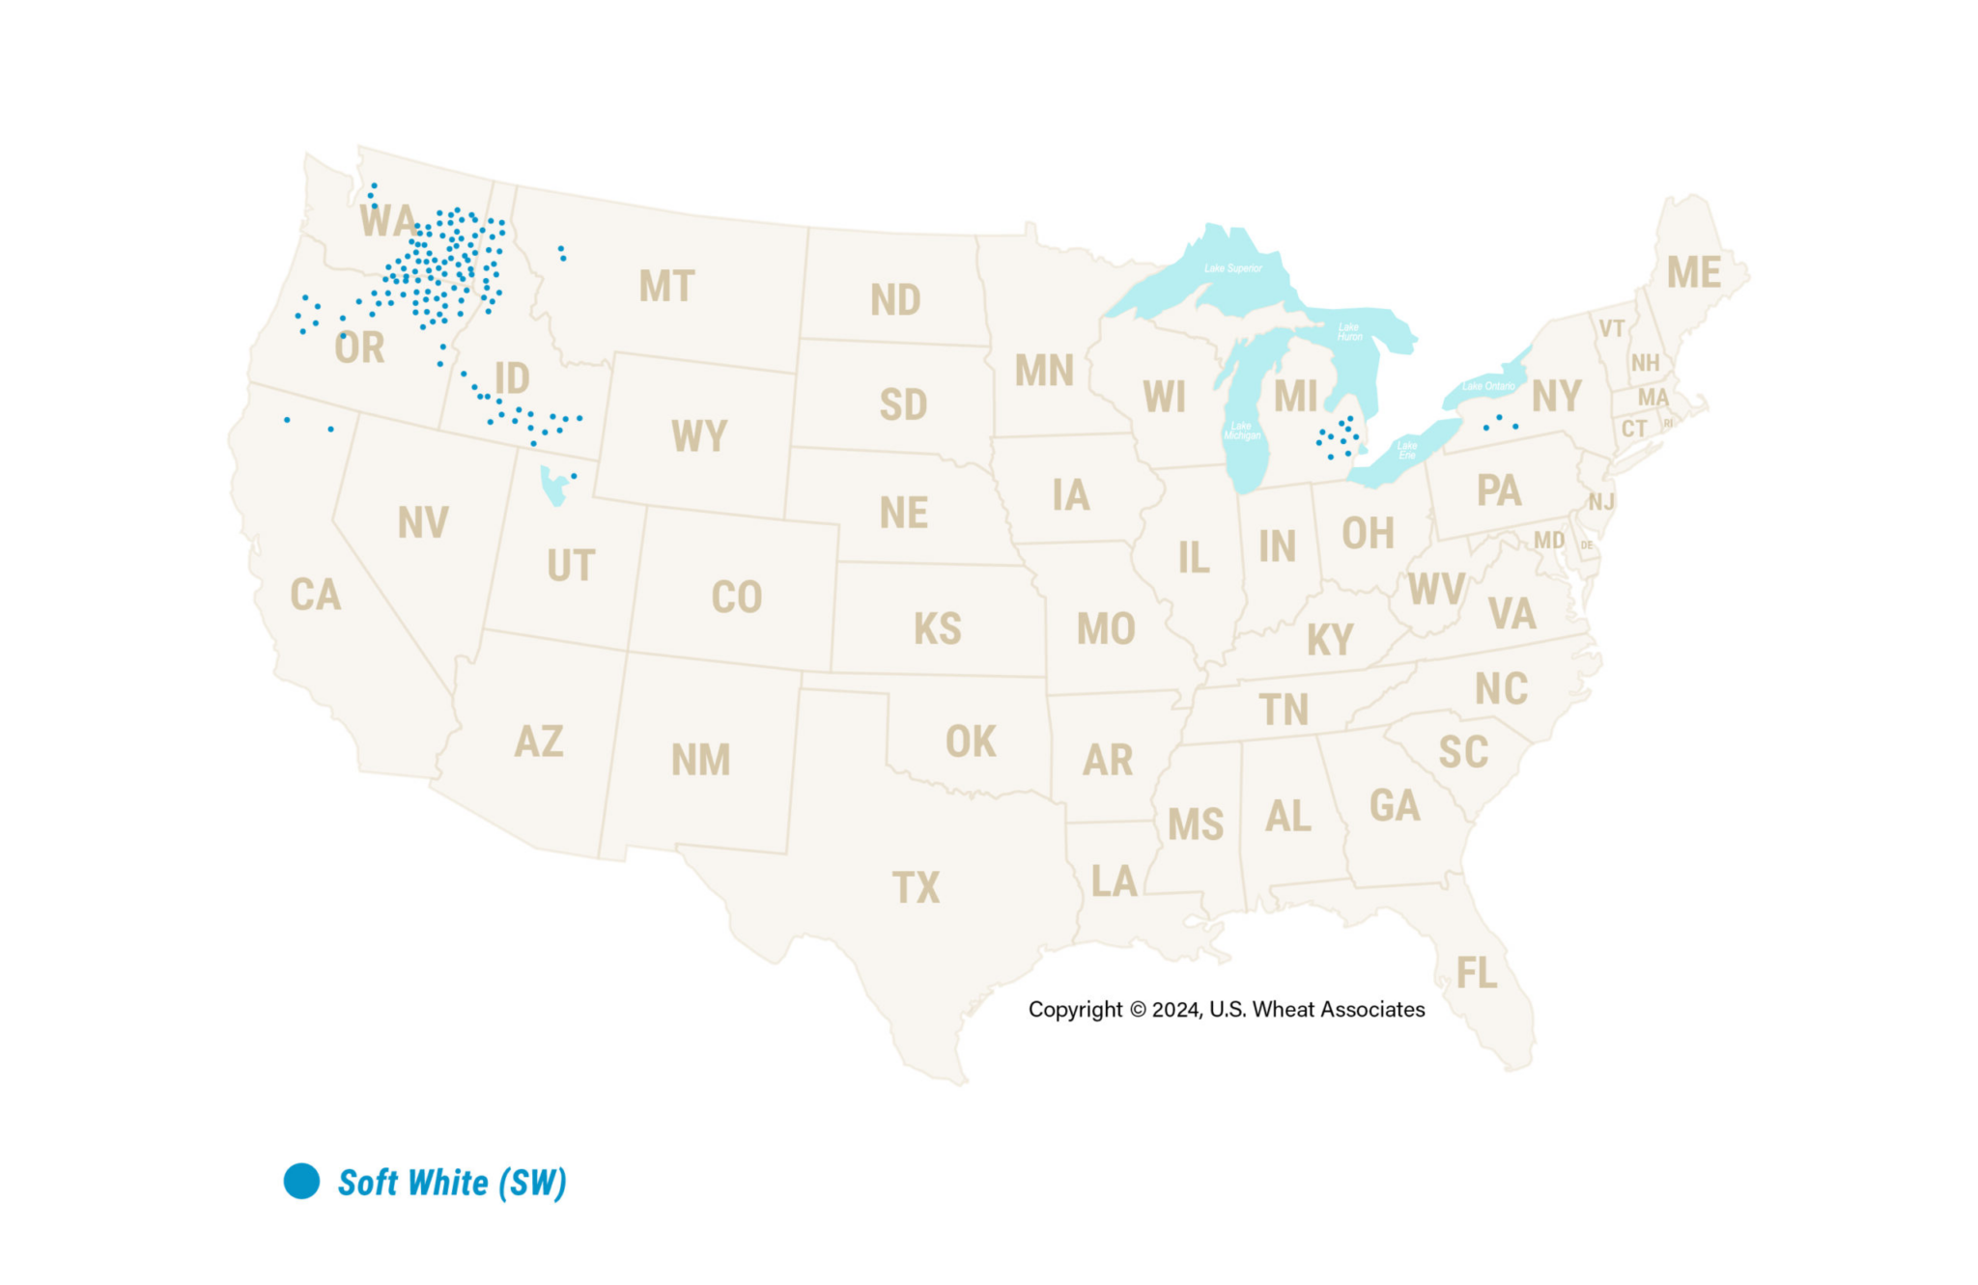
Soft White (SW) Growing Regions
SW is grown in other regions, but the blue dots represent the main growing area.

Slide 29
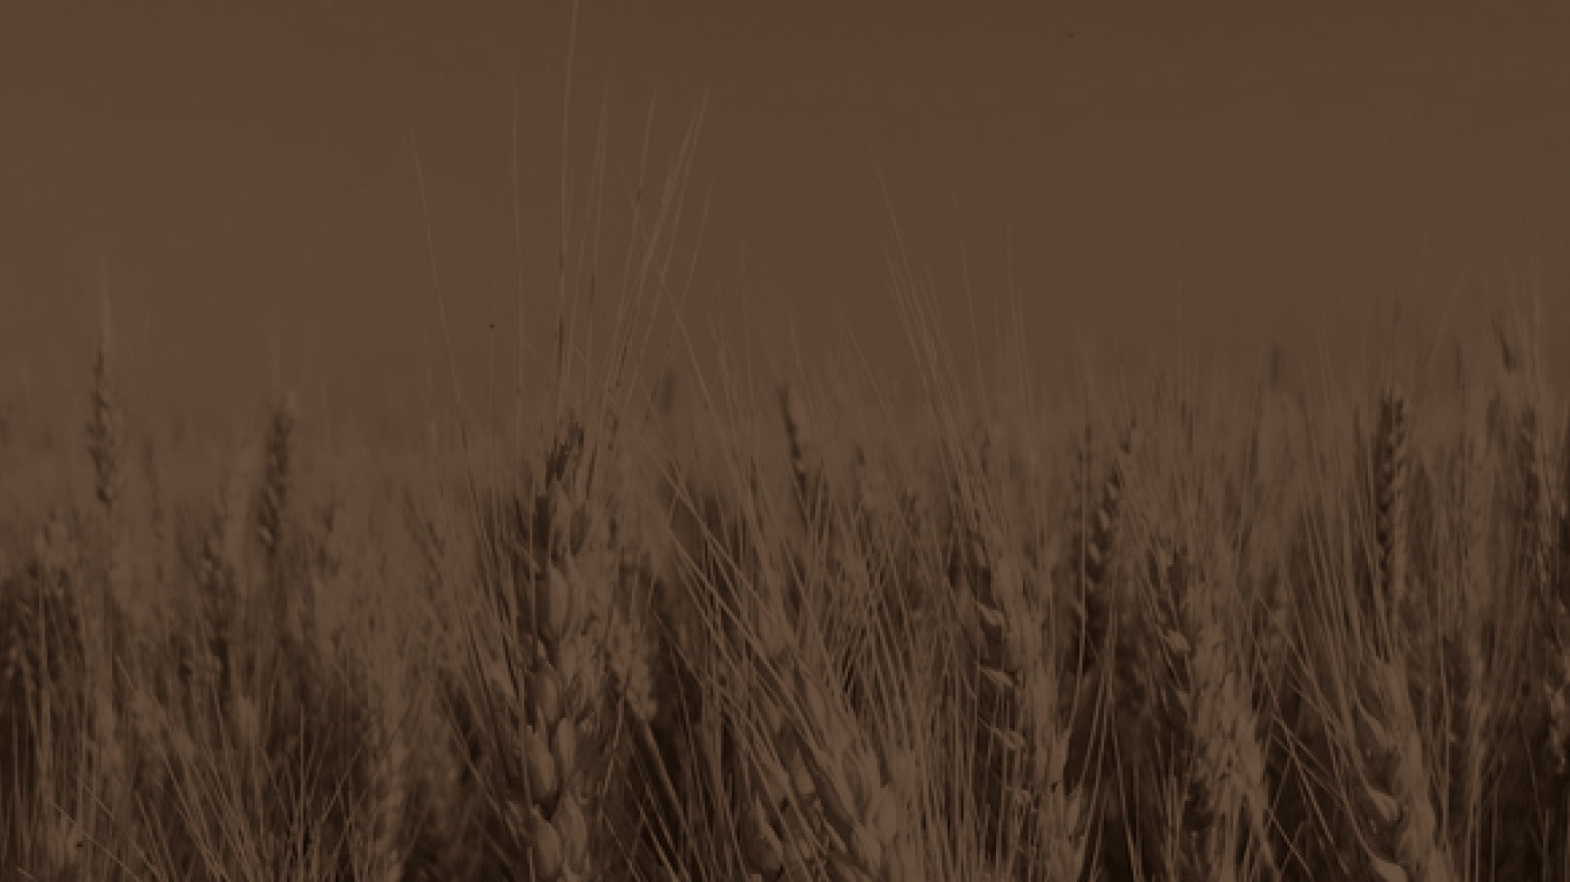

Sources:
National Geographic
  https://education.nationalgeographic.org/resource/grain/
Wheat Foods Council
  https://www.wheatfoods.org/wp-content/uploads/2024/03/What-Is-Wheat-1.jpg
U.S. Wheat Associates
  https://uswheat.org/working-with-buyers/wheat-classes/
Wheat Foods Council
  https://www.wheatfoods.org/wheat-101/classes-of-wheat/
USDA's National Agricultural Statistics Service Texas Field Office
  https://www.nass.usda.gov/Statistics_by_State/Texas/Publications/County_Estimates/ce_maps/ce_whea.php

Slide 30
Reviewers:
Ben Scholz
  Wheat Farmer & Texas Wheat Producers Board Director
Jordan Trees Waddle
  Agricultural Science Teacher, Medina Valley High School, Medina Valley ISD
Kyle Miller
  Family & Consumer Science Teacher, Mackenzie Middle School, Lubbock ISD
Rhonda Cantrell
  Retired Elementary Teacher, Texline ISD
Dr. Calvin Trostle
  Professor & Extension Agronomist, Texas A&M AgriLife Extension Service
Cater Wands
  Manager of Technical Sales, Miller Milling

