Slide 1

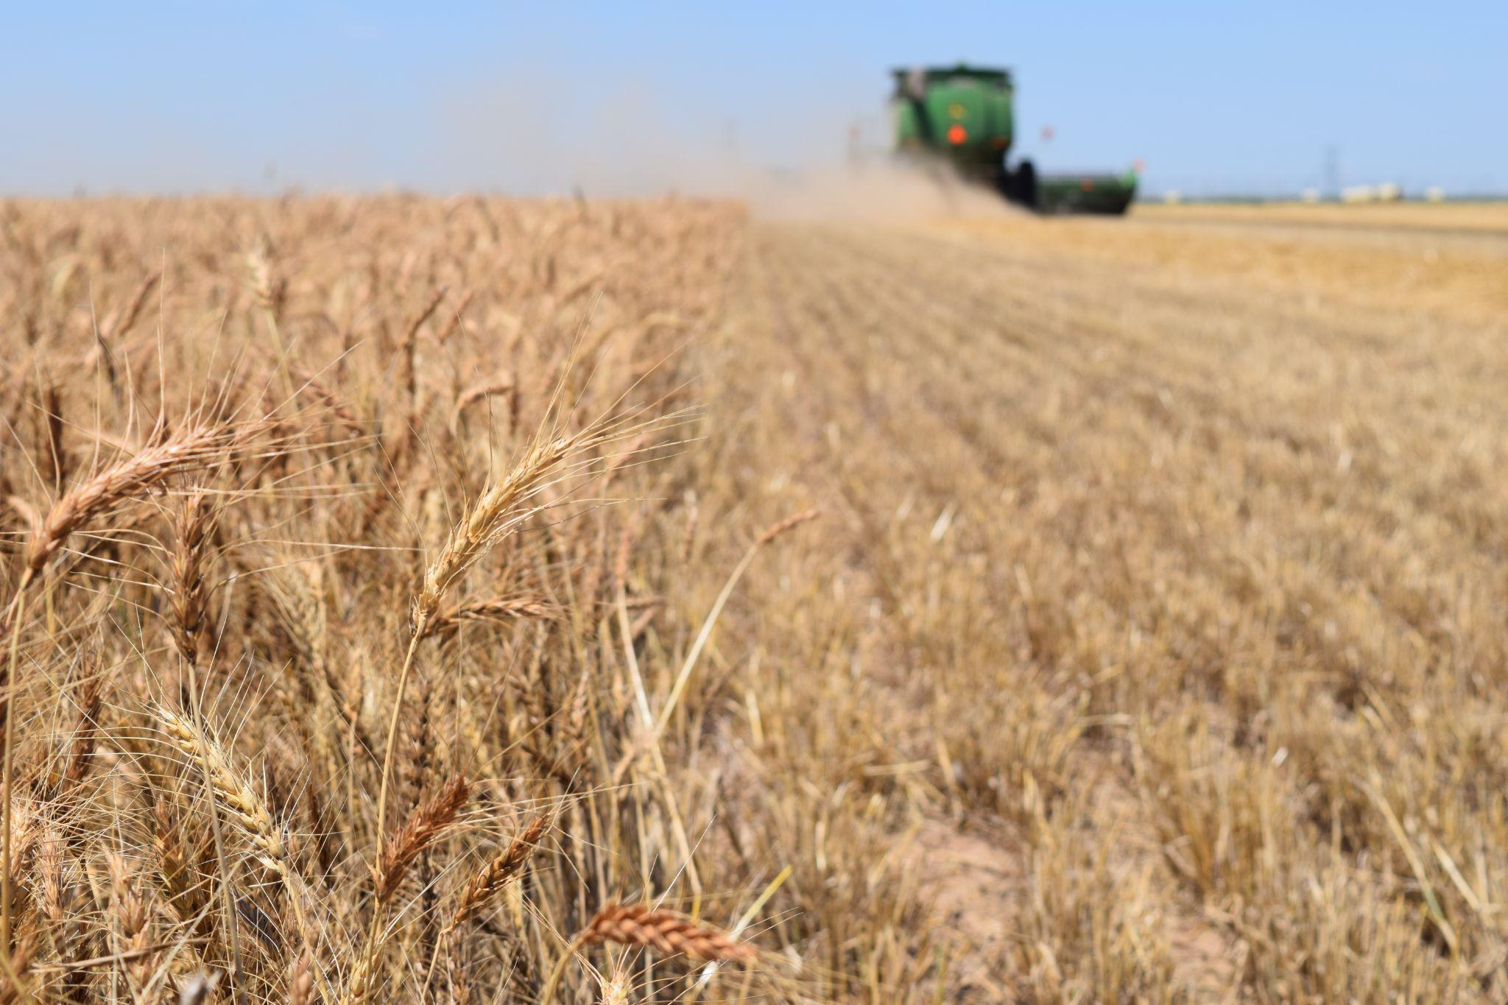
Uses of Wheat

Slide 2
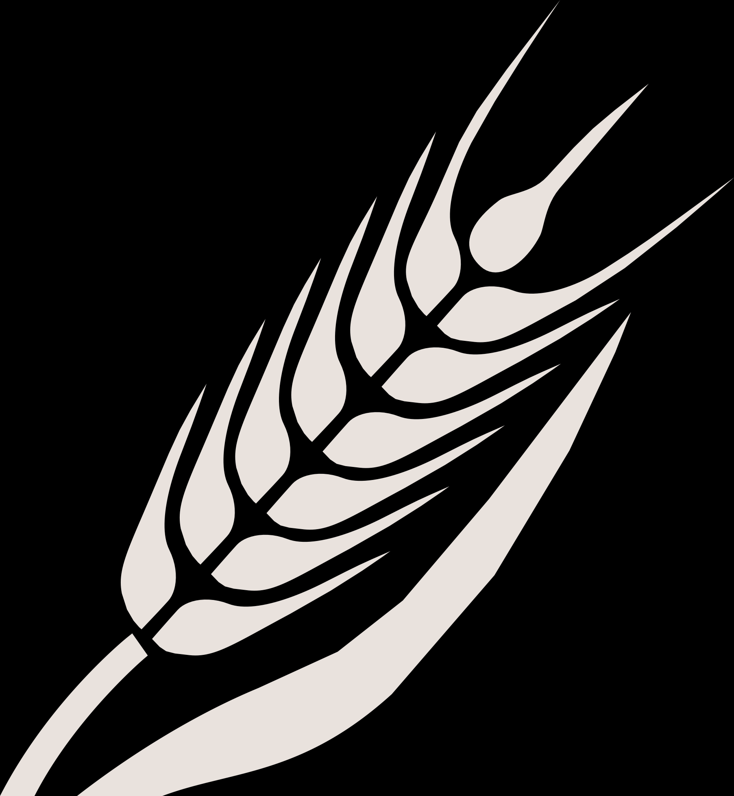
Components & Byproducts of Wheat
Gluten: A protein found in wheat, barley, rye and triticale. It has binding properties and makes baked goods chewy.
Wheat Starch: A carbohydrate made of sugar molecules. Starch is used as a thickening agent.
Wheat Grain: The seed of the wheat plant, also known as the kernel. It can be ground into flour or used as animal feed.

Slide 3
Components & Byproducts of Wheat
Wheat Straw: The stalk of the wheat plant.
Wheat Flour: The main product created from wheat. There are different kinds of wheat flour based on the intended use.
Wheat Germ Oil: The oil from the germ in the wheat kernel. It is full of vitamin E to help the wheat plant grow.
Wheat Byproducts: The leftover parts of wheat after is it processed or harvested.

Slide 4

Flour

Slide 5
The Milling Process at a Glance
Once the wheat arrives at the flour mill, it is cleaned to remove rocks, dirt, straw, other types of seeds or anything else that would impact the quality of the flour.
Next, the kernels are soaked in water to make them softer and easier to break apart.
Rollers crack the kernels open and separate the bran and germ from the endosperm (when milling white flour).
- If whole wheat flour is being milled, the bran and germ are also ground into flour.
- The bran and germ are saved and used for animal feed and other products.
The endosperm is ground into tiny particles until the texture is soft, smooth and consistent.
Depending on the type of flour being made, additives and agents may be added after milling is complete to bleach, enrich and/or fortify the flour.

Slide 6
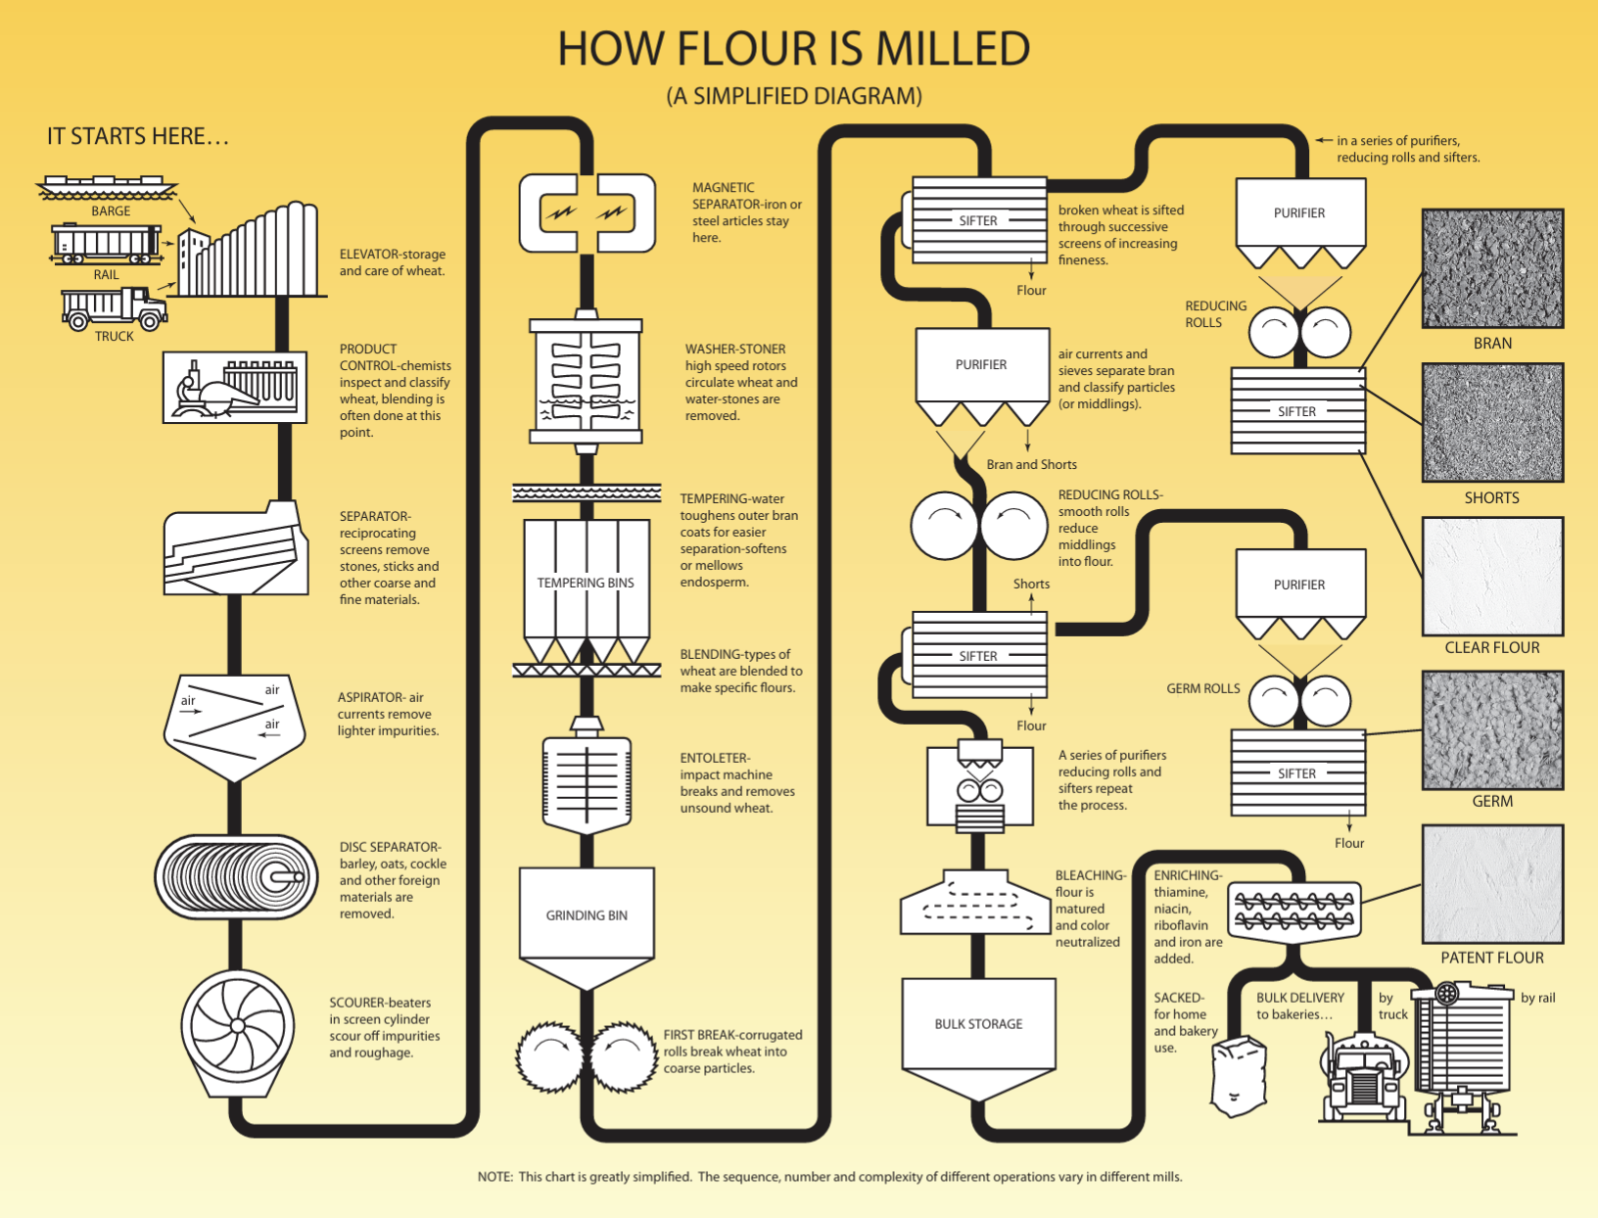
How Flour is Milled
Photo courtesy of Wheat Foods Council

Slide 7
From the Mill to the Table
Once the flour is milled, it is packaged and sold to grocery stores for consumers to use.
Or, if the flour is produced for food production purposes, it is sold to bakers and food manufacturing companies to make into store bought goods or used in bakeries or restaurants.
Consumers often purchase 2, 5 or 10 lb bags of flour at the grocery store, while professional bakers, chefs and food manufacturers buy bulk bags of 50 or 100 lbs (or more).

Slide 8
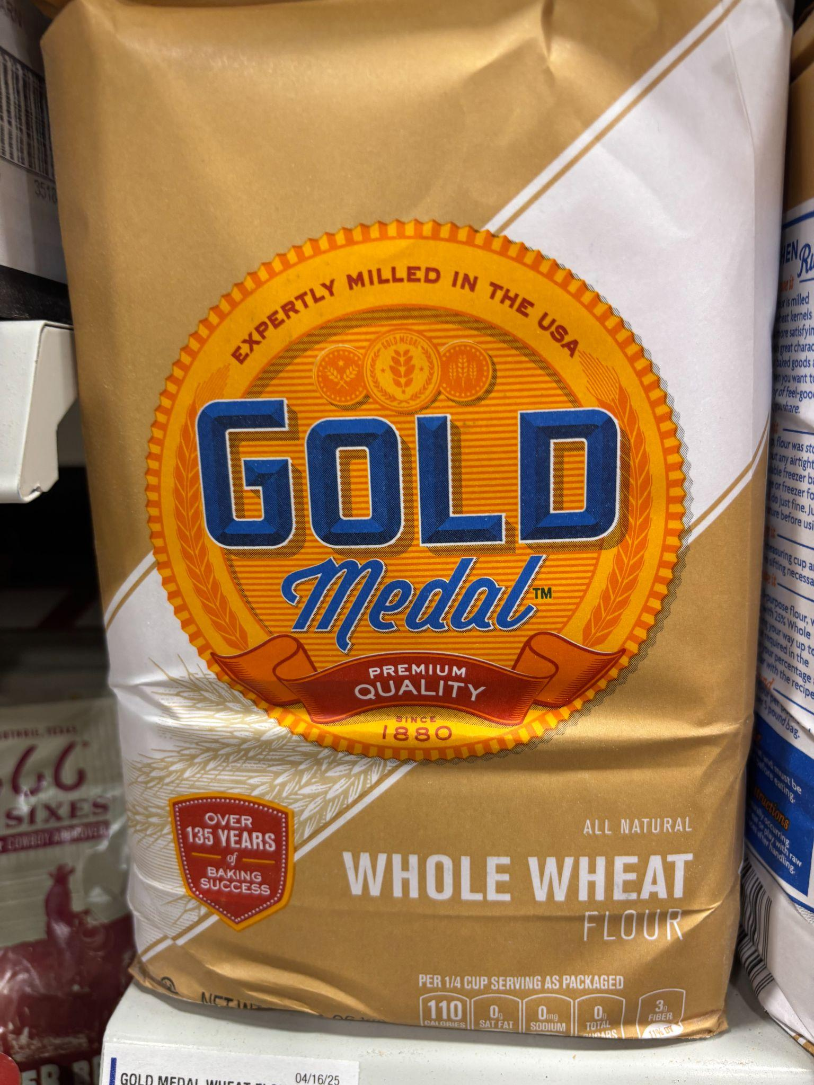
Whole Wheat vs. Refined Flour
Whole Wheat Flour: Flour made from the entire wheat kernel of red wheat varieties, including the bran, endosperm and germ.
White Whole Wheat Flour: Flour made from the entire wheat kernel of white wheat varieties, including the bran, endosperm and germ.
Refined Flour: Flour made from the endosperm part of the wheat kernel.

Slide 9
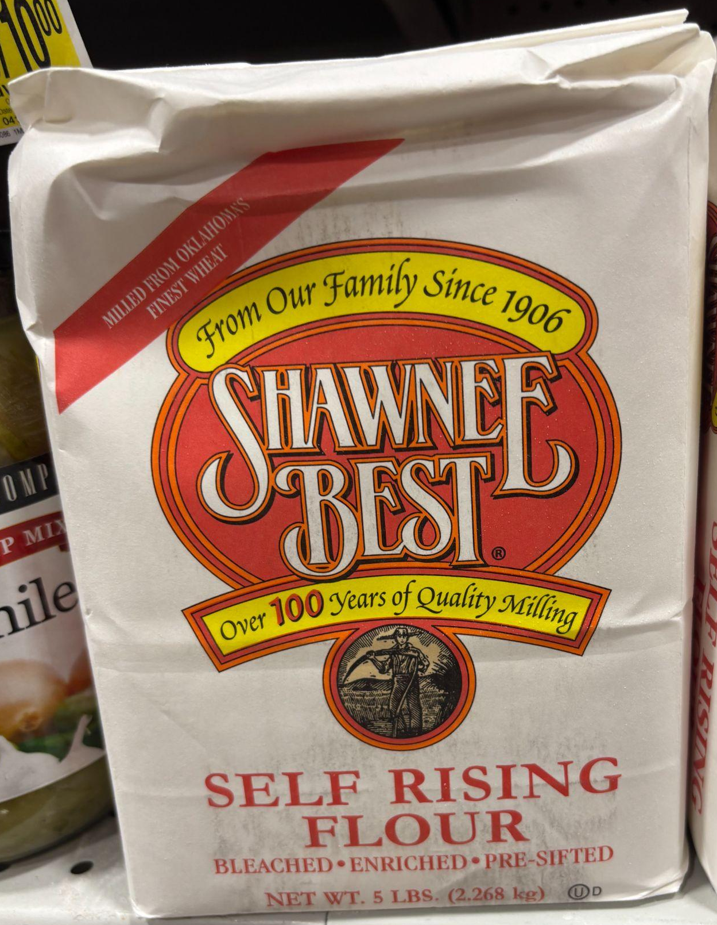
Enriched vs. Fortified Flour
Enriched Flour: Refined flour that has nutrients (B vitamins and iron) added back into the flour that have been lost during the milling process, while preserving shelf stability.
- Flour enrichment dates back to the early 1900s due to the high rates of diseases from vitamin B deficiencies.
Fortified Flour: A step beyond enriched flour, fortified flour contains additional nutrients (folic acid) at a higher level than those originally in the wheat.
- The fortification of flour began in the 1980s and 90s when the medical community connected folic acid deficiency to neural tube defects (NTDs), such as spina bifida and anencephaly.

Slide 10
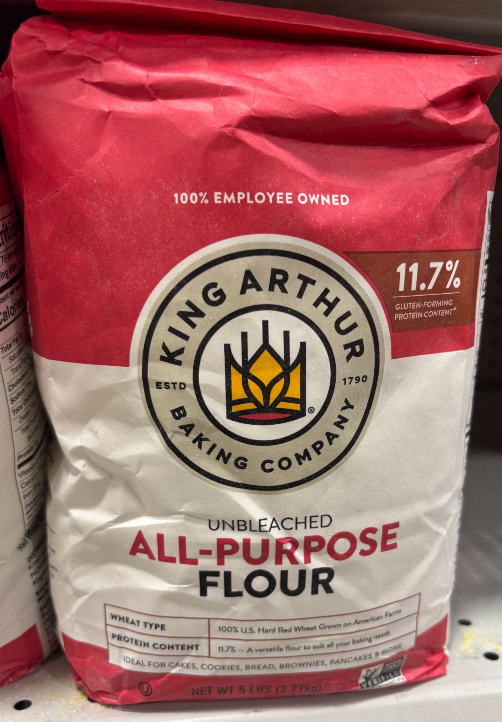
Bleached vs. Unbleached Flour
Bleached Flour: Bleached flour is whitened using chemicals (usually chlorine gas or benzoyl peroxide) to speed up the whitening process.
- This treatment also makes the flour softer than unbleached flour and slightly reduces the protein content.
- The use of these chemical agents is heavily regulated by the Food & Drug Administration and does not impact the safety of bleached flour.
Unbleached Flour: Flour naturally becomes more white as it ages. Unbleached flour has been allowed to naturally whiten.
- Because it takes longer to produce unbleached flour, it is often more expensive.

Slide 11
Flour Characteristics
Each type of flour has different characteristics and purposes.
The protein content and gluten formation of the flour impacts the structure of the baked good.
- High protein flours have more gluten, which makes them chewier.
- Lower protein flours have less gluten, which makes them more flaky.
The consistency of the flour affects the texture of the baked good.
- Finely milled flours create smoother textures.
- Course flours lead to more substance in the baked good.
The flavor of the flour is dependent on the type of wheat and how it is milled.
- Specialty flours can add unique flavor profiles and baking characteristics.

Slide 12
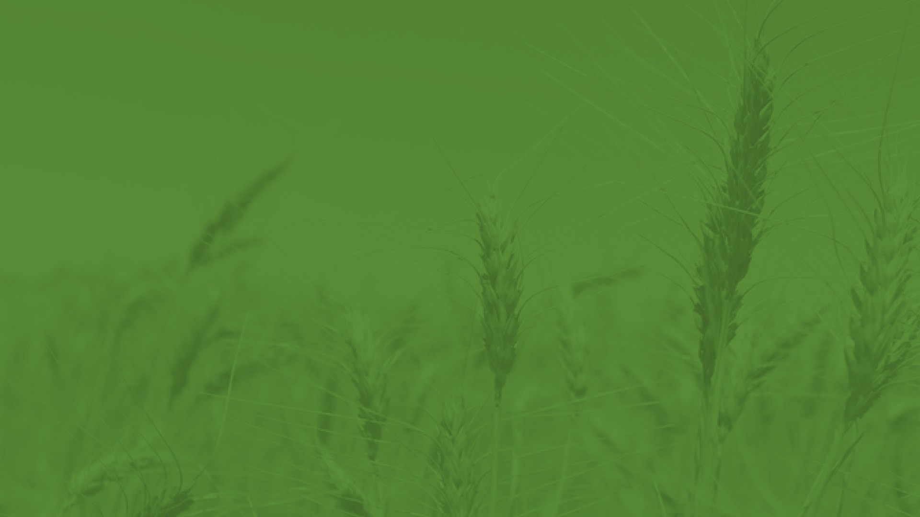
Types of Flour

Slide 13
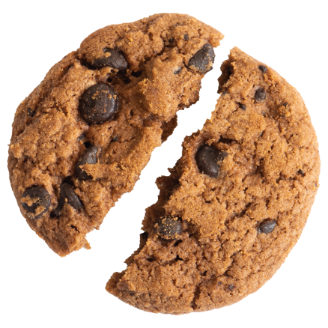
All Purpose Flour
All purpose flour is white flour blended from the endosperm of hard and/or soft wheats and can be used for any type of baked good. It is the most commonly used flour, especially for home baking.

Slide 14
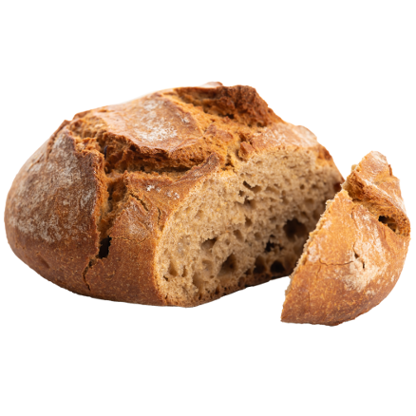
Whole Wheat Flour
Whole wheat flour is milled from the bran, endosperm and germ of the wheat kernel. It can be used for any type of baked goods, and is often a replacement for all purpose flour. White whole wheat flour is also available in some stores.

Slide 15
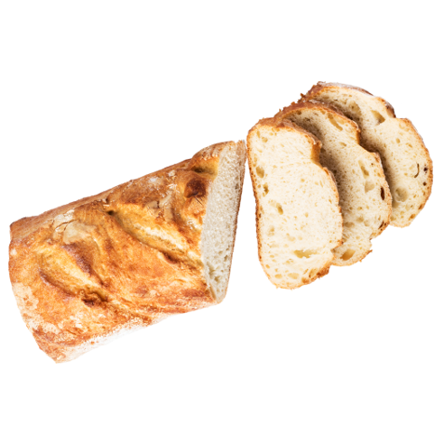
Bread Flour
Bread flour is a blend of hard, high-protein wheats with a high gluten content. It is best used for baguettes, sourdough, dinner rolls, bagels, pretzels, etc.

Slide 16
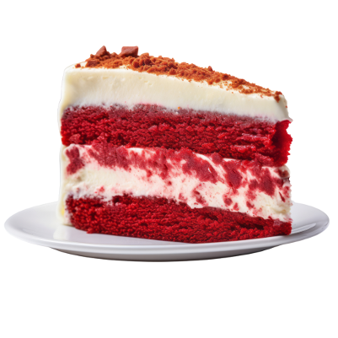
Cake Flour
Cake flour is a fine-textured flour milled from soft wheat with low protein content. Cake flour is ideal for cakes, cupcakes, doughnuts, brownies, pancakes, etc.

Slide 17
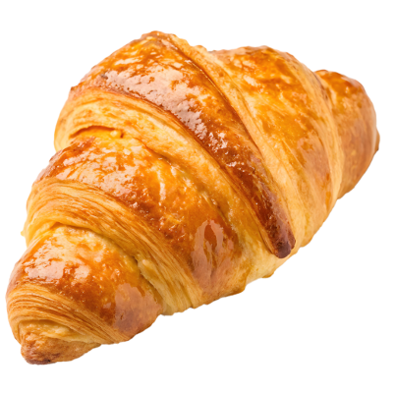
Pastry Flour
Pastry flour is milled from soft wheat that has a fine texture for croissants, cookies, crackers, pies, tarts, cinnamon rolls, etc.

Slide 18
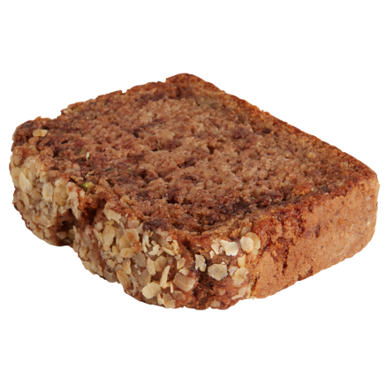
Self Rising Flour
Self-rising flour is all-purpose flour with added salt and leavening agents. It is used for quick breads, biscuits, scones, muffins, etc.

Slide 19
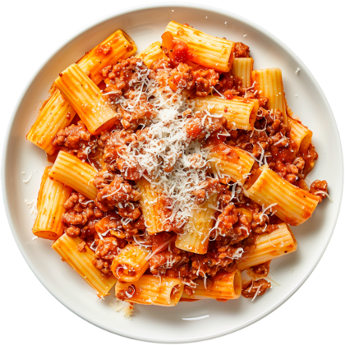
Semolina Flour
Semolina flour is made from coarsely milled Durum wheat and is most commonly used for pasta and couscous.

Slide 20

00 Flour
00 flour is an Italian flour made from finely milled Durum wheat. The high gluten content is ideal for pizza dough, pasta, etc.

Slide 21
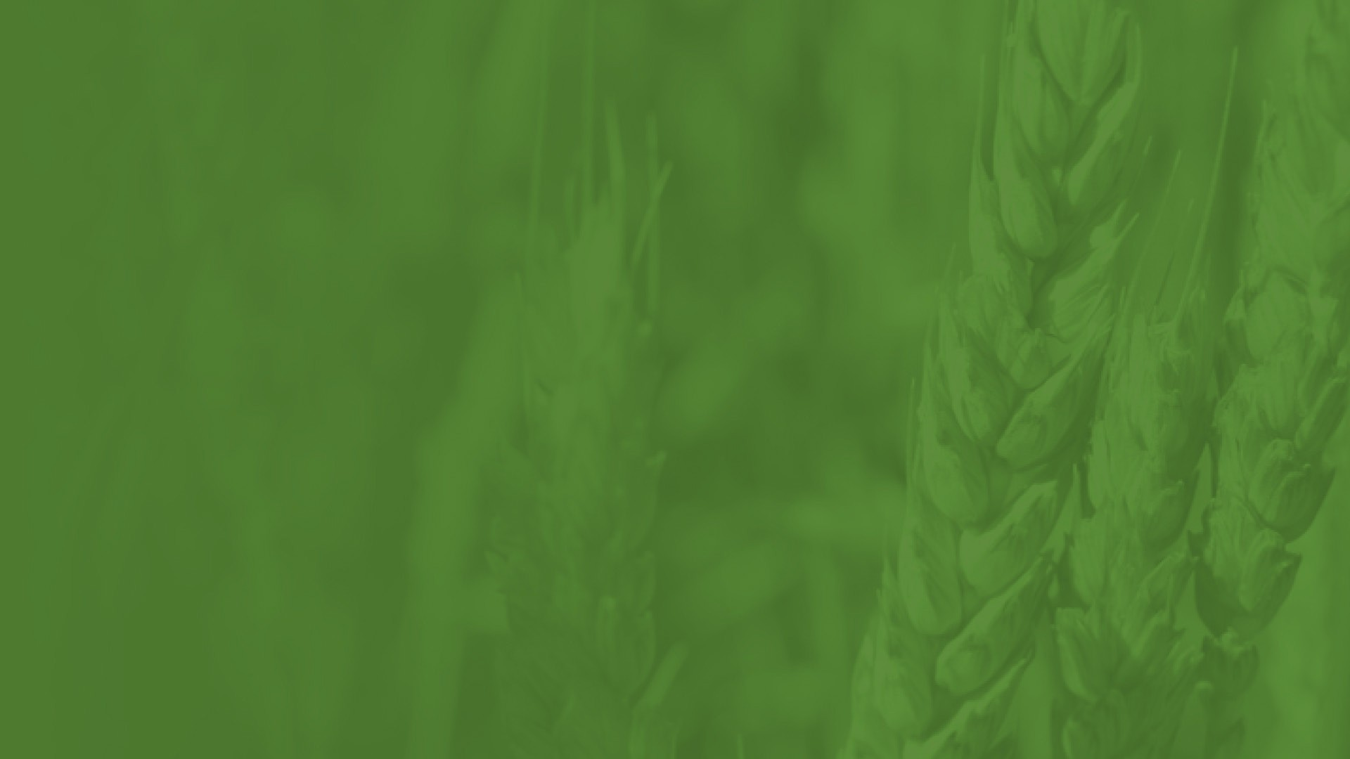
Feed & Forage

Slide 22
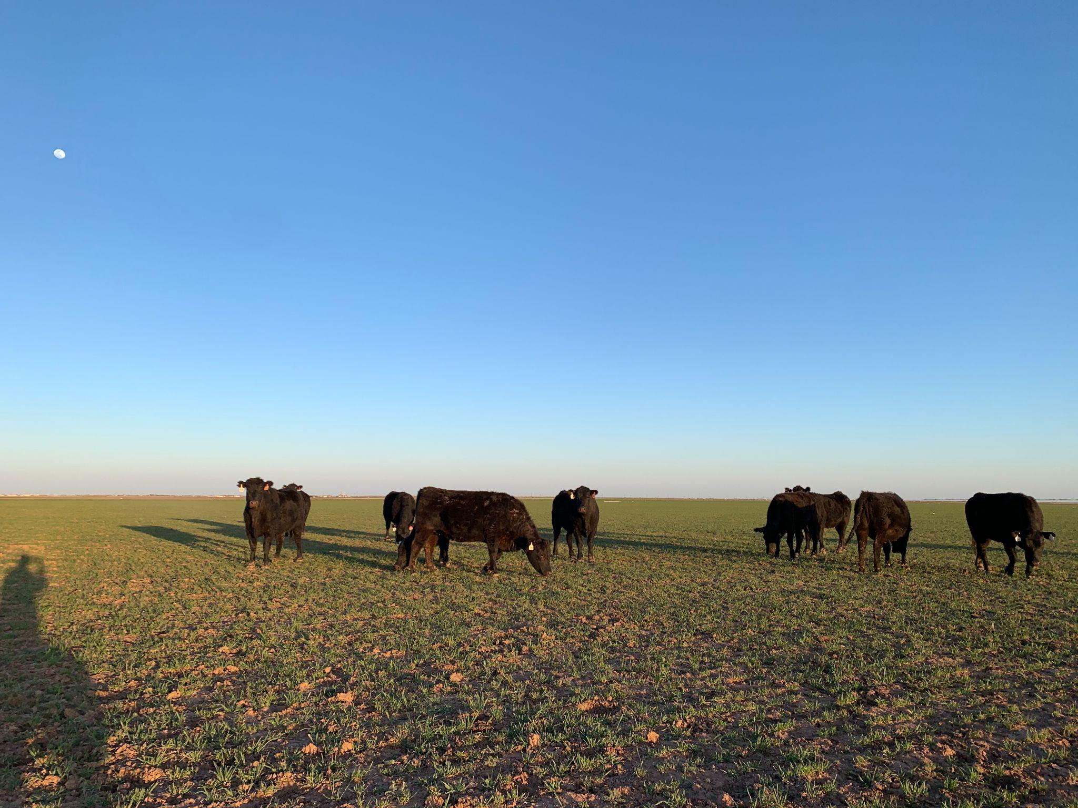
Grazing
Just like wheat products provide wholesome nutrition for humans, wheat is also an excellent source of carbohydrates and protein for animals.
Grazing offers many benefits, including:
- Reduced feed costs, especially in winter months
- Improved soil health from manure
- Weed control
Roughly 20% of the wheat grown in Texas is grazed by livestock.
- Wheat used for grazing is often called “wheat pasture.”
Cows grazing on wheat pasture

Slide 23
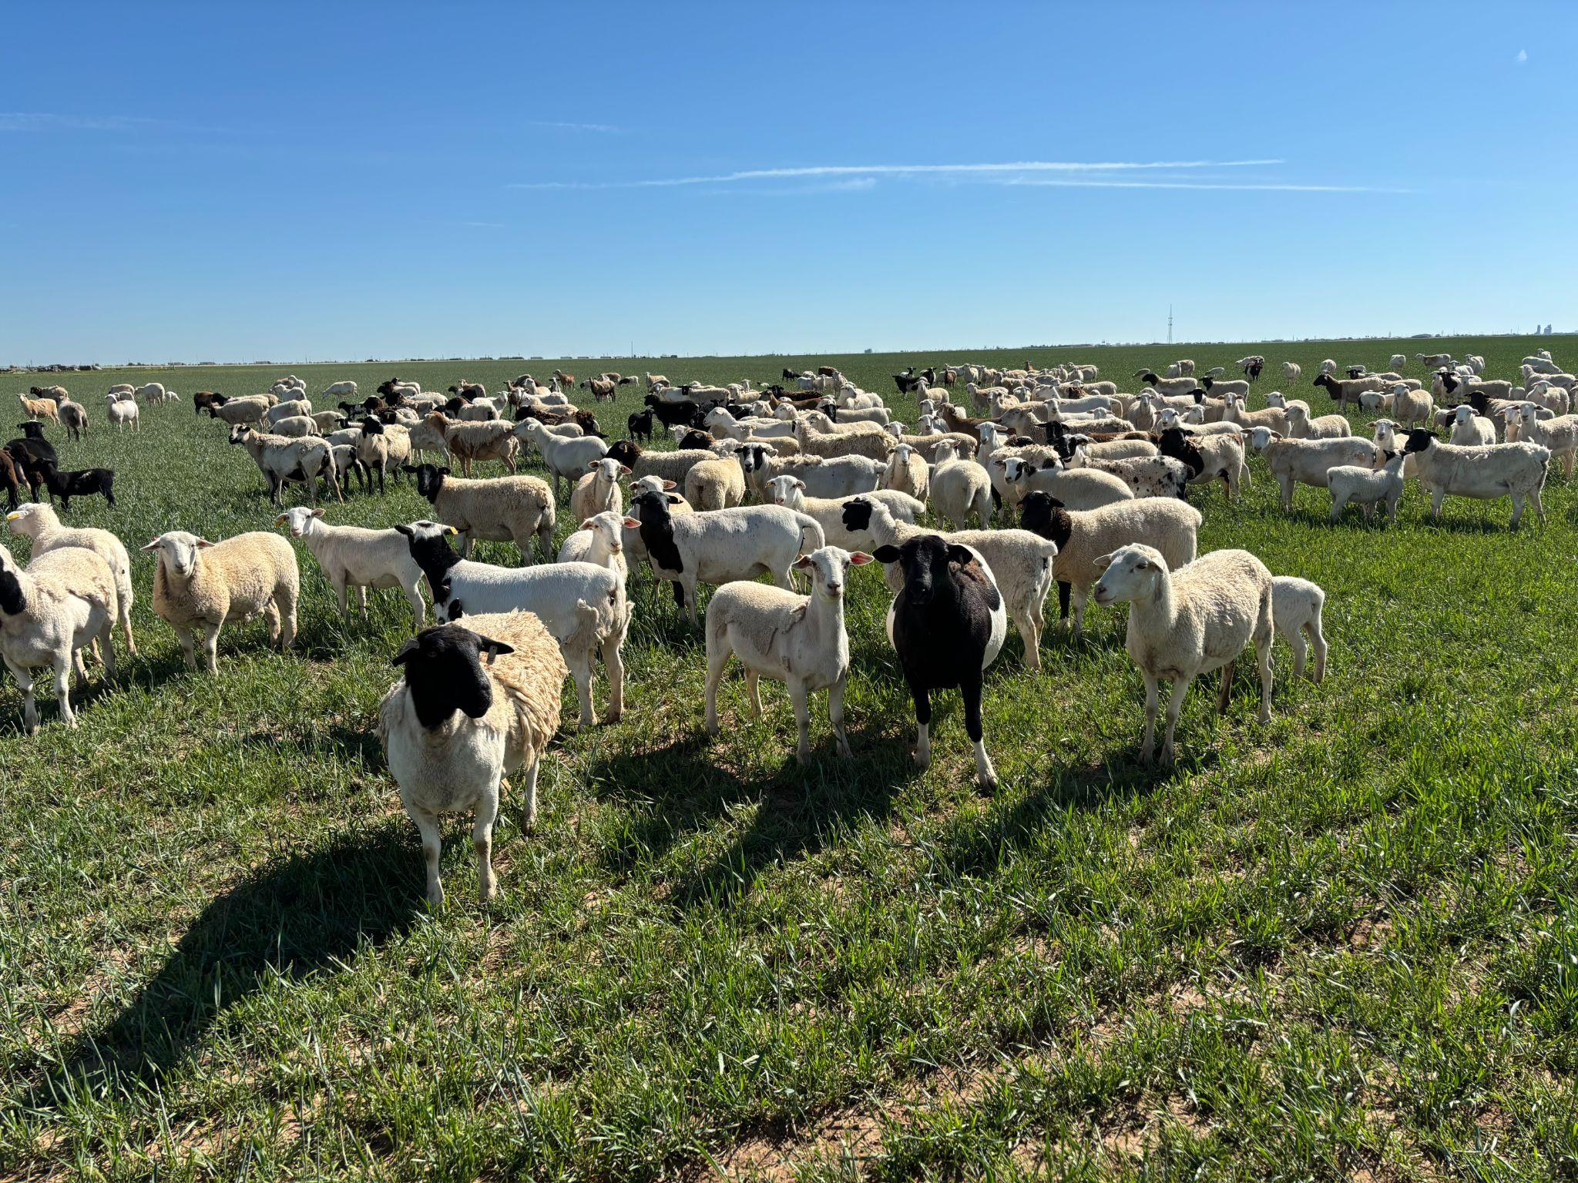
Grazing
Producers may choose to use wheat as a dual-purpose system. The livestock will eat the wheat as forage when it is young, usually in the fall and winter. Then they will be moved to another feed source in the spring.
- After the livestock are moved, the wheat will continue growing and will be harvested for grain in the late spring/early summer.
Producers can also choose to graze out the wheat, so its only purpose is for forage. Livestock will be on the wheat pasture for the crop’s lifecycle.
Sheep grazing on wheat pasture.

Slide 24
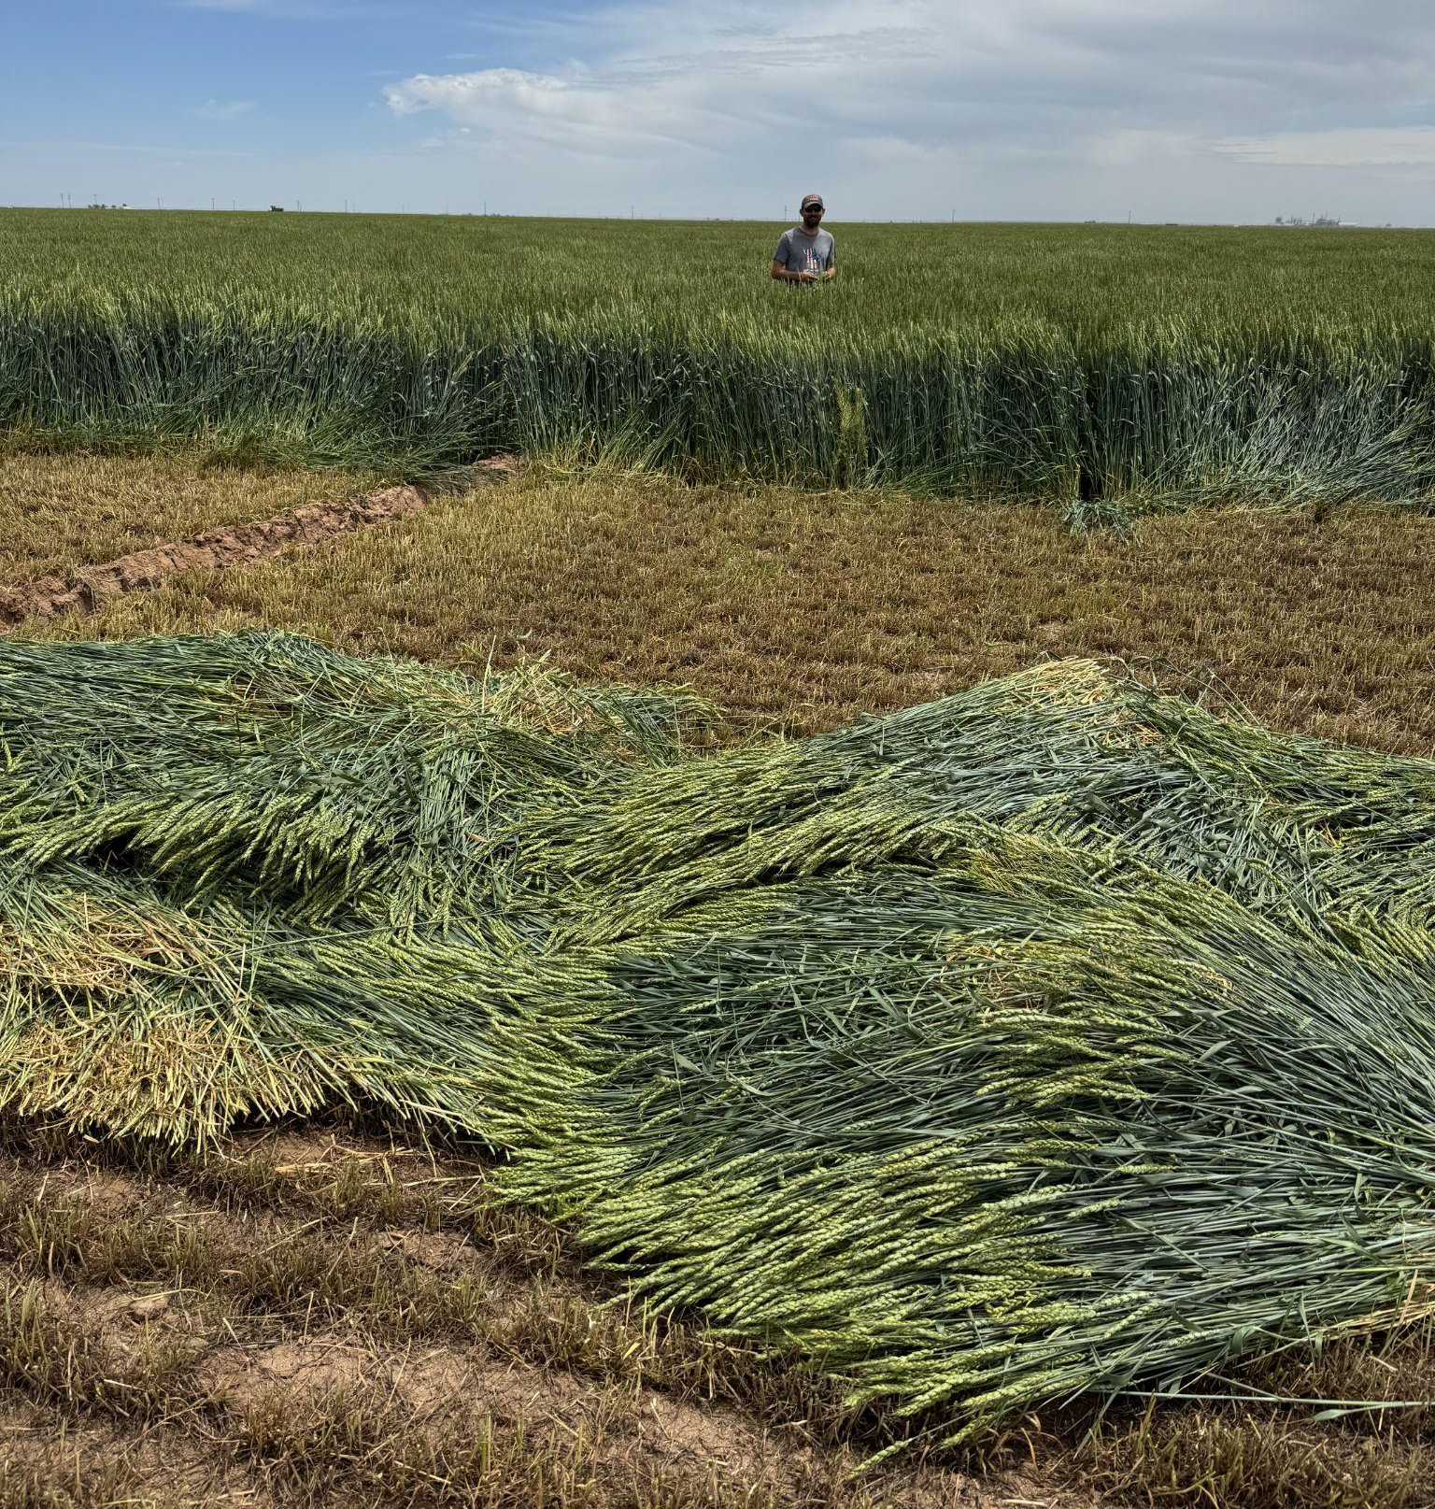
Silage (Wheatlage)
Silage (sometimes called wheatlage) is made from chopped wheat.
- Instead of using a combine to harvest the grain, silage is cut using a machine called a forage harvester or chopper.
- Wheat for silage is harvested earlier than wheat harvested for grain, usually in the spring and early summer, when the plant is still green.
Silage is commonly used in dairies and feedyards, especially in the Texas panhandle.
Freshly cut silage

Slide 25
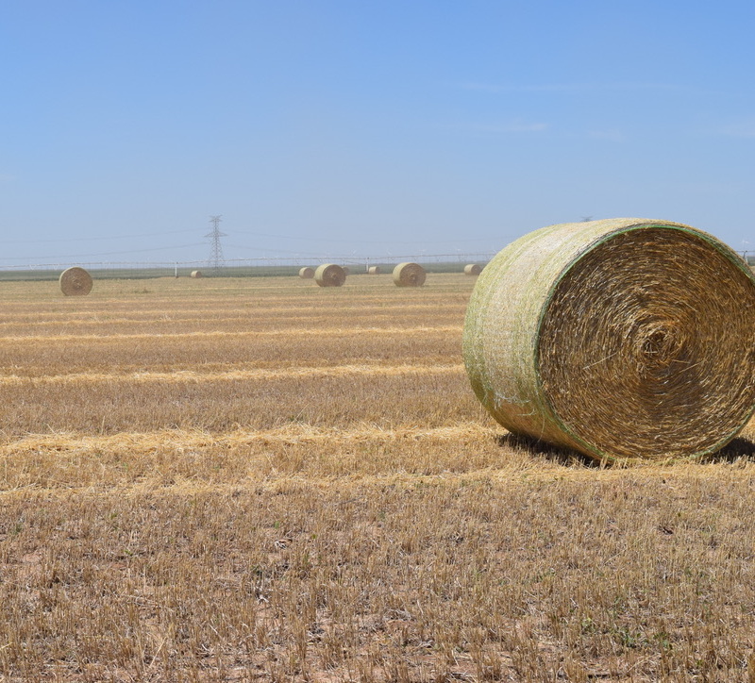
Hay
Wheat can also be used for hay to feed livestock.
- The wheat is cut by a mower and then left to dry for several days.
- Once the wheat is dry enough, it is baled in wrap or netting.
- Once the hay is baled, it can remain in the field or stacked.
Wheat hay is most commonly fed to beef cattle.
Wheat baled as hay

Slide 26
Feed
Wheat can also be turned into animal feed, especially for livestock.
- When used for feed, wheat is often combined with other grains like corn or sorghum to increase nutritional value and improve digestibility for animals.
- Feed can be made from the whole kernel or from byproducts from flour milling, such as the bran.

Slide 27
Feed
There are many ways to prepare wheat for animal feed, including:
- Dry Rolling: Dry wheat kernels are cracked by large rollers to expose the inner parts of the kernel and increase digestibility.
- Steam Rolling (Flaking): Wheat kernels are steamed and then cracked to expose the inner parts of the kernel and slow down the digestion of starch.
- Grinding: Hammermills grind the wheat kernels into smaller particles than rolling or flaking.

Slide 28

Other Uses of Wheat

Slide 29
Alternative Uses Wheat
Wheat byproducts and parts of the wheat plant can also be used for other purposes, such as:
- Household & consumer products
Ex. Cat litter, laundry detergent, packing peanuts, etc.
- Personal care products
Ex. Cosmetics, hair conditioner, sunscreen
- Industrial & manufacturing products
Ex. Glue, insulation, roofing materials
- Environmental & ag products
Ex. Wastewater treatment
Use the Alternative Uses of Wheat handout to see a full list of alternative uses of wheat.

Slide 30
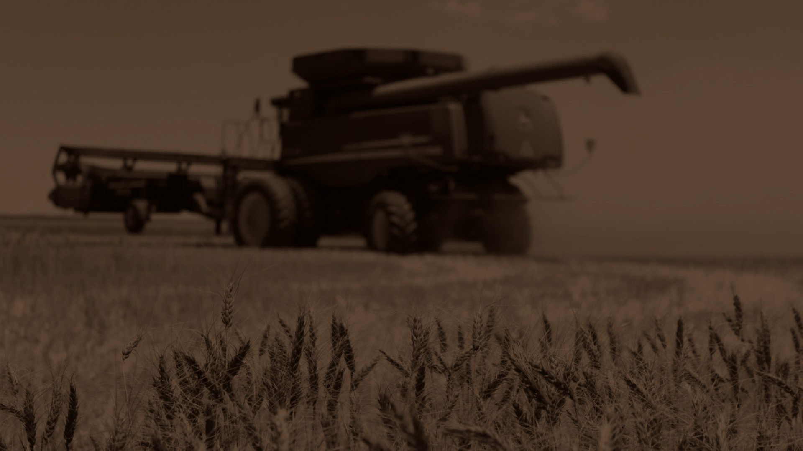

Sources:
Pastry Class
https://www.pastryclass.com/articles/types-of-flour-for-baking
Baker Bettie
https://bakerbettie.com/varieties-flour/
Wheat Foods Council
https://www.wheatfoods.org/how-flour-is-milled/

Slide 31
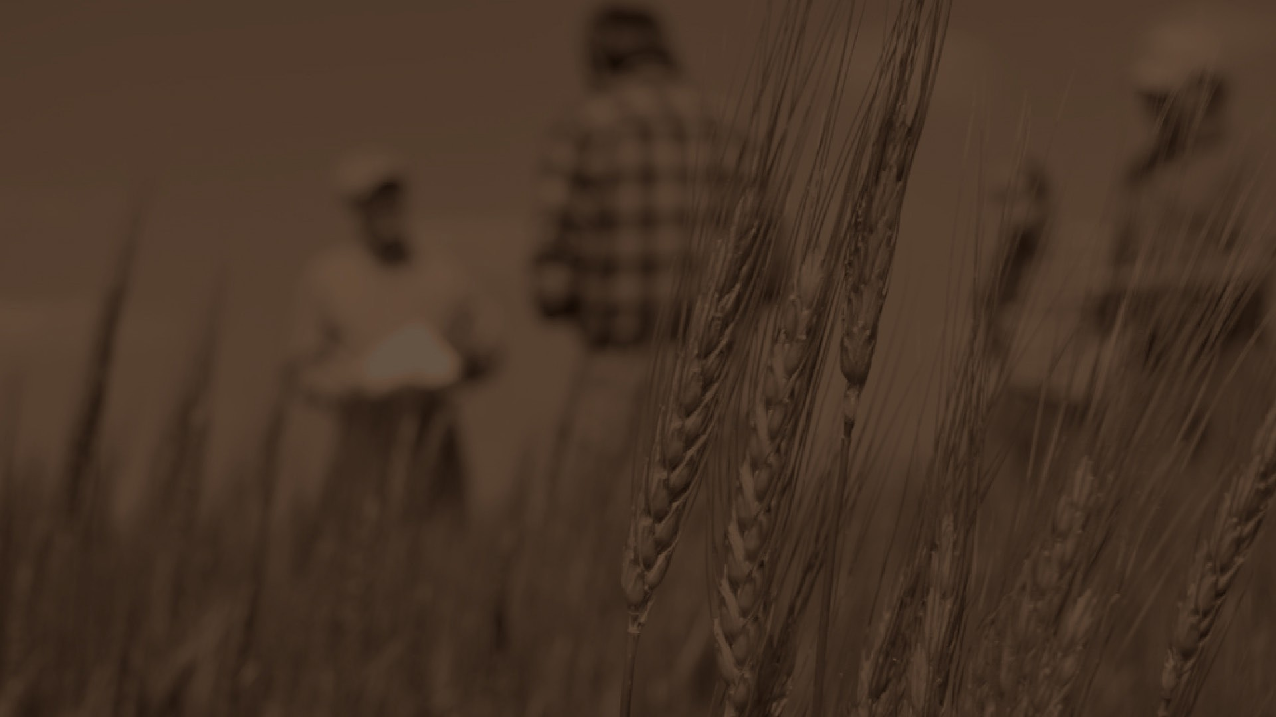
Reviewers:
Ben Scholz
Wheat Farmer & Texas Wheat Producers Board Director
Jordan Trees Waddle
Agricultural Science Teacher, Medina Valley High School, Medina Valley ISD
Kyle Miller
Family & Consumer Science Teacher, Mackenzie Middle School, Lubbock ISD
Rhonda Cantrell
Retired Elementary Teacher, Texline ISD
Dr. Calvin Trostle
Professor & Extension Agronomist, Texas A&M AgriLife Extension Service
Cater Wands
Manager of Technical Sales, Miller Milling

