Slide 1


Wheat Nutrition

Slide 2

The Wheat Kernel

Slide 3
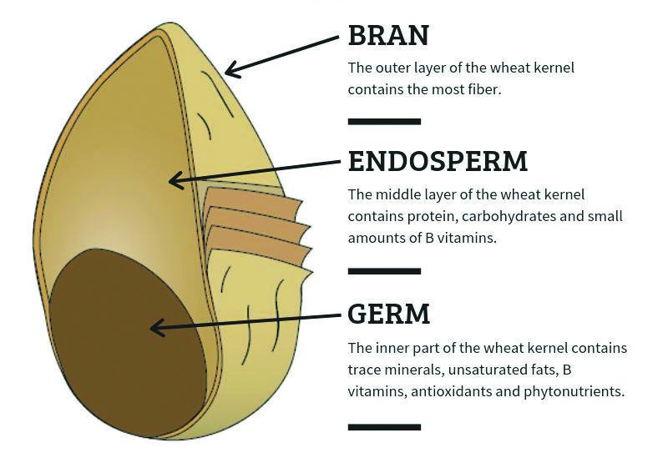
Parts of the Wheat Kernel

Slide 4
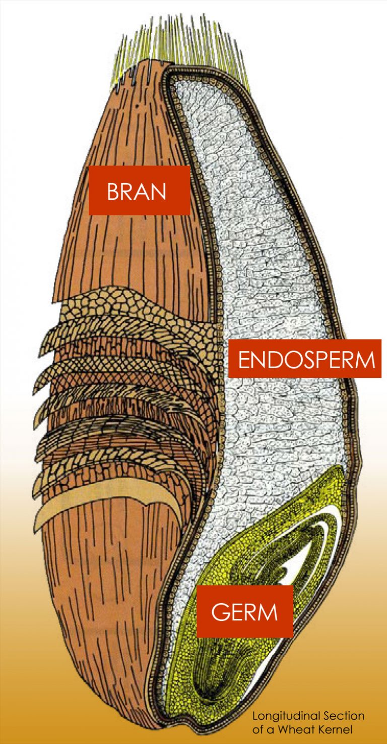
Parts of Wheat Kernel Vocabulary
Bran: The outermost protective layer of the wheat kernel is rich in fiber and nutrients and makes up approx. 14.5% of the kernel weight. It is separated during milling to produce refined flour. The bran layers are included in whole wheat flour and can also be sold separately.
Endosperm: The starchy middle layer of the wheat kernel makes up approx. 83% of the weight. It is ground into flour and contains carbohydrates, protein and vitamins. White flour is composed of the endosperm.
Germ: The nutrient-dense embryo of the wheat plant makes up approx. 2.2% of the kernel weight. While it is important for the growth of the wheat plant, it is not included in enriched flour because it can limit shelf life due to the high fat content in the germ.
Photo courtesy of Wheat Foods Council

Slide 5

Wheat & Flour Nutrients

Slide 6
Carbohydrates
Complex Carbohydrates: Carbohydrates are the most efficient source of energy. Complex carbs are long chains of sugar molecules naturally found in grains, beans and vegetables.
- Wheat flour is a good source of complex carbohydrates.
Fiber: Fiber is an indigestible carbohydrate in food that acts like a broom to sweep the digestive tract and promotes digestive regularity and heart health by reducing cholesterol. A high fiber diet can reduce the risk of heart disease, Type II diabetes and reduces inflammation associated with certain types of cancer.
- Fiber comes from the bran and germ in the wheat kernel.

Slide 7
Protein
Protein: Protein is an essential nutrient that is critical for strong bones, muscles, organs and cells.
Amino Acids: Amino acids are building blocks of protein. Wheat is a moderate source of protein because it contains eight of the twenty amino acids necessary for a healthy diet.
Grain foods provide roughly the same protein per serving as milk or dairy foods.
Combining wheat products with food with naturally occurring protein, like animal proteins or legumes, can make a complete meal or snack.

Slide 8
Fat
Fat: Fat is an essential nutrient that stores energy and is critical for bodily functions like hormone production, nutrient absorption and cell structure. Fat also protects organs.
Wheat itself contains very little fat, but wheat-based products can contain higher levels of fat. Any fat that wheat does contain comes from the germ.
Typically, fat content in wheat-based foods is the result of oil or shortening found in many baked goods. Bread and pasta products are considered low-fat foods compared to other wheat-based products.

Slide 9
Vitamins
During the milling process, naturally occuring vitamins and nutrients are added to enriched wheat flour to enhance the nutritional quality.
Thiamine (Vitamin B1): Promotes good appetite, digestion and healthy nerves.
Riboflavin (Vitamin B2): Essential for growth and good vision.
Niacin (Vitamin B3): Essential for the efficient use of protein by the body.
Folic Acid (Vitamin B9): Helps the body make red blood cells and is important for healthy pregnancies.
- Most people get half of the daily value of folic acid from grain-based foods.

Slide 10
Minerals
During the milling process, naturally occuring vitamins and minerals are added to enriched wheat flour to enhance the nutritional quality.
Iron: Allows blood to carry oxygen throughout the body.
- Most people get half of the daily value of iron from grain-based foods.
Zinc: Important for skin healing and growth and prevents infection.
Selenium: Helps the body grow and keeps the eyes and skin healthy.
Magnesium: Promotes healthy muscle function, keeps the heart healthy and helps nerves send messages throughout the body.

Slide 11

Gluten

Slide 12
Gluten
Gluten: Gluten is a naturally occurring protein found in wheat, barley, rye and triticale. Gluten creates structure, chewiness and volume in products made from these grains.
Wheat with high protein content, like Hard Red Winter, Hard Red Spring, Durum and Hard White wheats, have a higher amount of gluten, which makes products made from these wheats more dense and chewy.
Wheat with low protein content, like Soft Red Winter and Soft White wheats, have a lower amount of gluten, which makes products made from these wheats softer and lighter.

Slide 13
Gluten-Related Disorders
About 5% of the global population has difficulty digesting and processing gluten. For those with gluten-related disorders, they should avoid products that contain gluten.
- There is no medical reason for those without these disorders to avoid gluten or wheat-based products, but some people may choose to do so based on personal choice and preference.
Celiac Disease: an autoimmune disorder that causes the immune system to attack the small intestine when gluten is consumed.
- Only 1% of the population is diagnosed with celiac disease.
Non-Celiac Sensitivity: a syndrome where a person experiences digestive discomfort after consuming foods containing gluten.
- This disorder cannot be clinically diagnosed, but is determined when symptoms are relieved when gluten is eliminated from the patient’s diet.
Wheat Allergy: an immune reaction to the proteins in wheat.

Slide 14

Types of Grains & Flours

Slide 15
Types of Flour
Whole Wheat Flour: Flour made from the entire wheat kernel, including the bran, endosperm and germ.
Refined Flour: Flour made from the endosperm part of the wheat kernel.
Enriched Flour: Refined flour that has nutrients (B vitamins and iron) added back into the flour that have been lost during the milling process, while preserving shelf stability.
- Flour enrichment dates back to the early 1900s due to the high rates of diseases from vitamin B deficiencies.
Fortified Flour: A step beyond enriched flour, fortified flour contains additional nutrients (folic acid) at a higher level than those originally in the wheat.
- The fortification of flour began in the 1980s and 90s when the medical community connected folic acid deficiency to neural tube defects (NTDs), such as spina bifida and anencephaly.

Slide 16
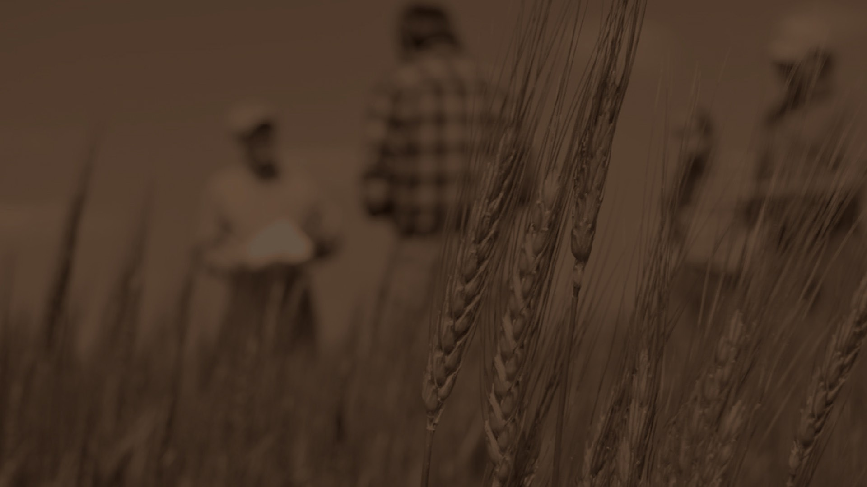

Sources:
Eat Wheat
https://eatwheat.org/learn/a-kernel-of-wheat/
Wheat Foods Council
https://www.wheatfoods.org/resources/wheat-facts/kernel-of-wheat/
Grain Foods Foundation
https://grainfoodsfoundation.org/grain-facts/grains-an-essential-building-block-for-proper-nutrition/
Wheat Foods Council
https://texaswheat.org/wp-content/uploads/2018/05/The-Truth-About-Gluten.pdf
Grain Foods Foundation
https://grainfoodsfoundation.org/whole-grains/
PubMed Central
https://pmc.ncbi.nlm.nih.gov/articles/PMC7409416/
Grain Foods Research Institute
https://grainfoodsresearch.org/history-and-public-health-benefits-of-enrichment-and-fortification-of-refined-grains/

Slide 17
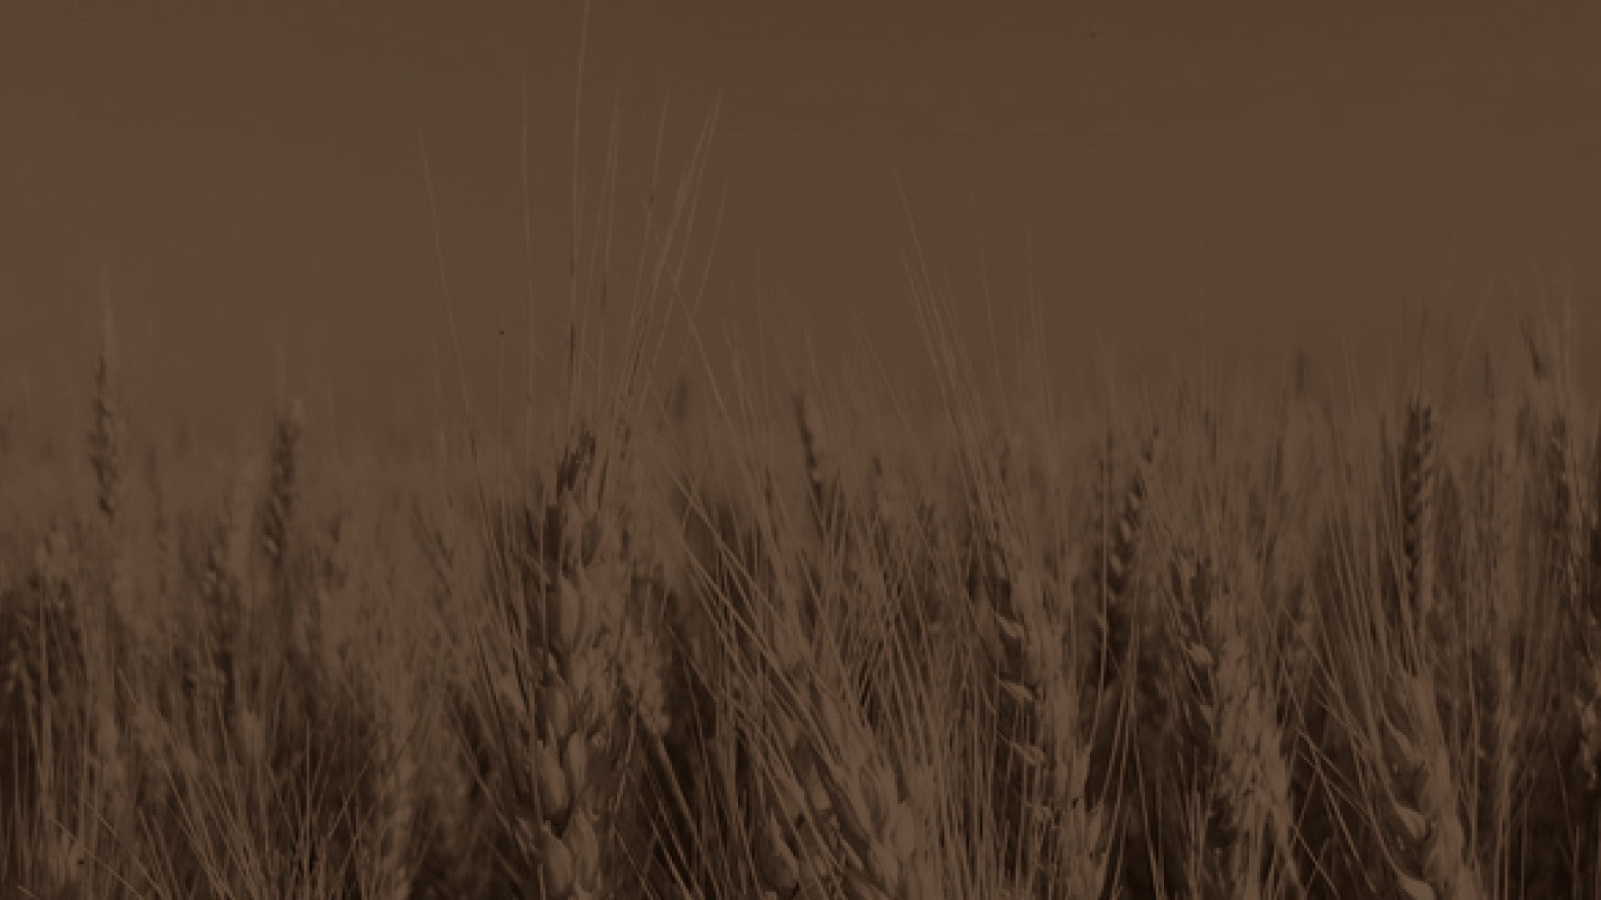
Reviewers:
Ben Scholz
Wheat Farmer & Texas Wheat Producers Board Director
Jordan Trees Waddle
Agricultural Science Teacher, Medina Valley High School, Medina Valley ISD
Kyle Miller
Family & Consumer Science Teacher, Mackenzie Middle School, Lubbock ISD
Rhonda Cantrell
Retired Elementary Teacher, Texline ISD
Dr. Calvin Trostle
Professor & Extension Agronomist, Texas A&M AgriLife Extension Service
Cater Wands
Manager of Technical Sales, Miller Milling

