Slide 1

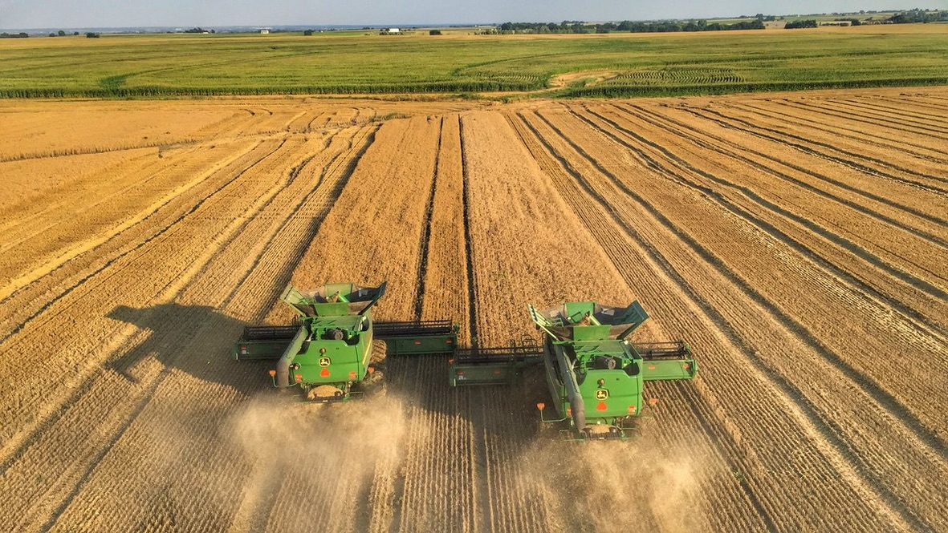
Wheat Production

Slide 2

Important Vocabulary Terms
Acre: A unit of measurement that equals 4,840 square yards and is used to measure land area.
    - This is roughly the size of a football field.
    - A typical crop circle is 125 acres.
Yield: The amount of grain harvested per acre, typically measured in bushels per acre for wheat production.
    - In 2025, the national average yield was 53.5 bushels per acre.
    - In 2025, the average yield in Texas was 37 bushels per acre.
Bushel: A unit of dry volume measurement used in agriculture to measure harvested crops.
    - One bushel of wheat is equal to 60 pounds.

Slide 3
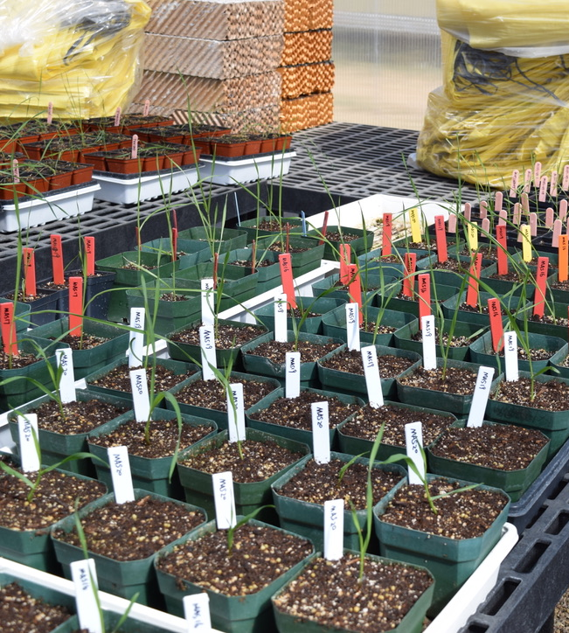
Wheat Breeding & Research
Creating and identifying the best wheat varieties through genetic research is an important part of the wheat industry.
A wheat variety has been selectively bred for certain traits, such as disease and pest resistance, drought tolerance, milling and baking quality, etc.
    - While there are only six classes of wheat, there are hundreds of wheat varieties.
It takes many years to create a new wheat variety, and then several more years of field trials to see how the new variety grows in various geographies and climates.
Wheat varieties growing in a greenhouse.

Slide 4
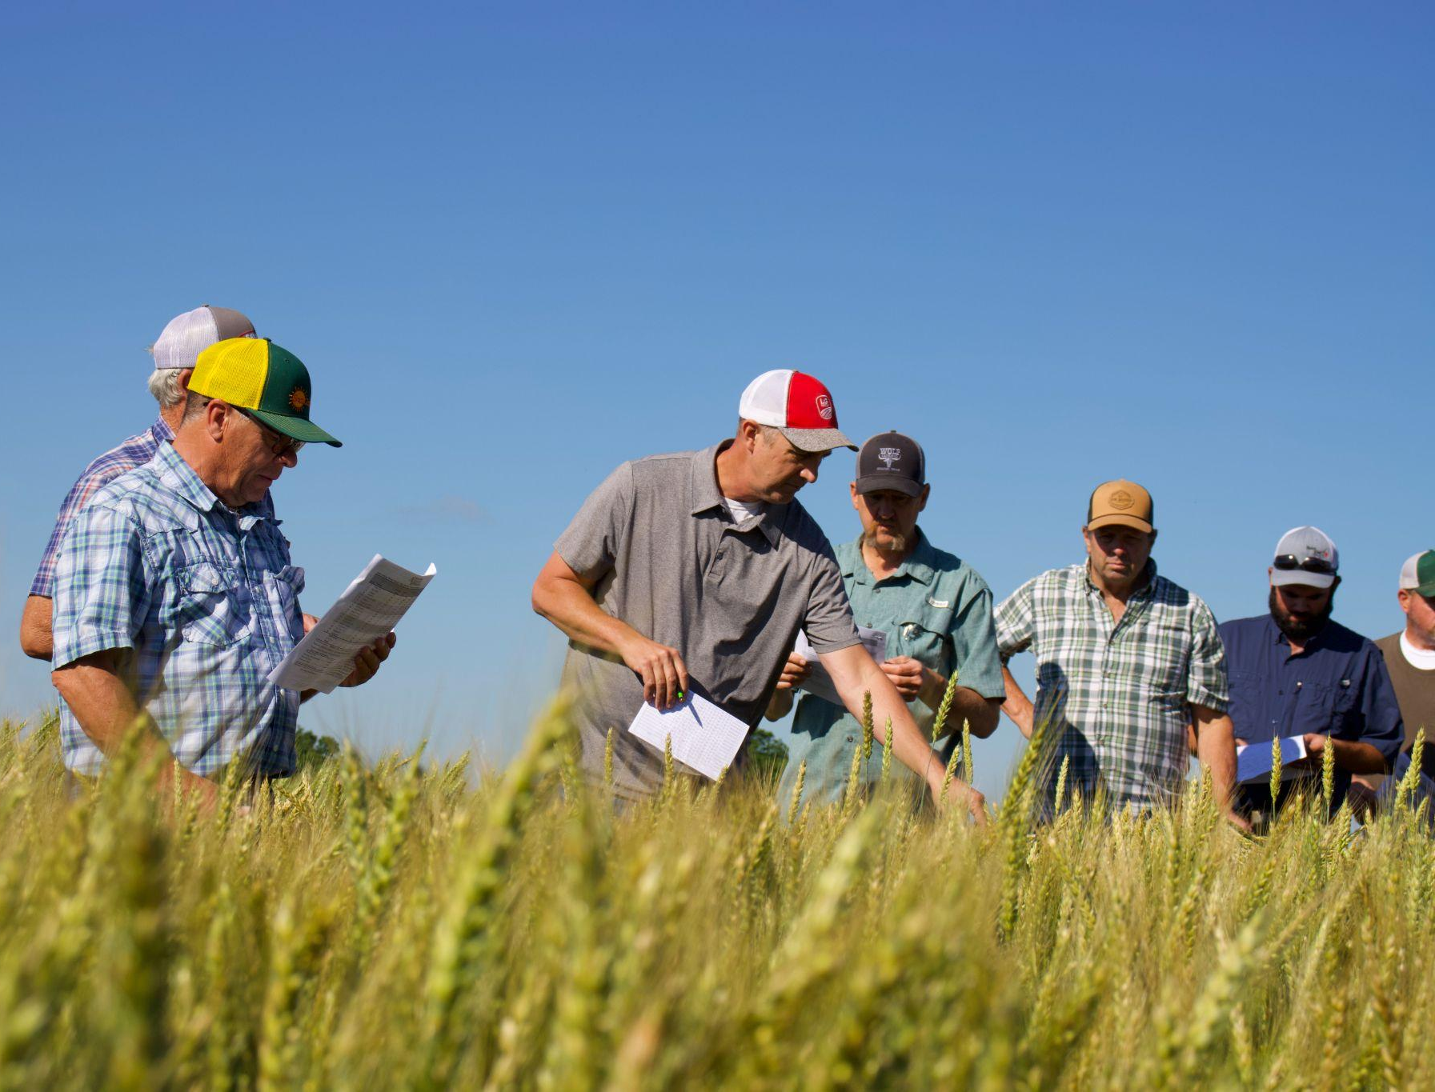
Variety Selection
Before planting their crop, the farmer will select the varieties they will plant.
Most farmers will pick multiple varieties to plant to maximize yield potential and reduce pest and disease risk.
Farmers choose which variety to plant based on several factors, such as:
    - Yield, test weight and protein potential
    - Disease and pest resistance
    - Drought tolerance
    - Brands/varieties they know and trust to be successful
Farmers learning about variety performance at a field day for the Uniform Variety Trials research coordinated by Texas A&M AgriLife Research.

Slide 5
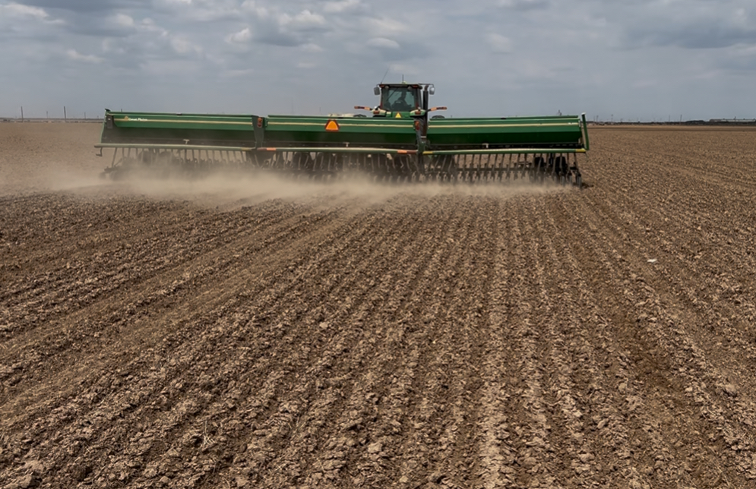
Planting
Farmers plant wheat seed using a grain drill, which is an implement pulled by a tractor. A grain drill plants seeds at consistent depth and spacing, which improves germination and yield potential.
The time of year a farmer plants wheat seed is based on the type of wheat they’re planting and their geography.
    - Winter wheat is planted in the fall.
    - Spring wheat is planted in the spring.
    - Durum, soft white and hard white wheats can be planted any time of year based on the geographic region.
Farmers aim to plant wheat in time with rains to ensure the soil has enough moisture to kickstart the plant’s growth.
- Farmers who use wheat to graze cattle plant early in the fall.
Farmer planting wheat seed.

Slide 6
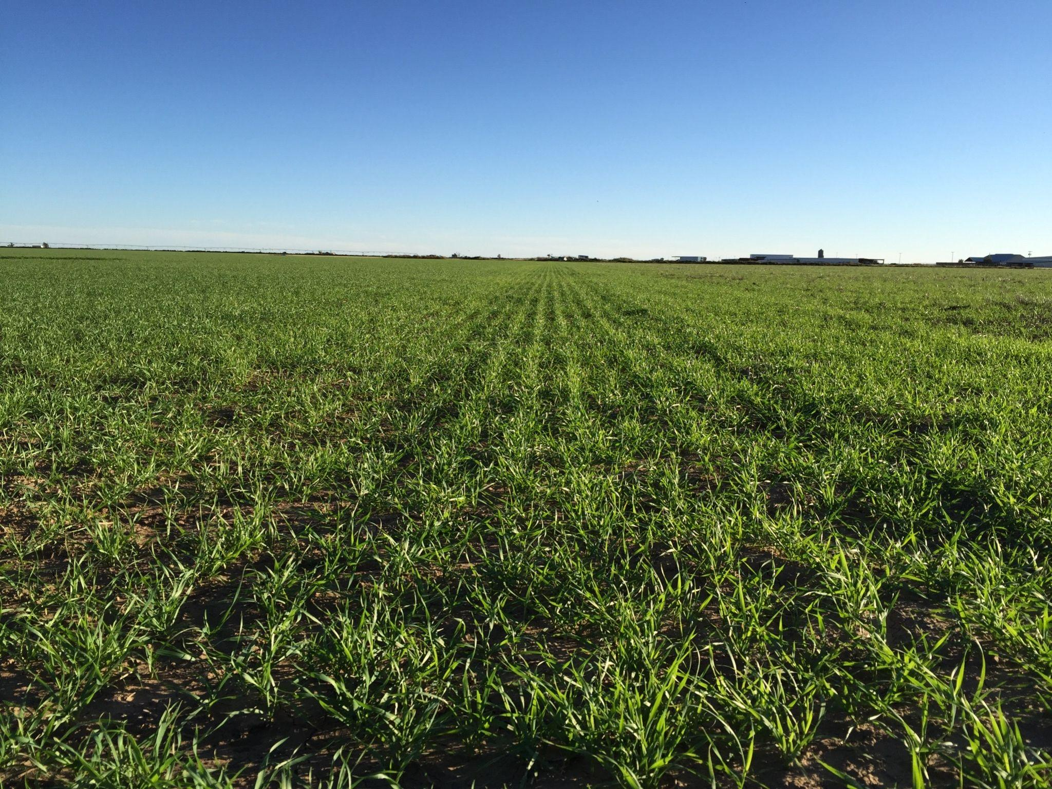
Growth
While the wheat plant grows, the farmer monitors the plant for any signs of distress, such as:
    - Drought stress
    - Heat stress
    - Signs of disease
    - Signs of pests
    - Signs of weeds
Signs of distress could look like:
    - Wilting
    - Slow Growth
    - Discoloration
    - Damage to plant
Farmers will choose to either irrigate or not irrigate their wheat crop.
    - If a crop is not irrigated, it is called dryland (ex. dryland wheat)
Dryland wheat growing in the field.

Slide 7
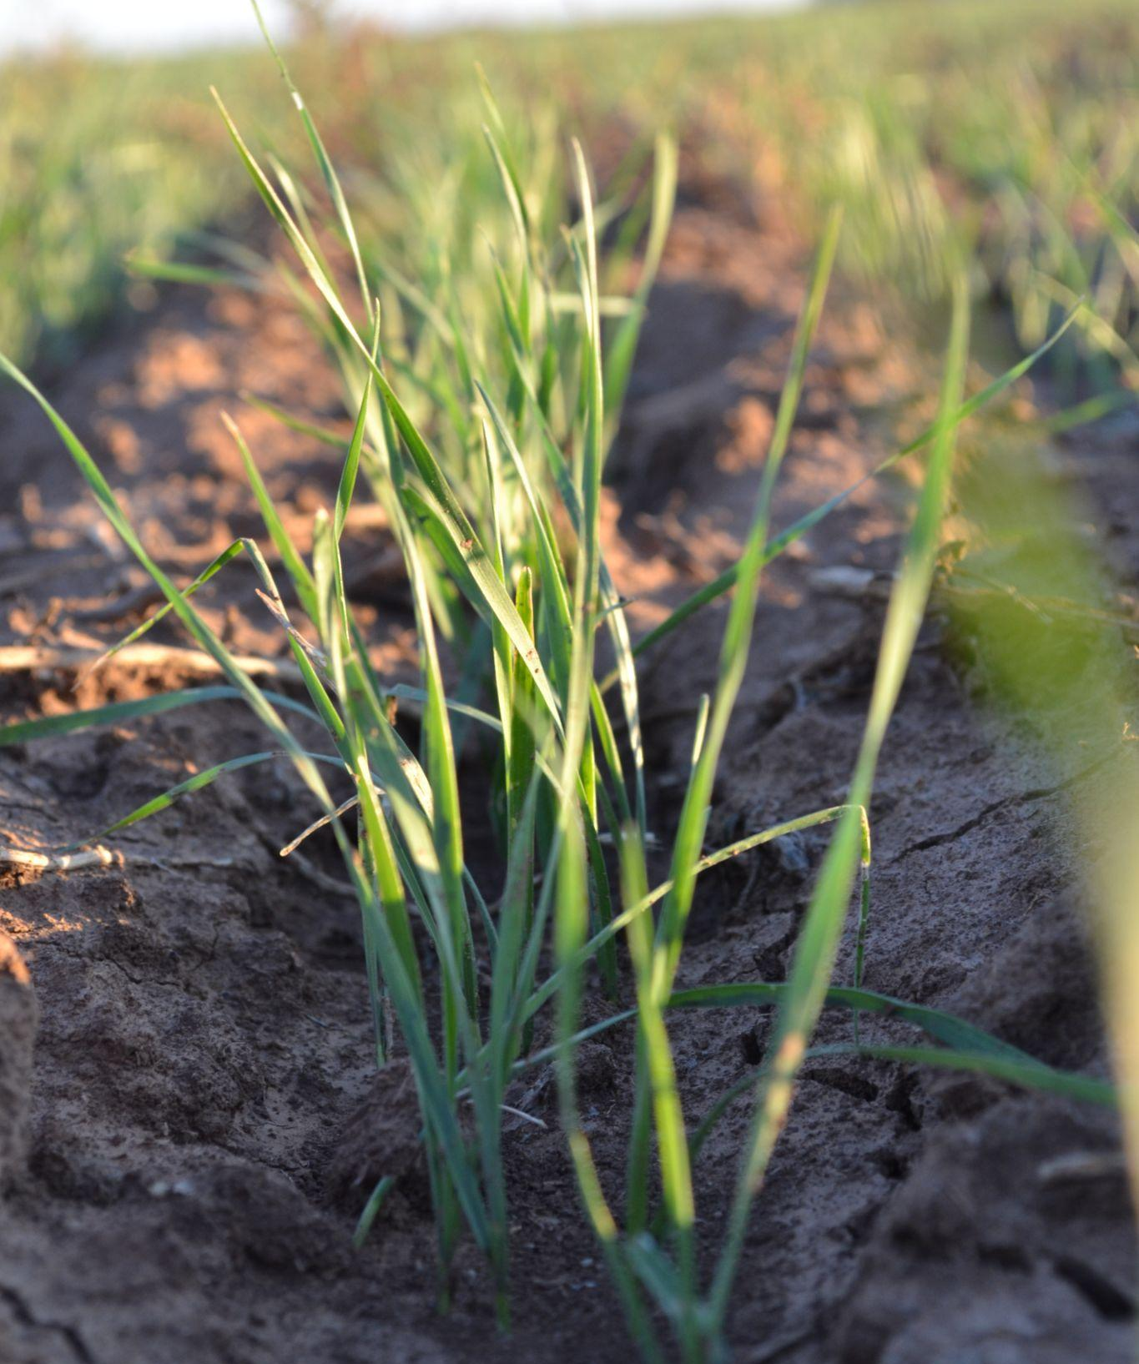
Timeline for Winter Wheat
Germination & Emergence
- The wheat seed will germinate as soil temperature decrease and emerge from the soil roughly two weeks after planting.
Tillering
- The wheat plant develops tillers, which are additional stems that grow from the main stem of the wheat plant. Tillers are essential for yield and help the crop survive dormancy during the winter.
Dormancy
    - As temperatures drop below 32°F, the wheat plant goes dormant and above ground growth stops while the roots continue to develop underneath the soil.
Wheat in tillering stage.

Slide 8
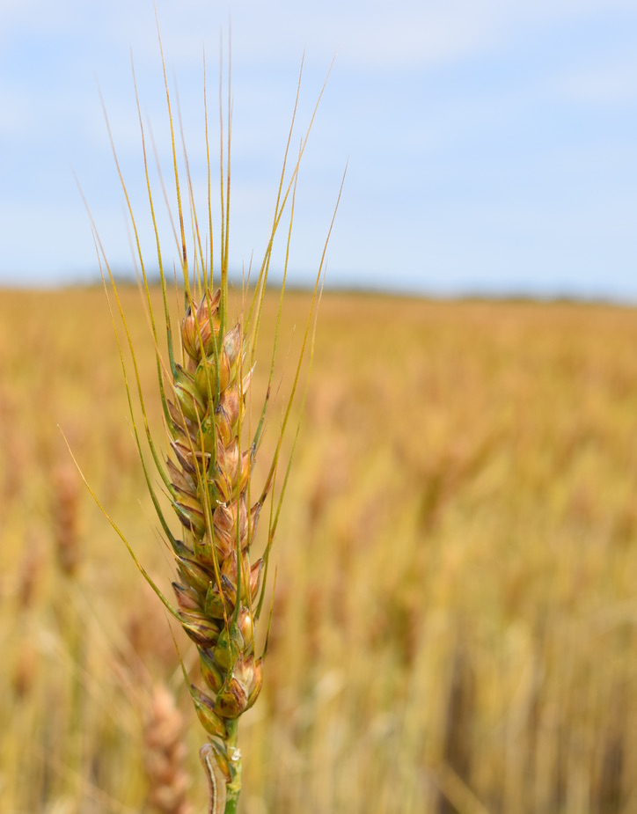
Timeline for Winter Wheat
Regrowth
- When temperatures rise, active growth resumes. Tillering will start again, the stem will elongate and leaves expand.
Reproductive Stages
- The wheat plant will head out, flower and the grain (the kernel) will begin to fill and then harden.
Maturation & Harvest (April - June)
- Kernels mature and then will dry out ahead of harvest.
Wheat drying out ahead of harvest.

Slide 9
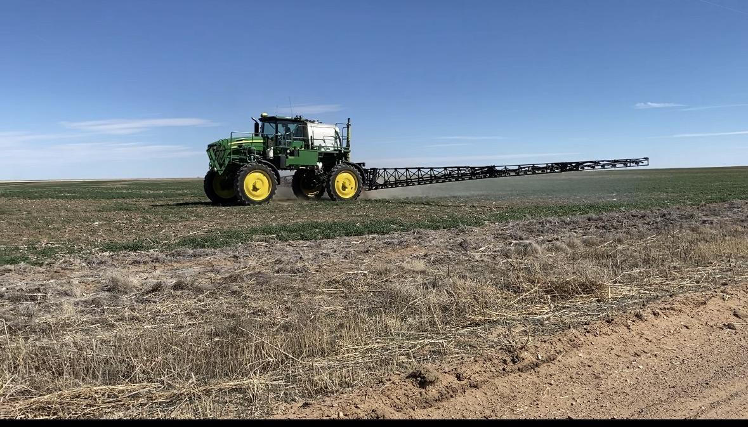
Inputs
Fertilizer
  - Fertilizer provides macronutrients like nitrogen, phosphorus and potassium.
    - Fertilizer is spread on the soil before planting or over the crop after emergence. It can be either a solid or liquid, depending on the type of fertilizer and needs of the plant and soil.
Pesticides
  - Pesticides are safety tested and approved chemical applications to protect the plant from harmful pests. There are different types of pesticides based on the “pest:”
    - Herbicides: control weeds and other plant growth that take nutrients and elements away from the wheat plant
    - Insecticides: kills or repels insects that harm the wheat plant
    - Fungicides: stops fungal disease that spread throughout fields
Farmer spraying a field of wheat using a ground rig sprayer.

Slide 10
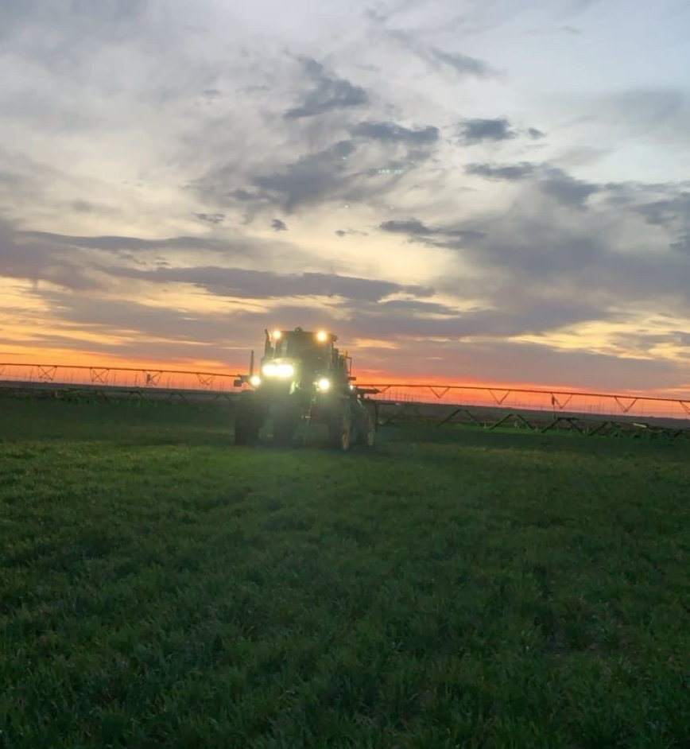
Inputs
Farmers carefully apply inputs and only use what is absolutely necessary.
- Because the wheat kernel is protected by the glume, any input applied to the wheat plant does not touch the kernel.
A custom spray applicator a field of wheat using a ground rig sprayer.

Slide 11
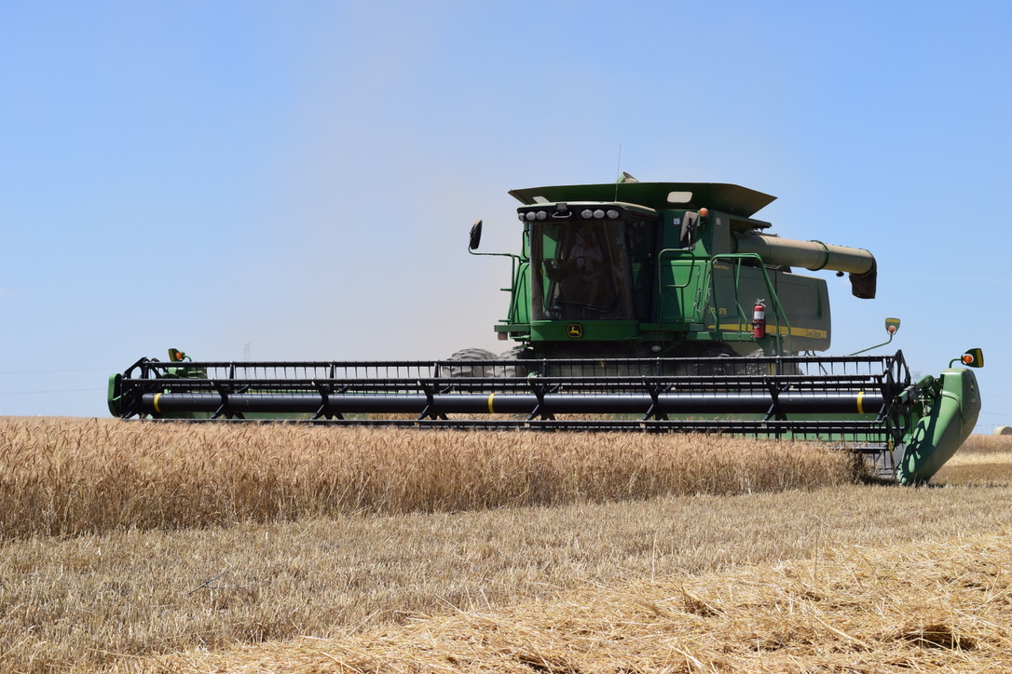
Harvest
Farmers harvest wheat using a combine. The combine does many different tasks in one machine.
    - Reaping: gathering the wheat using the header and cutting the stalk
    - Threshing: separating the grain from the rest of the plant
    - Winnowing: cleaning the grain
The time of year a farmer harvests the wheat is based on the type of wheat they’re harvesting and their geography.
- Winter wheat is harvested in the spring or summer.
- Spring wheat is harvested in the summer or fall.
- Durum, soft white and hard white wheats can be harvested any time of year based on the geographic region.
Farmer harvesting wheat.

Slide 12
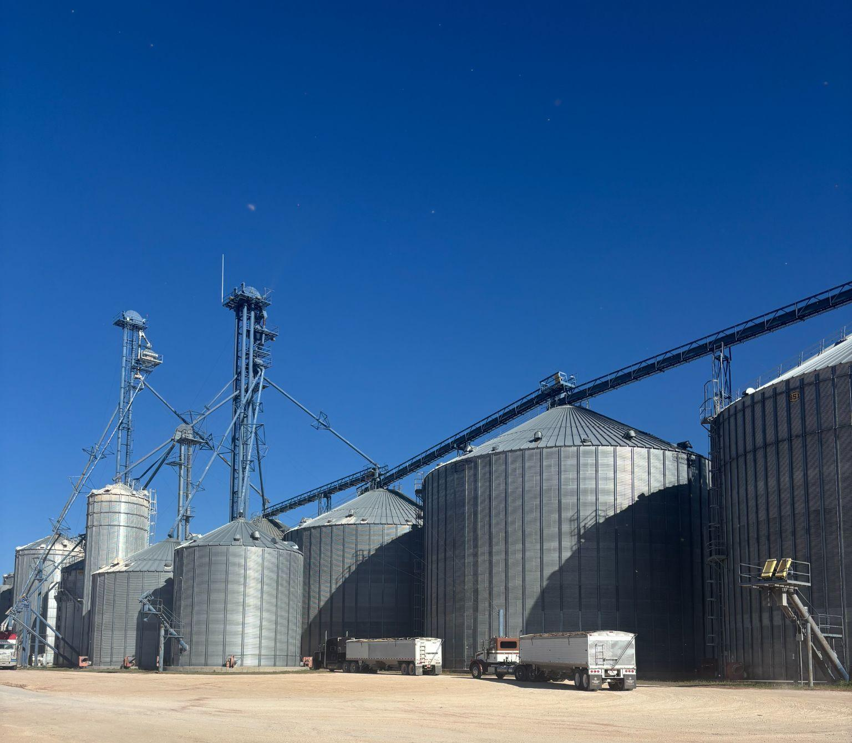
Storage
After harvest, farmers can choose to store the grain on their own farms or deliver it to their local elevator.
    - An elevator is a large storage facility that is made of either concrete or steel bins and can store grain for a long time while preserving the grain quality.
      - After delivering the grain to the elevator, the farmer is paid for their crop.
At the elevator, the grain is weighed, tested and graded.
    - Test Weight: how many pounds per bushel of wheat
    - Protein: indicator of grain, milling and baking quality
    - Moisture: how much water is in the grain
The grain merchandiser (also called grain marketer) decides when to sell the wheat. Their decision is based on the price of wheat at the time and the amount of storage at their facility.
Trucks waiting to unload wheat at the grain elevator.

Slide 13
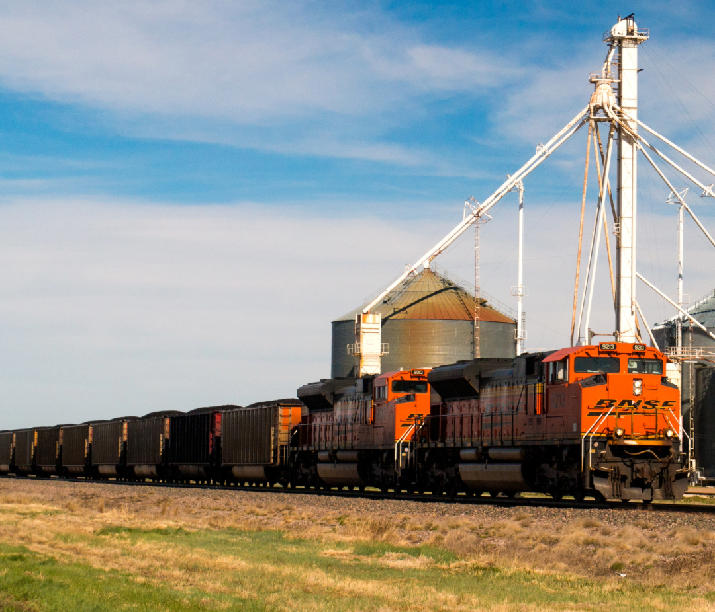
Transportation
After the wheat is sold by the grain elevator, it is then transported to regional or export elevators or mills.
Wheat is transported using trucks, rail or barges. The mode of transportation depends on where the wheat is grown, sold and the final destination.
A train going past grain elevators.

Slide 14
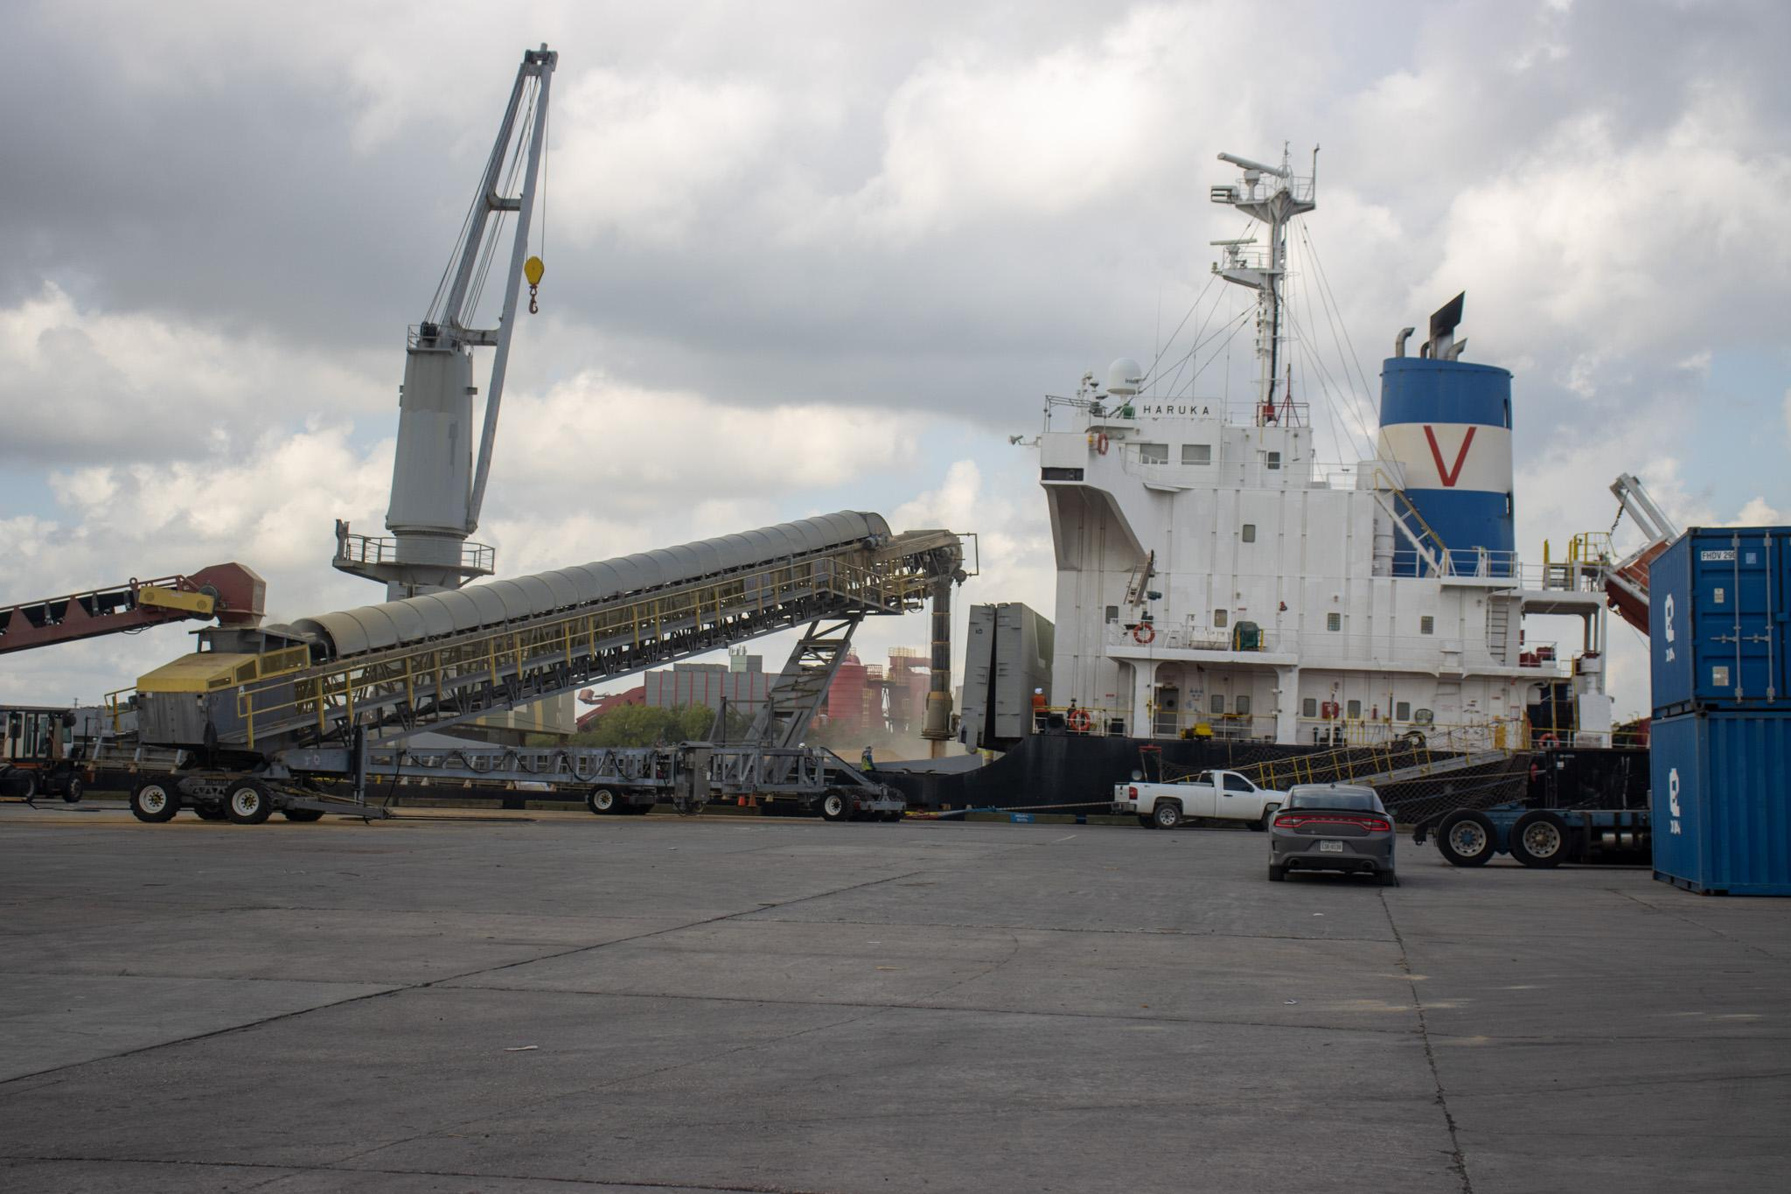
Exporting Wheat
Half of the wheat harvested for grain in Texas and half the wheat grown in the U.S. is exported to countries around the world.
At the export elevator, the wheat is blended to meet the exact contract specifications requested by the buyer.
    - The wheat is inspected to ensure it meets the contract’s requirements.
    - The wheat is loaded onto ships and transported all around the world.
Grain being loaded onto a ship in the Port of Houston.

Slide 15
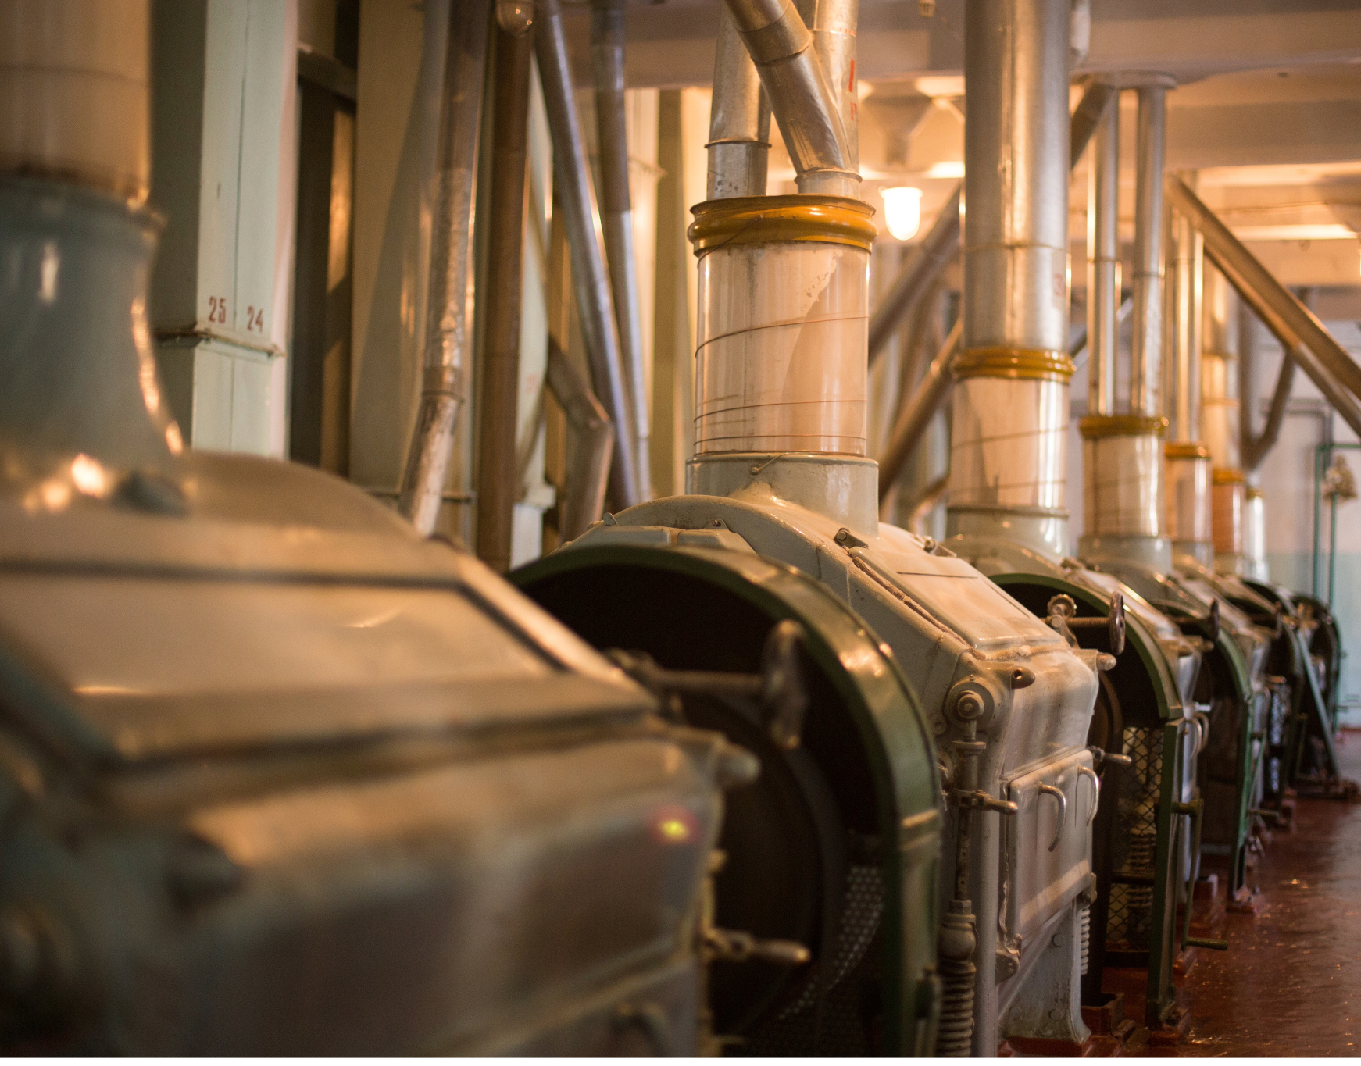
Flour Milling
If wheat is not exported internationally, it is sold to:
    - Flour mills
    - Feed mills
    - Other production facilities
At the flour mill, the wheat is ground down into a fine powder.
    - The process is overseen by the miller, who is trained in the science of flour production
After the flour is milled, it is sold to grocery stores or to food production facilities to be made into store-bought goods.
Flour milling is a highly mechanized process.

Slide 16
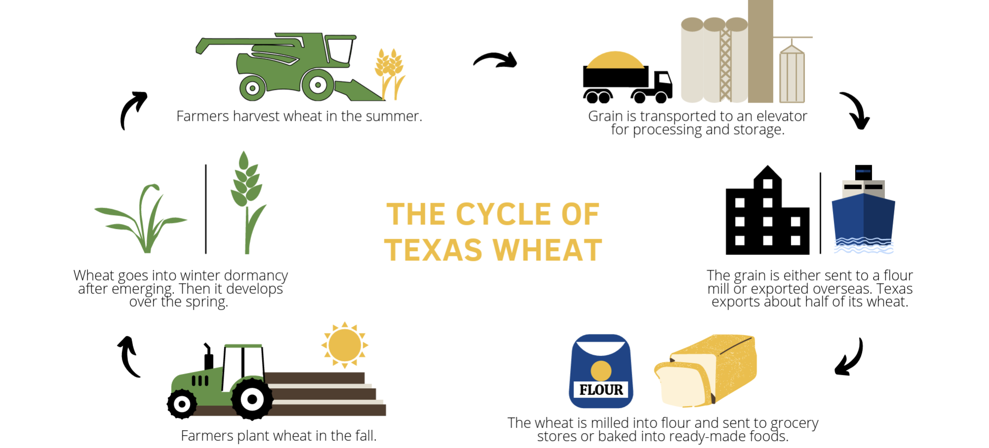
The Cycle of Texas Wheat for Grain Production

Slide 17
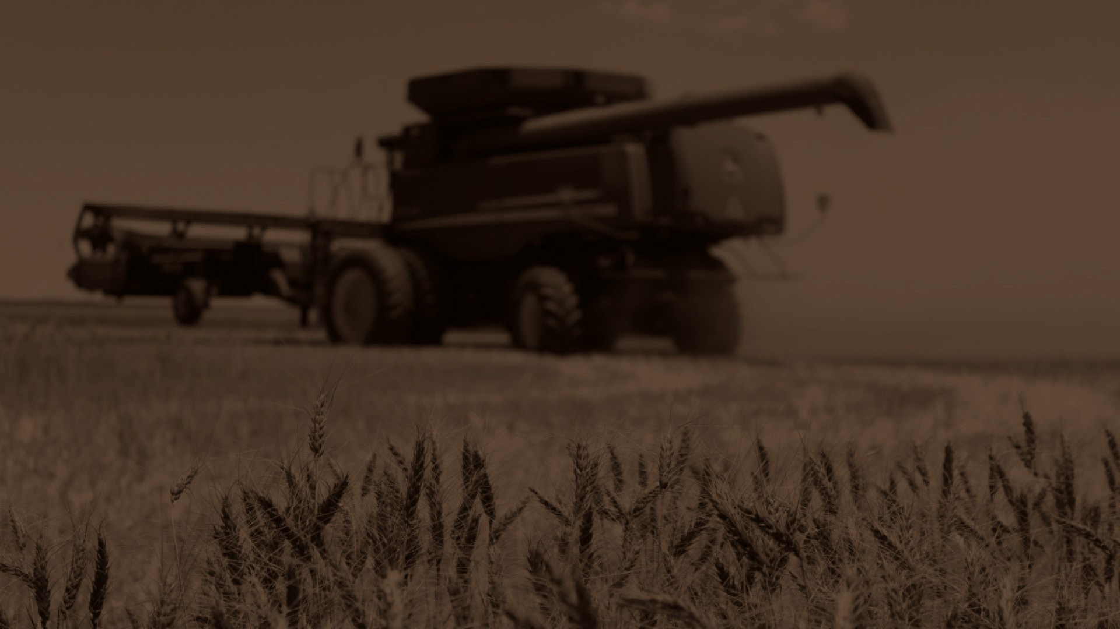

Reviewers:
Ben Scholz
  Wheat Farmer & Texas Wheat Producers Board Director
Jordan Trees Waddle
  Agricultural Science Teacher, Medina Valley High School, Medina Valley ISD
Kyle Miller
  Family & Consumer Science Teacher, Mackenzie Middle School, Lubbock ISD
Rhonda Cantrell
  Retired Elementary Teacher, Texline ISD
Dr. Calvin Trostle
  Professor & Extension Agronomist, Texas A&M AgriLife Extension Service
Cater Wands
  Manager of Technical Sales, Miller Milling

