Slide 1

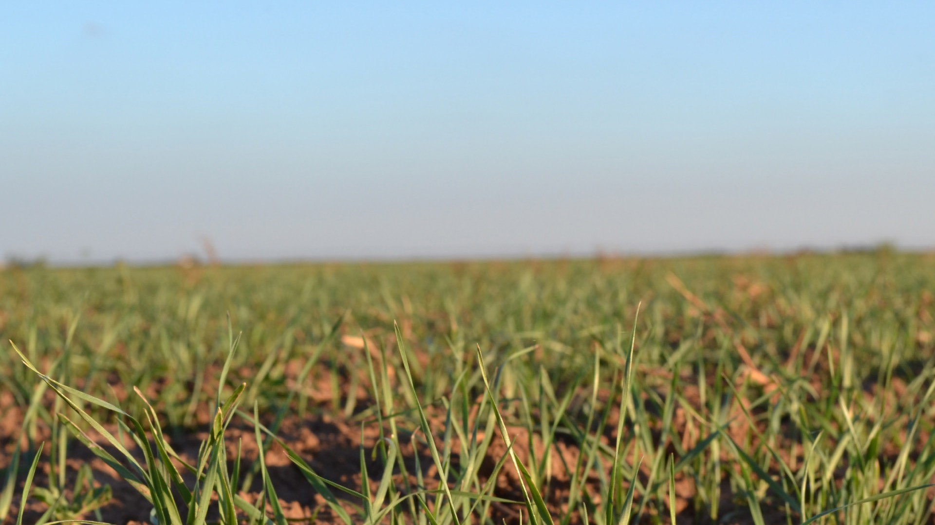
Wheat Anatomy & Plant Growth

Slide 2

Fundamentals of Plant Growth

Slide 3

Primary Elements of Plant Growth
Sunlight
  - Plants use sunlight for photosynthesis, which converts carbon dioxide and water into energy the plant needs to grow.
Water
  - Plants use water for photosynthesis and to transport nutrients.
Air
- Plants need carbon dioxide for photosynthesis.

Slide 4
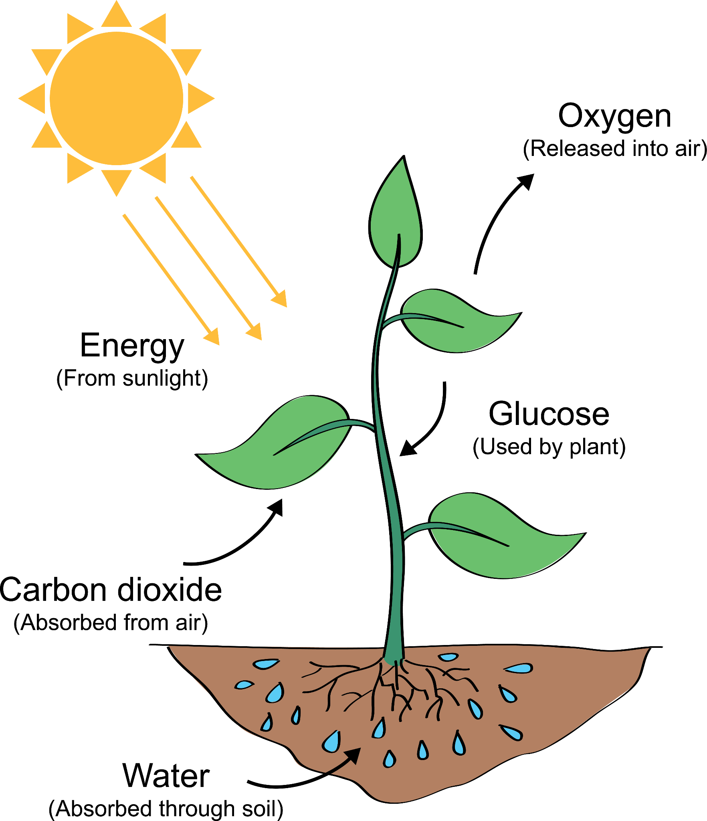
Photosynthesis
Plants use carbon dioxide, sunlight and water to make their own food to give the plant energy to grow.
Plants absorb carbon dioxide through the leaves and absorb water through the root system.
The chlorophyll in the leaves use sunlight to create glucose, which is a form of sugar and gives the plant the energy it needs to grow.
The plant releases oxygen as a byproduct of photosynthesis.

Slide 5
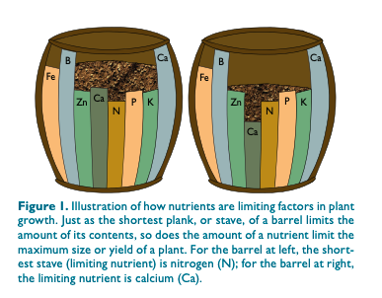
Nutrients
Plant scientists have identified 16 essential nutrients that plants need to grow.
Macronutrients are what plants need in the greatest quantity:
  - Carbon, hydrogen, oxygen, nitrogen, phosphorus and potassium
    - These are called primary nutrients.
Plants need secondary nutrients in moderate amounts:
  - Calcium, magnesium and sulfur
Micronutrients are necessary in very small quantities:
  - Boron, chlorine, copper, iron, manganese, molybdenum and zinc
    - These are called trace nutrients.
Mg
Mg
Photo courtesy of Texas A&M AgriLife Extension

Slide 6
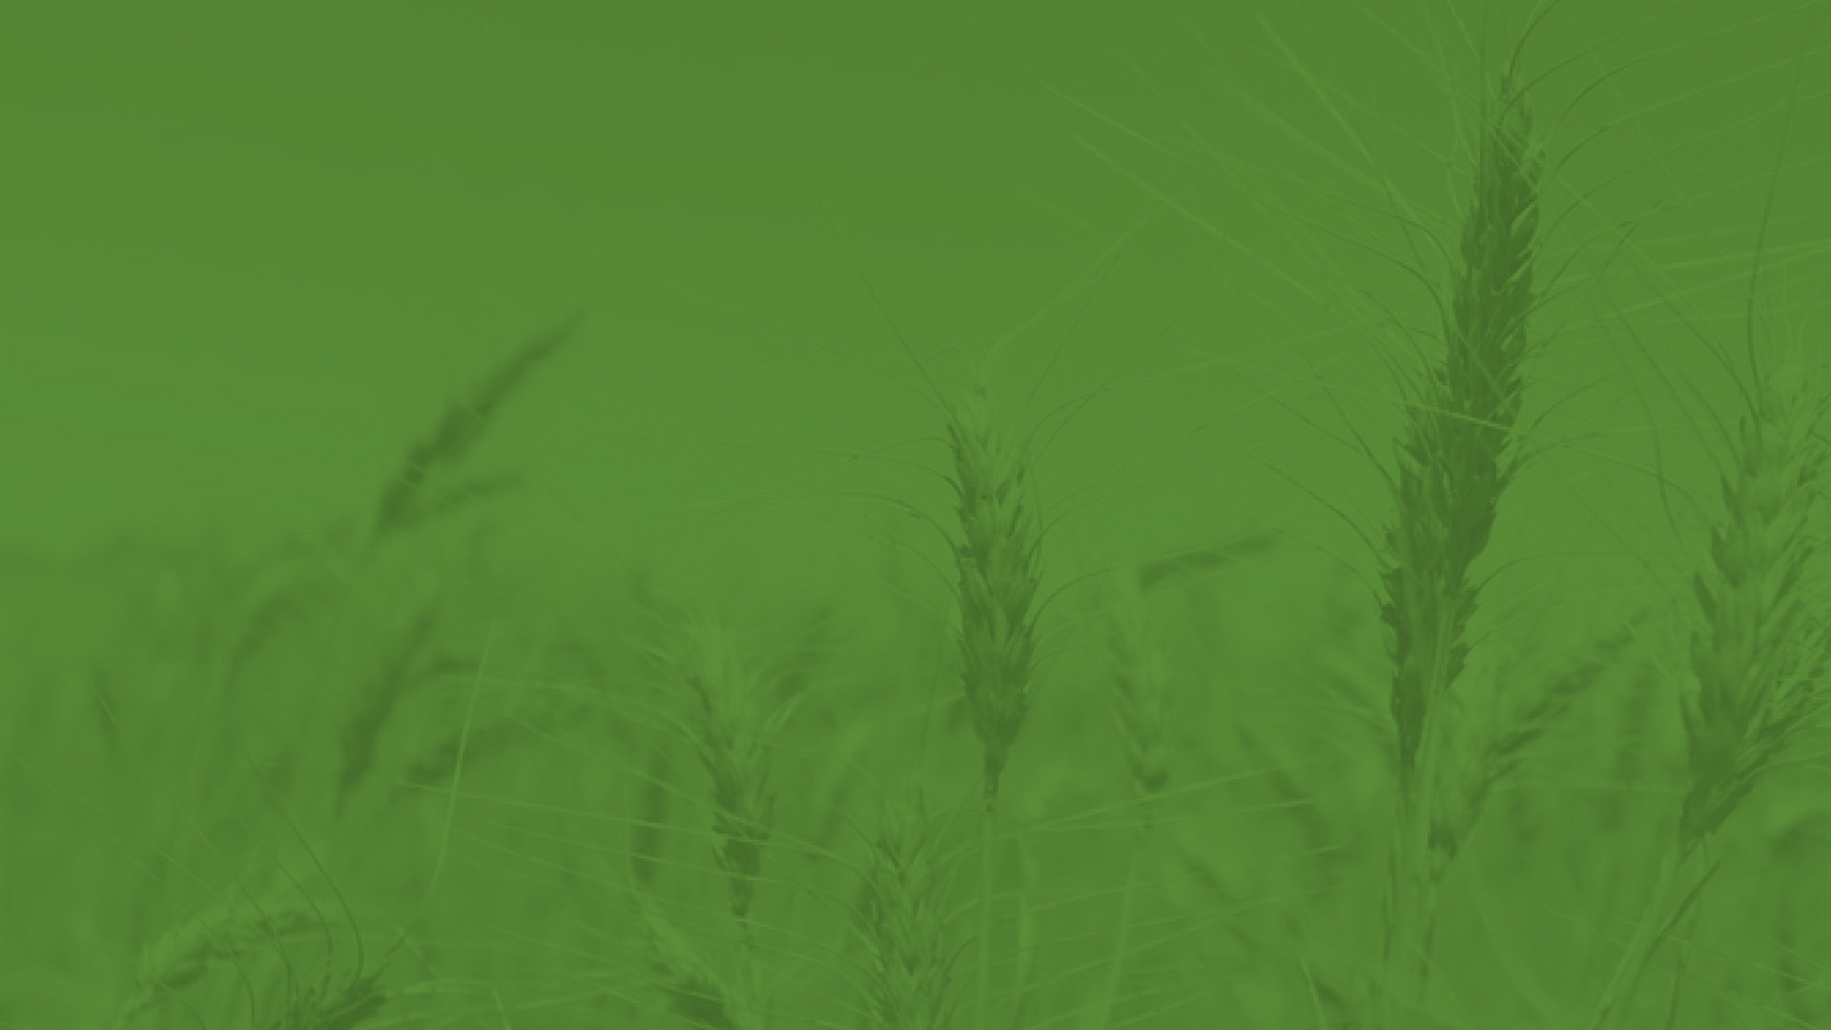
The Wheat Plant

Slide 7
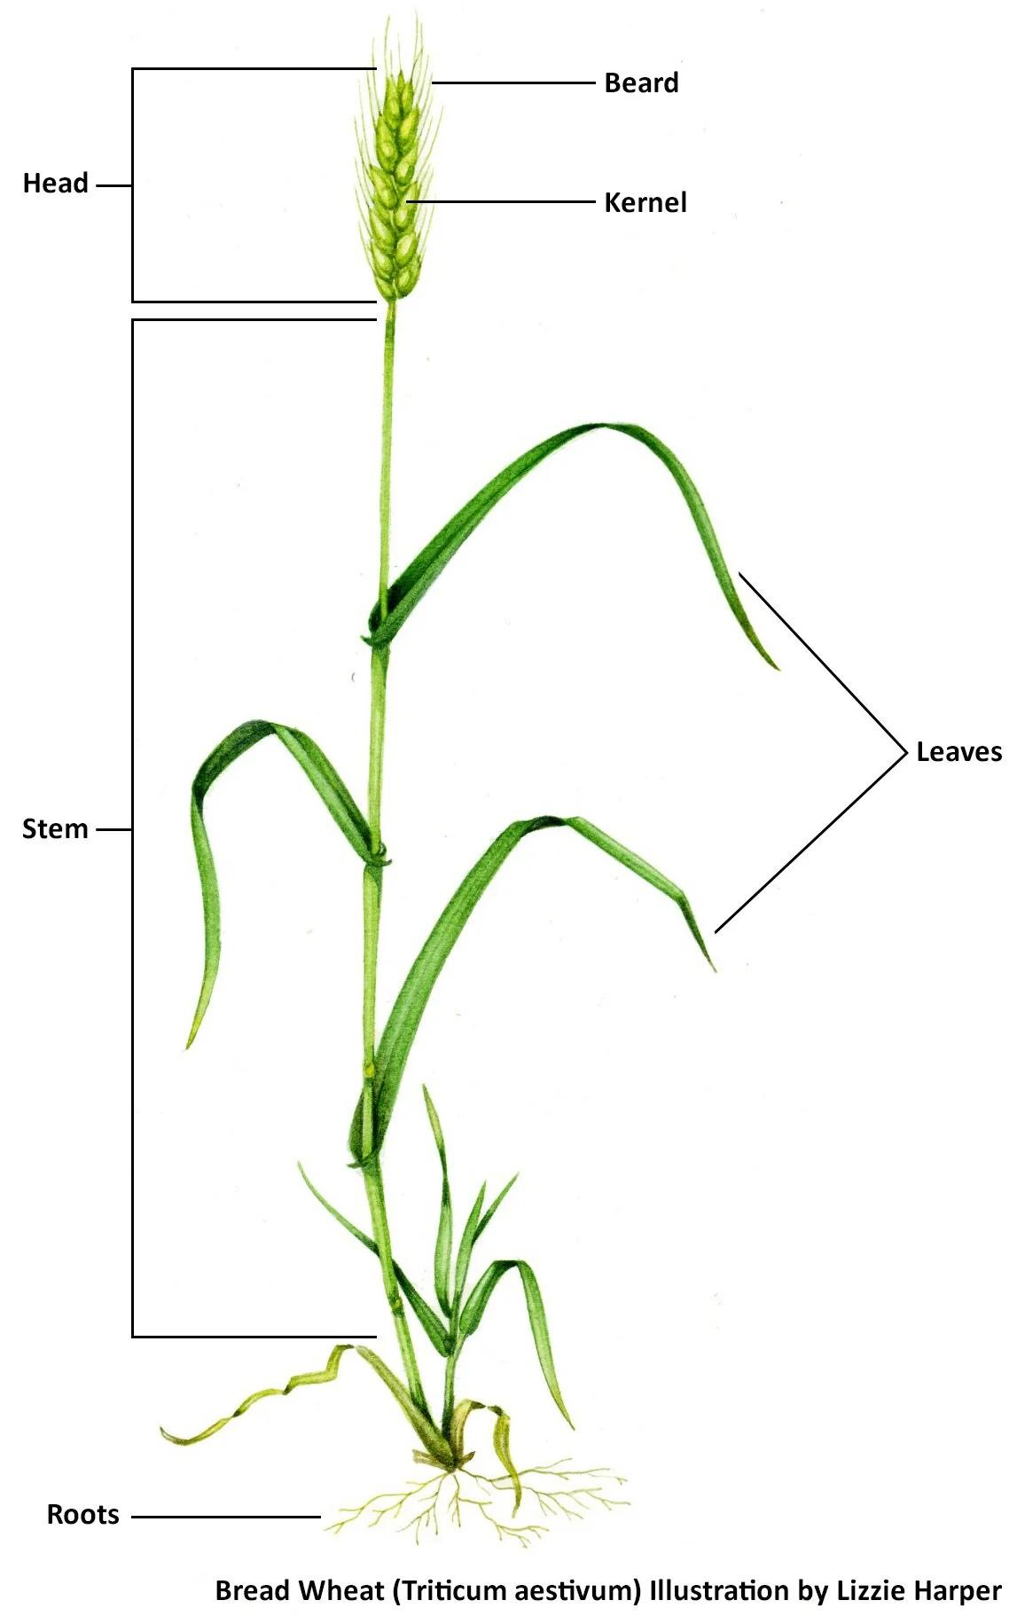
Parts of the Wheat Plant

Slide 8
Parts of Wheat Plant Vocabulary
Head: The part of the plant where the kernels develop. The head contains 16-24 spikelets, which produce 2-3 kernels each.
Beard: The bristly spike that protects the seed kernel. Some wheat varieties do not have a beard. The beard may also be called the awn.
Kernel: The main part of the wheat plant. The kernel, also called the seed, can be planted to grow new wheat plants, used for human use in food and other products or used as animal feed.

Slide 9
Parts of Wheat Plant Vocabulary
Stem: The stem supports the wheat plant and transports water and nutrients. It is also called the stalk. After harvesting the kernels, the stem can be used for animal bedding (usually called straw).
    - Stems left in the field provide excellent protection to the soil, acting as a dead cover crop.
      - Cover crops are important to conservation by capturing moisture and preventing wind from eroding soil.
Leaves: Plants rely on photosynthesis to convert sunlight into energy. Leaves also help the wheat plant collect water.
Roots: Wheat has a fibrous root system, meaning there are numerous, shallow roots that anchor the plant in the soil and absorb water and nutrients.

Slide 10
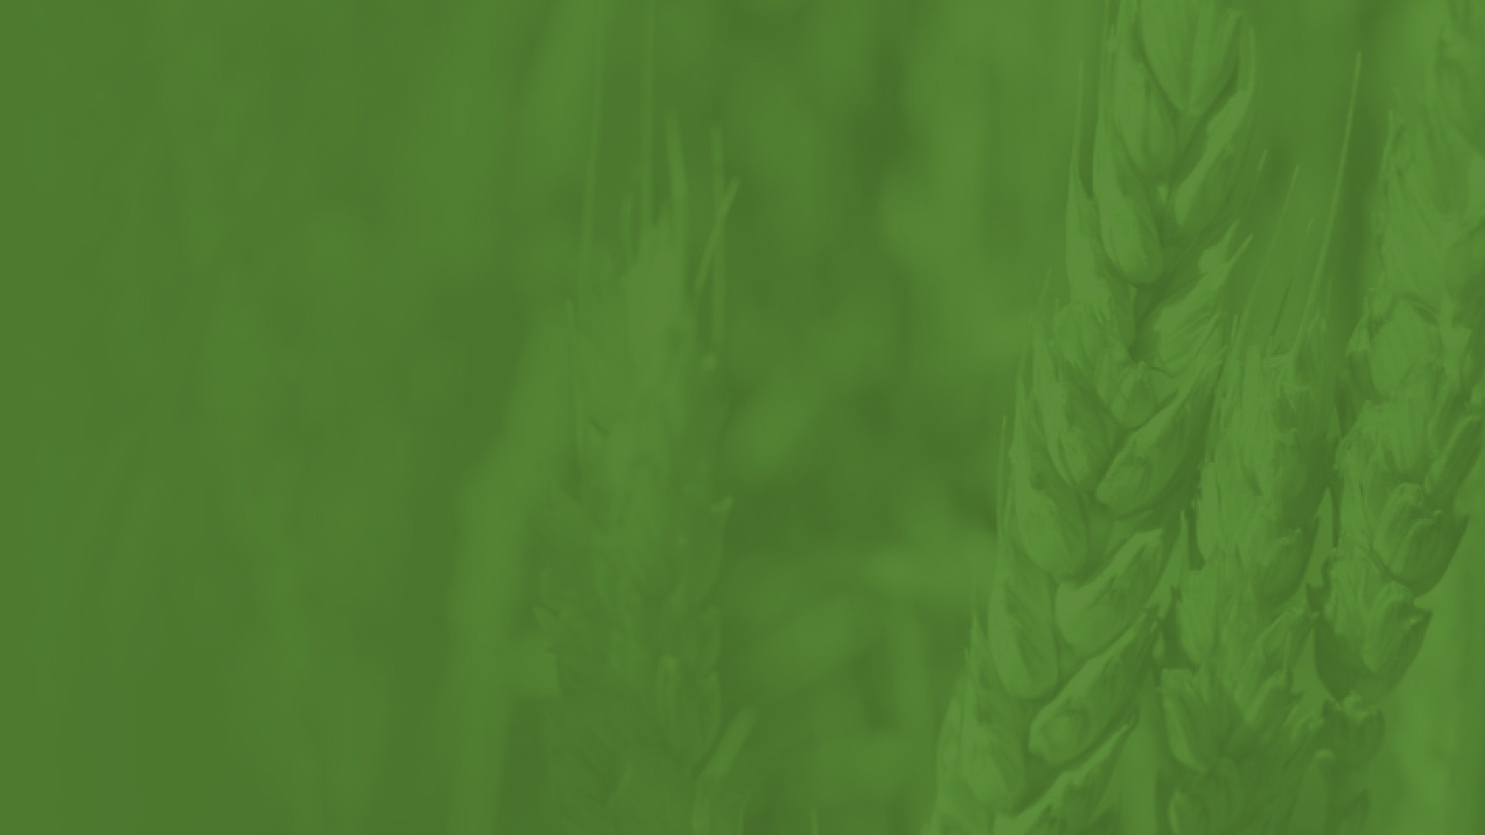
The Wheat Kernel

Slide 11
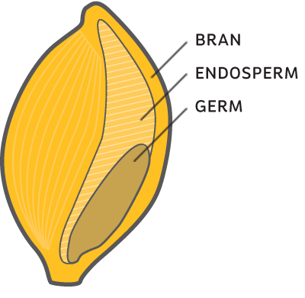
Parts of the Wheat Kernel

Slide 12
Parts of Wheat Kernel Vocabulary
Bran: The outermost protective layer of the wheat kernel is rich in fiber and nutrients and makes up approx. 14.5% of the kernel weight. It is separated during milling to produce refined flour. The bran layers are included in whole wheat flour and can also be sold separately.
Endosperm: The starchy middle layer of the wheat kernel makes up approx. 83% of the weight. It is ground into flour and contains carbohydrates, protein and vitamins. White flour is composed of the endosperm.
Germ: The nutrient-dense embryo of the wheat plant makes up approx. 2.2% of the kernel weight. While it is important for plant growth, it is not included in enriched flour because it can limit shelf life due to high fat content.

Slide 13
Protecting the Wheat Kernel
The kernel is not exposed prior to harvest.
The kernel is encased in the glume, which covers the kernel to protect it from the elements and keeps it attached to the head until harvest.
During harvest, the threshing process separates the glumes from the kernels.
The glume is not present in any type of flour, including whole wheat flour.

Slide 14
Stages of Growth

Slide 15
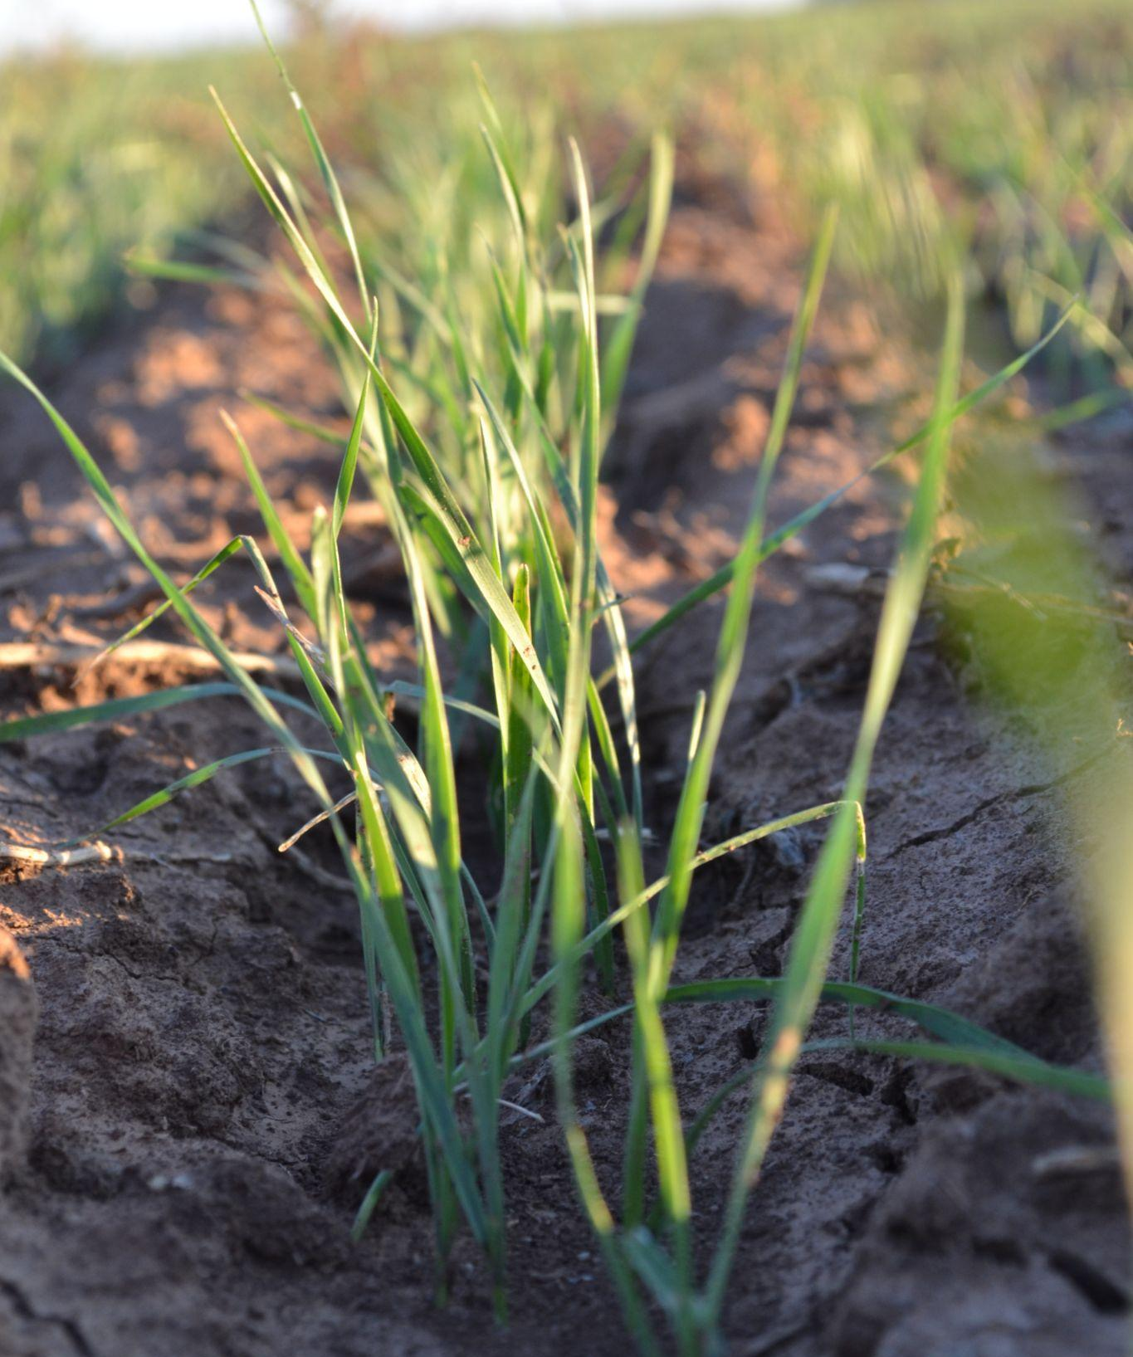
Timeline for Winter Wheat
Planting (September - December)
    - Farmers plant winter wheat in late fall and try to plant as close to rainfall as possible to give the seed moisture to kickstart growth.
    - Farmers who use wheat to graze cattle will plant early in the fall.
Germination & Emergence
- The wheat seed will germinate as seed absorbs water and emerge from the soil roughly 7-10 days after planting.
Tillering
- The wheat plant develops tillers, which are additional stems that grow from the main stem of the wheat plant. Tillers are essential for yield and helps the crop survive dormancy during the winter.
Wheat in tillering stage.

Slide 16
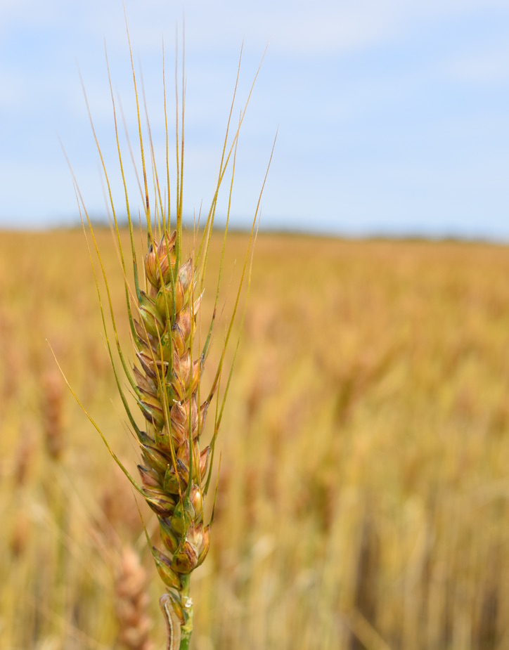
Timeline for Winter Wheat
Dormancy
    - As temperatures drop (around 32°F), winter wheat goes dormant and growth stops above ground while the roots continue to develop underneath the soil.
    - Most varieties need 3-6 weeks of temperatures between 32-45 °F. This is called vernalization.
Regrowth (Spring “Green Up”)
- When temperatures rise, active growth resumes. Tillering will start again, the stem will elongate and leaves will expand.
Reproductive Stages
- The wheat plant will head out, flower and the kernels (the grain) will begin to fill and then harden.
Maturation & Harvest (April - June)
- Kernels mature and then will dry out ahead of harvest.
Wheat drying out ahead of harvest.

Slide 17
Measuring Wheat Growth
There are several scales used to measure the growth of wheat, but one of the most common in the U.S. is the Feekes scale.
The Feekes scale has 11 stages that describe the plant’s development from emergence to maturity. The main stages are:
- Tillering & Leaf Development
- Stem Elongation
- Heading & Flowering
- Grain Filling
- Ripening
Farmers and scientists use scales to better understand crop development and to know when to apply inputs, such as fertilizer, to maximize yield.
Wheat has officially entered a level of growth once 50% of the primary tillers reach the new growth stage.

Slide 18
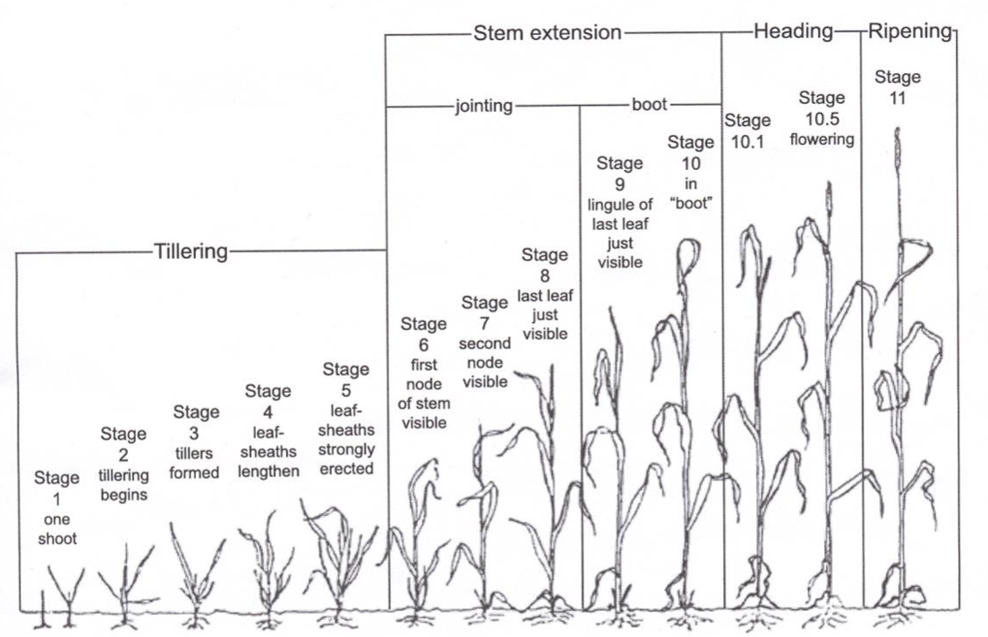
Feekes Scale of Wheat Development
Photo courtesy of Texas A&M AgriLife Extension

Slide 19
Feekes Scale - Tillering
Stage 1 - The wheat plant emerges from the soil.
Stage 2 - Tillers, which are additional stems that grow from the main stem of the wheat plant, begin to emerge.
Stage 3 - Tillers become fully formed and leaves may twist spirally.
Stage 4 - Most tillers are formed and the secondary root system begins to form while the leaves grow larger.
Stage 5 - The wheat plant begins to stand up straighter and the head begins to develop.
Photo courtesy of Texas A&M AgriLife Extension

Slide 20
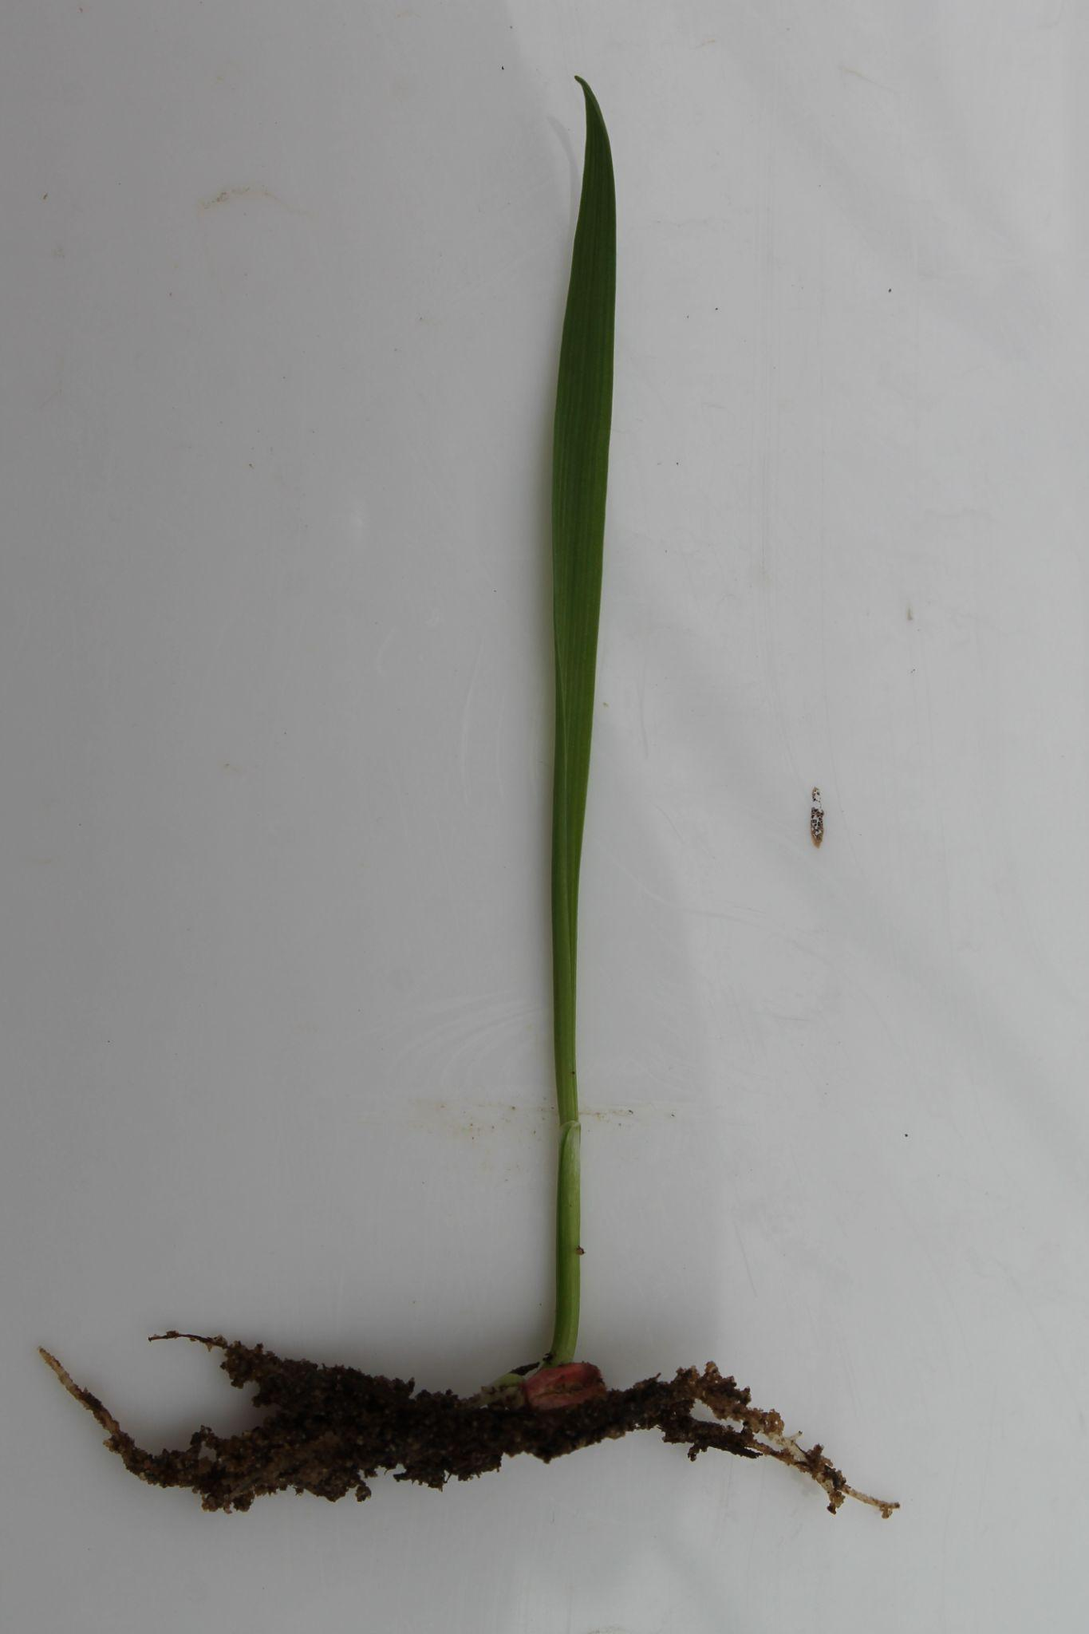
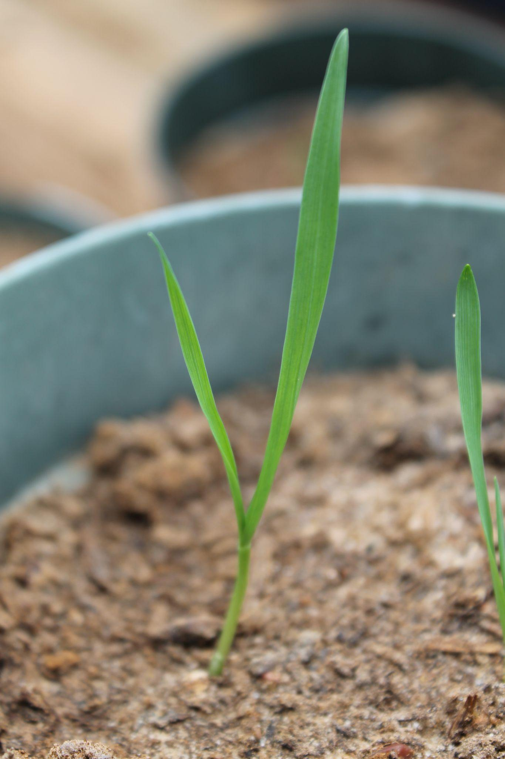
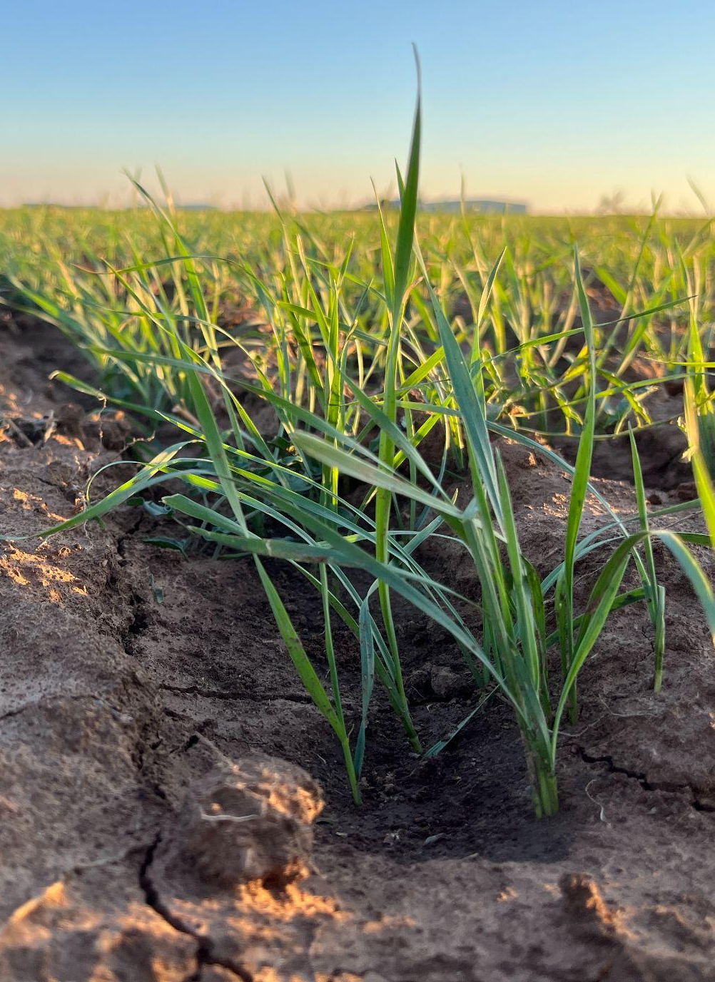
Feekes Scale - Tillering
Stage 1 - The wheat plant emerges from the soil.
Photo courtesy of Brandon Gerrish.
Stage 2 - Tillers, which are additional stems that grow from the main stem of the wheat plant, begin to emerge.
Photo courtesy of Brandon Gerrish.
Stage 3 - Tillers become fully formed and leaves may twist spirally.

Slide 21
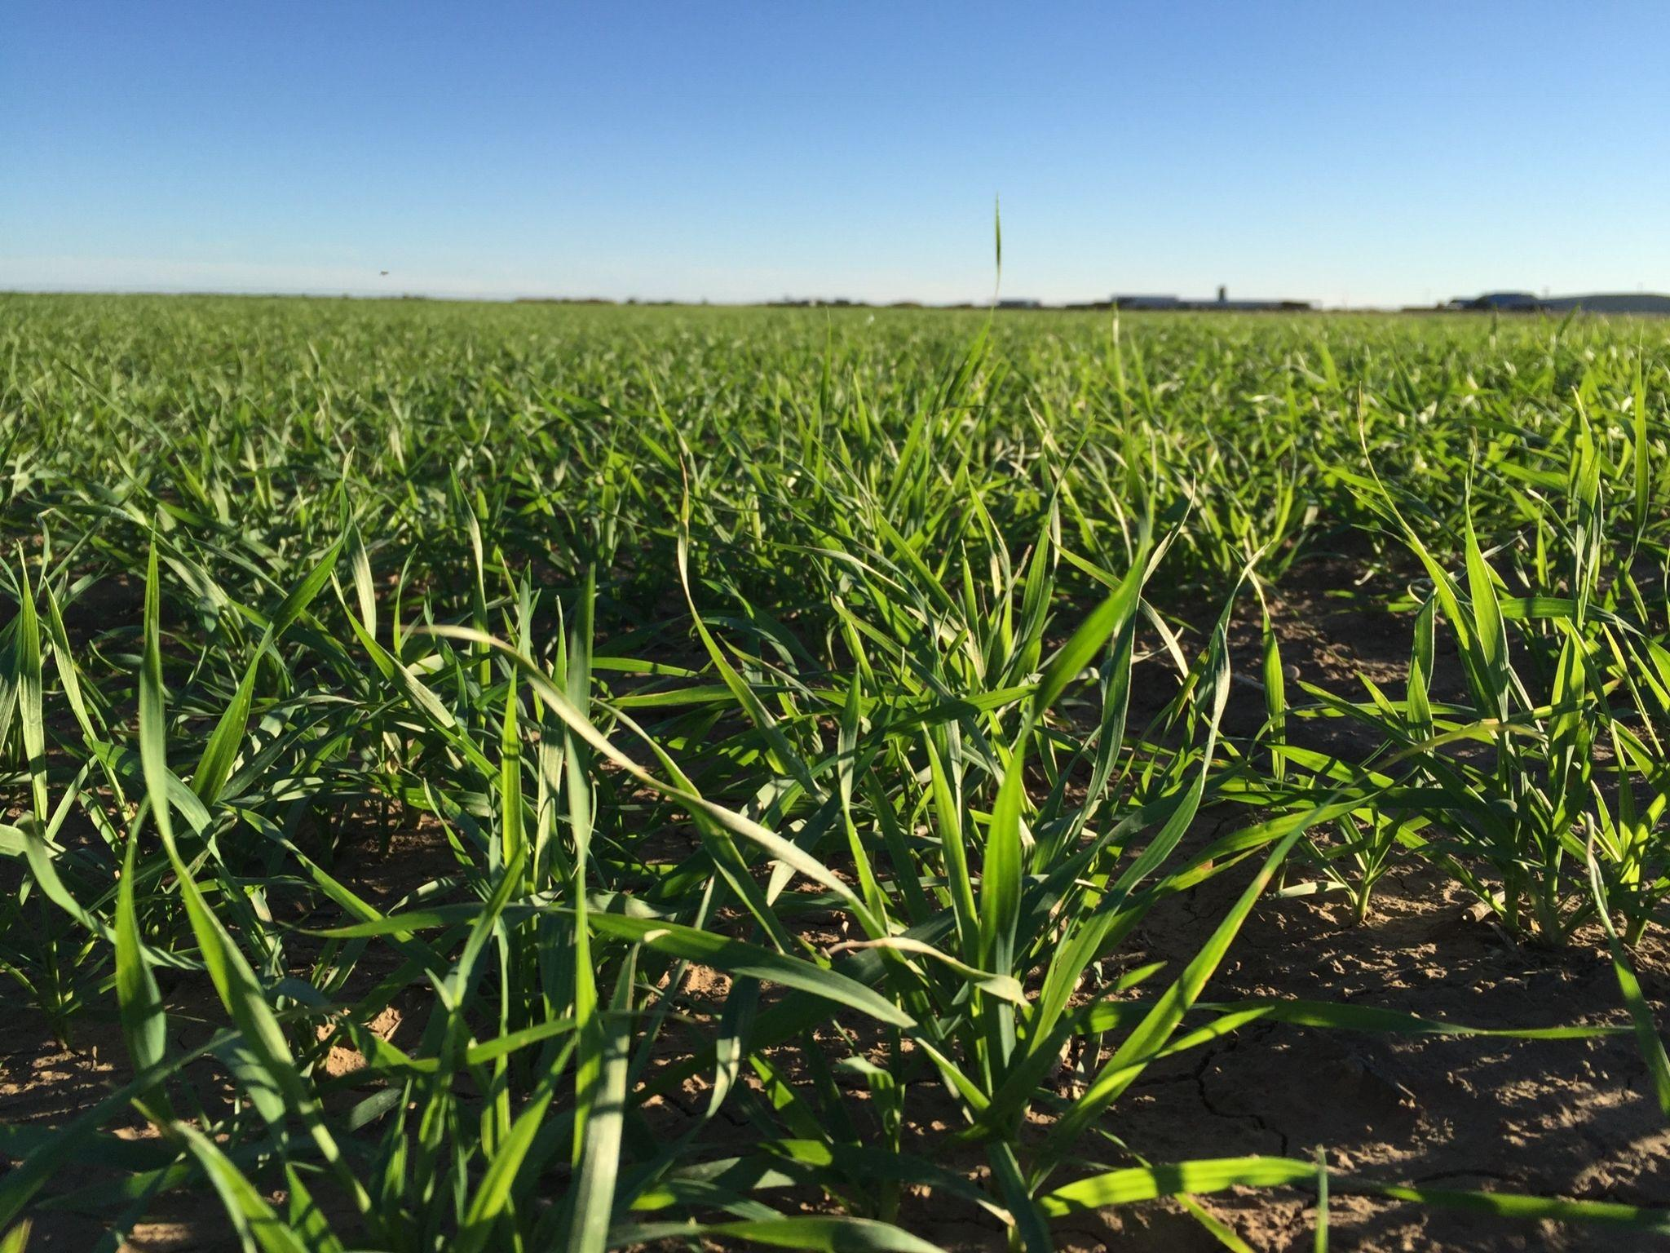
Feekes Scale - Tillering
Stage 4 - Most tillers are formed and the secondary root system begins to form while the leaves grow larger.
Stage 5 - The wheat plant begins to stand up straighter and the head begins to develop.
It is very difficult to see the difference between Feekes 4 and 5 without extensive analysis.

Slide 22
Feekes Scale - Stem Extension
Stage 6 - The first node, which is a bump or joint in the stem, can be seen above the soil and no more tillers will grow.
Stage 7 - The next node appears higher up on the stem.
Stage 8 - The last leaf, known as the flag leaf, unfolds. The flag leaf is usually larger than other leaves and is near the top of the plant.
  - This can be confirmed with a knife to split the leaf sheath above the highest node.
Stage 9 - The flag leaf fully unfolds.
Stage 10 - The head, which contains the kernels, swells inside the “boot” (the flag leaf sheath, which connects the flag leaf to the stem).
Photo courtesy of Texas A&M AgriLife Extension

Slide 23
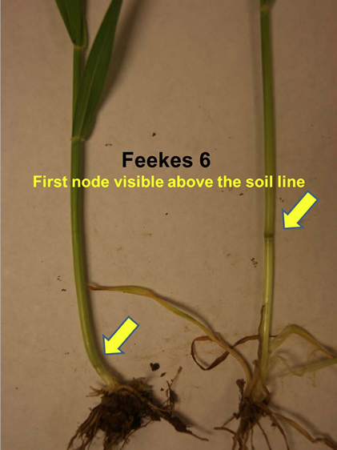
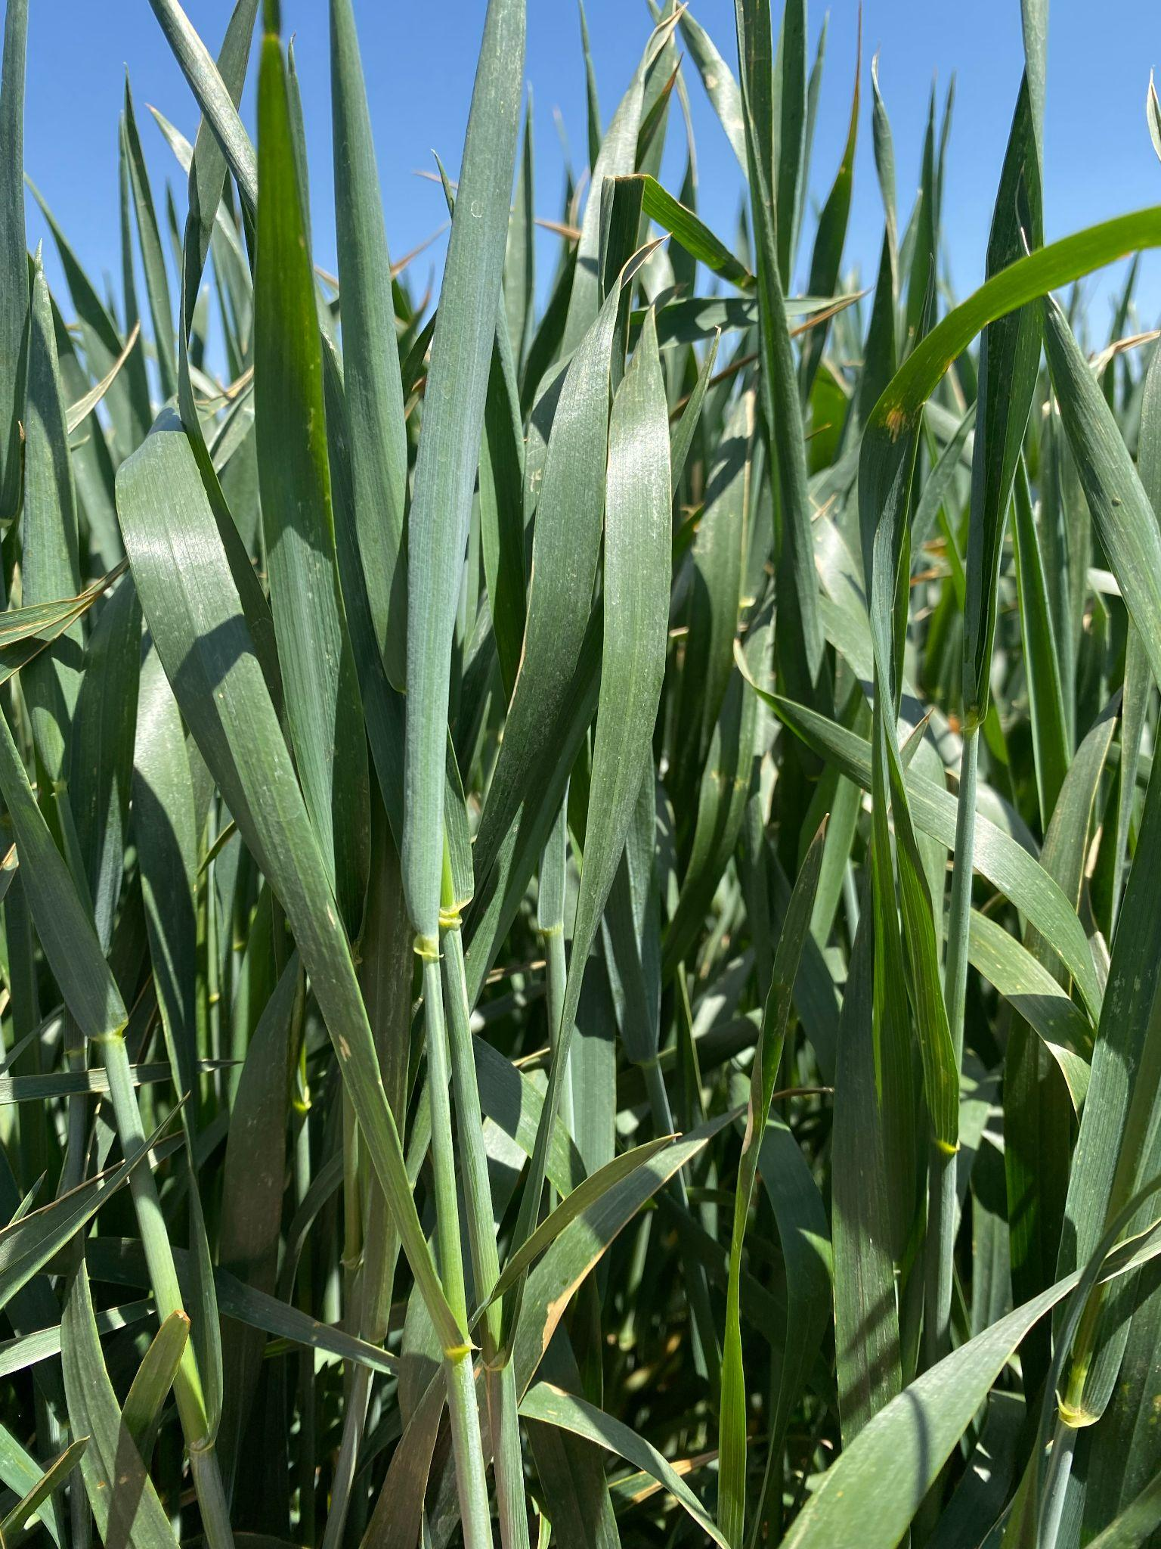
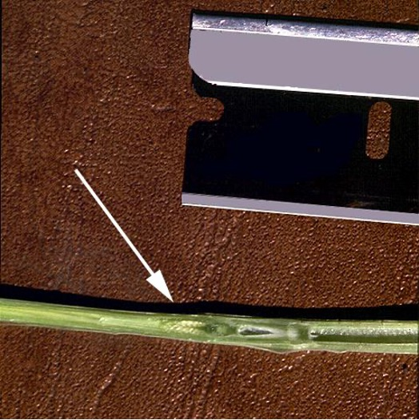
Feekes Scale - Stem Extension
Stage 6 - The first node, which is a bump or joint in the stem, can be seen above the soil and no more tillers will grow.
Photo courtesy of Paul Pierce.
Stage 7 - The next node appears higher up on the stem.
Photo courtesy of Calvin Trostle.
Stage 8 - The last leaf, known as the flag leaf, unfolds. The flag leaf is usually larger than other leaves and is near the top of the plant. Photo courtesy of Jourdan Bell.

Slide 24
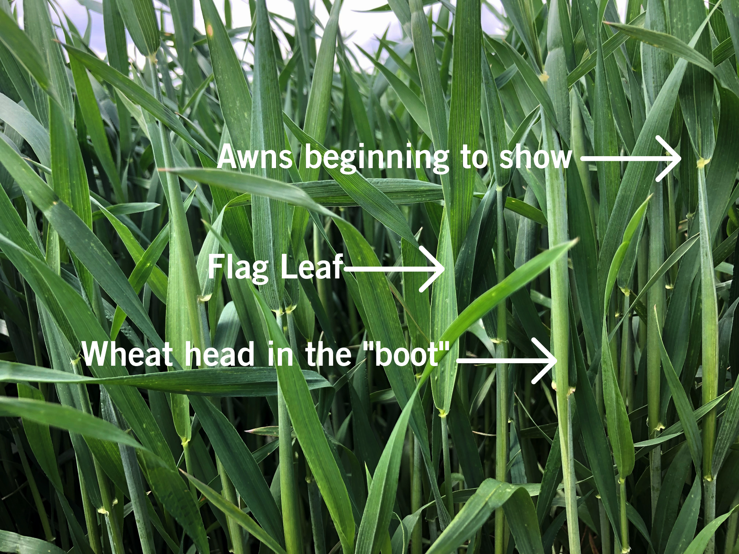
Feekes Scale - Stem Extension
Stage 9 - The flag leaf fully unfolds.
Stage 10 - The head, which contains the kernels, swells inside the “boot.”
Photo courtesy of Jourdan Bell.

Slide 25
Feekes Scale - Heading
Stage 10.1 - The very tip of the beard, also known as the awn, begin to poke out.
Stage 10.3 - Half of the head is visible.
Stage 10.5 - The head fully emerges.
Stage 10.5.1- Flowering (tiny yellow flowers) begin in the middle of the head.
Stage 10.5.2 - Flowering is complete at the top of the head.
Stage 10.5.3 - Flowering finishes at the bottom of the head.
Stage 10.5.2 - The wheat kernels are “watery ripe.”
Photo courtesy of Texas A&M AgriLife Extension

Slide 26
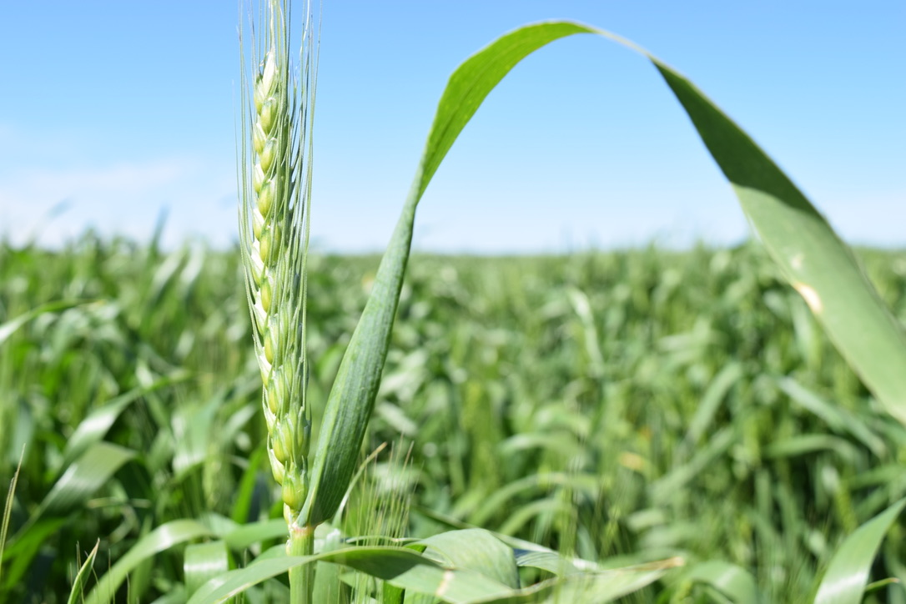
Feekes Scale - Heading
Stage 10.5 - The head fully emerges.

Slide 27
Feekes Scale - Ripening
Stage 11.1 Milky Ripe- The kernels are filled with milky, white fluid.
Stage 11.2 Mealy Ripe - The kernels are soft like dough if pressed.
Stage 11.3 Kernel Hard - The kernels harden and cannot be smashed with a thumbnail. This means the plant is almost ready for harvest.
Stage 11.4 Harvest Ready - The wheat kernels are dry (about 15% moisture) and the plant turns golden brown.
Photo courtesy of Texas A&M AgriLife Extension

Slide 28
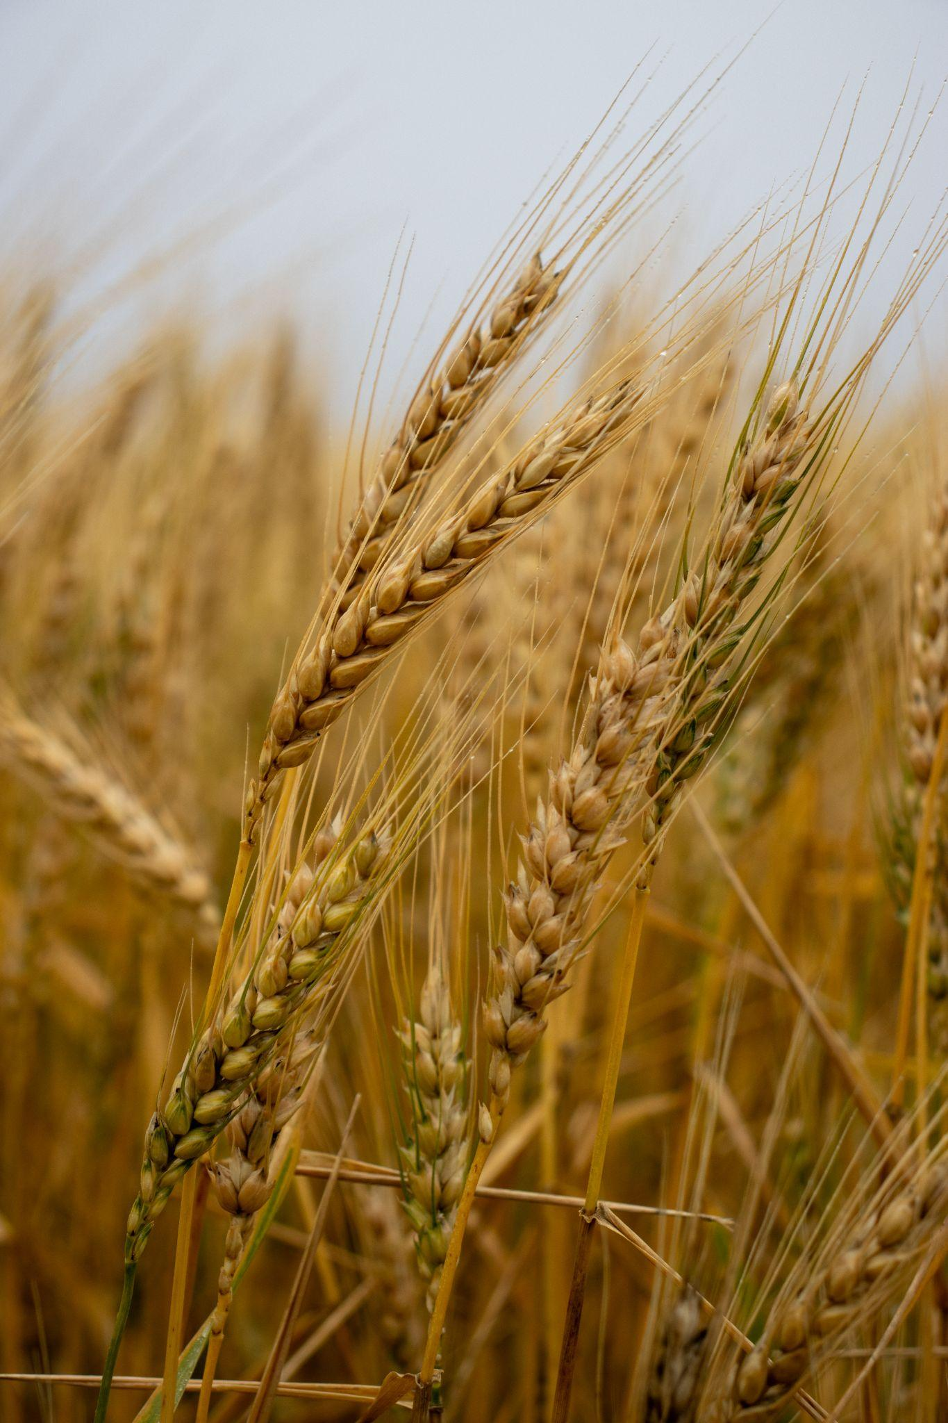
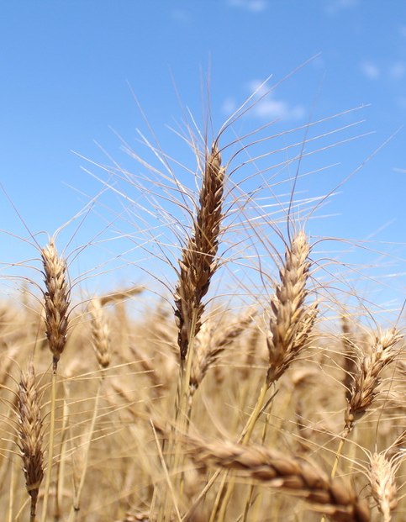
Feekes Scale - Ripening
Stage 11.2 - If pressed, the kernels feel soft like dough.
Stage 11.4 - The wheat kernels are dry and the plant turns golden brown.

Slide 29
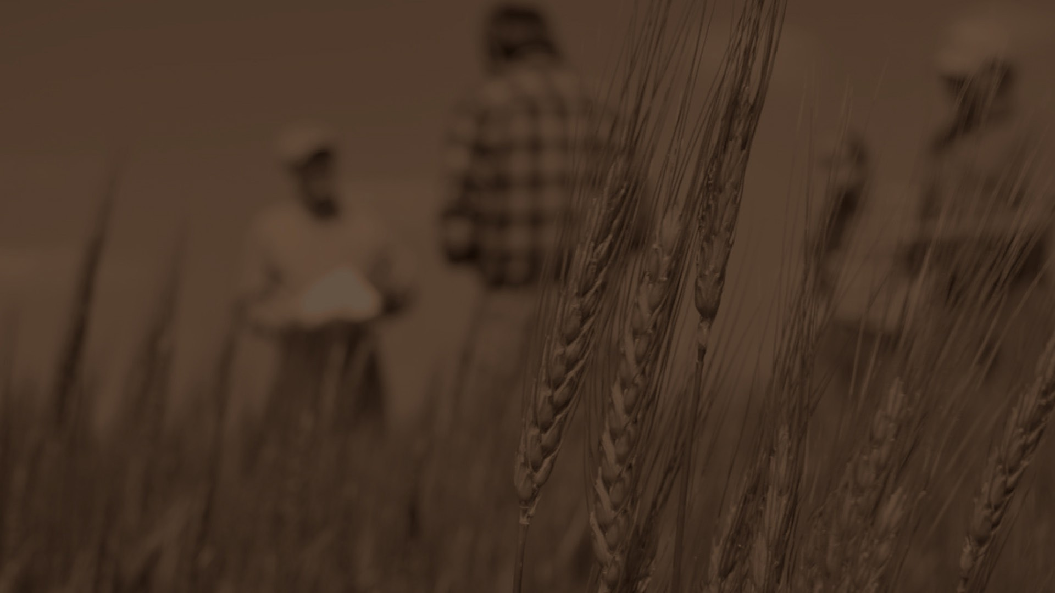

Sources:
Texas A&M AgriLife Extension
  https://agrilifeextension.tamu.edu/library/gardening/essential-nutrients-for-plants/
National Geographic Education
  https://education.nationalgeographic.org/resource/photosynthesis/
Texas A&M AgriLife Extension
  https://agrilifeextension.tamu.edu/library/gardening/essential-nutrients-for-plants/
Texas A&M AgriLife Extension
  https://pathtotheplate.tamu.edu/youth/food/wheat/
Eat Wheat
  https://eatwheat.org/learn/wheat-kernels/
Oklahoma State Extension
  https://extension.okstate.edu/fact-sheets/glyphosate-use-as-a-pre-harvest-treatment-not-a-risk-to-food-safety.html
Texas A&M AgriLife Extension
  https://texaswheat.org/wp-content/uploads/2018/05/07-30-17WinterWheatMgmtCalendar-ESC-048.pdf
Texas A&M Agricultural Extension Service
  https://varietytesting.tamu.edu/wp-content/uploads/sites/17/legacy-files/wheat/docs/mime-5.pdf

Slide 30
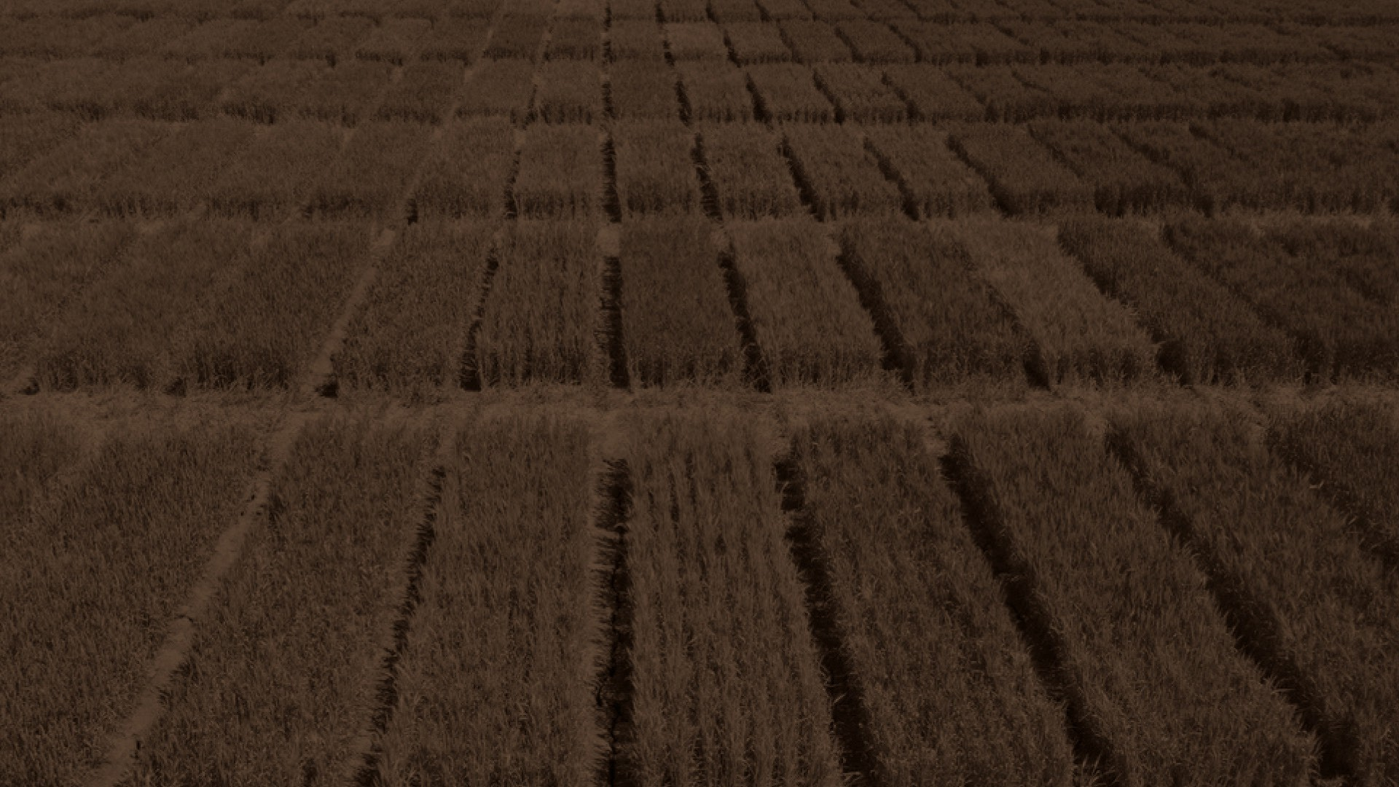
Reviewers:
Ben Scholz
  Wheat Farmer & Texas Wheat Producers Board Director
Jordan Trees Waddle
  Agricultural Science Teacher, Medina Valley High School, Medina Valley ISD
Kyle Miller
  Family & Consumer Science Teacher, Mackenzie Middle School, Lubbock ISD
Rhonda Cantrell
  Retired Elementary Teacher, Texline ISD
Dr. Calvin Trostle
  Professor & Extension Agronomist, Texas A&M AgriLife Extension Service
Cater Wands
  Manager of Technical Sales, Miller Milling

