Slide 1

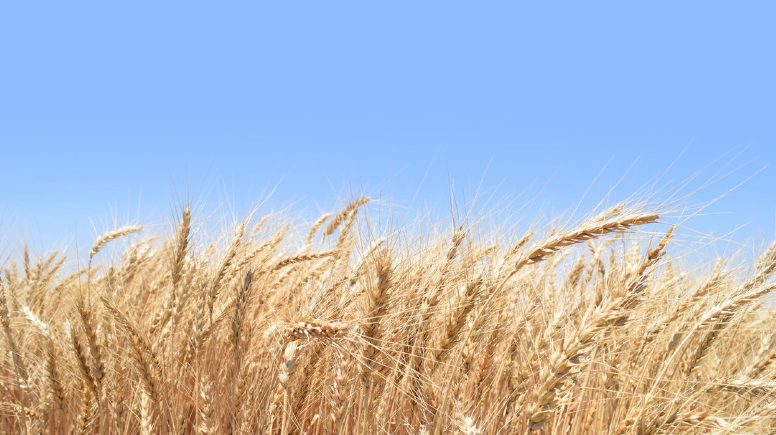
Types of Wheat & Flour

Slide 2

All About Wheat

Slide 3
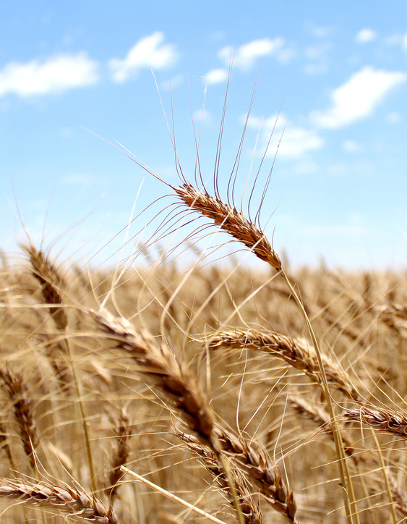
What is Wheat?
Wheat is an ancient cereal grain and is a staple food worldwide.
    - Cereal grains are edible grasses, such as wheat, rice, corn, oats, barley, rye, sorghum (milo) and millet.
Wheat is the main food grain produced in the U.S. It is grown in more than 40 states across the country.
Most of the wheat grown in the U.S. is used for flour, but wheat has many other uses, including non-food products for human use and feed for livestock.
Wheat is known as one of the most sustainable crops because of its water and nitrogen efficiency.
Mature wheat

Slide 4
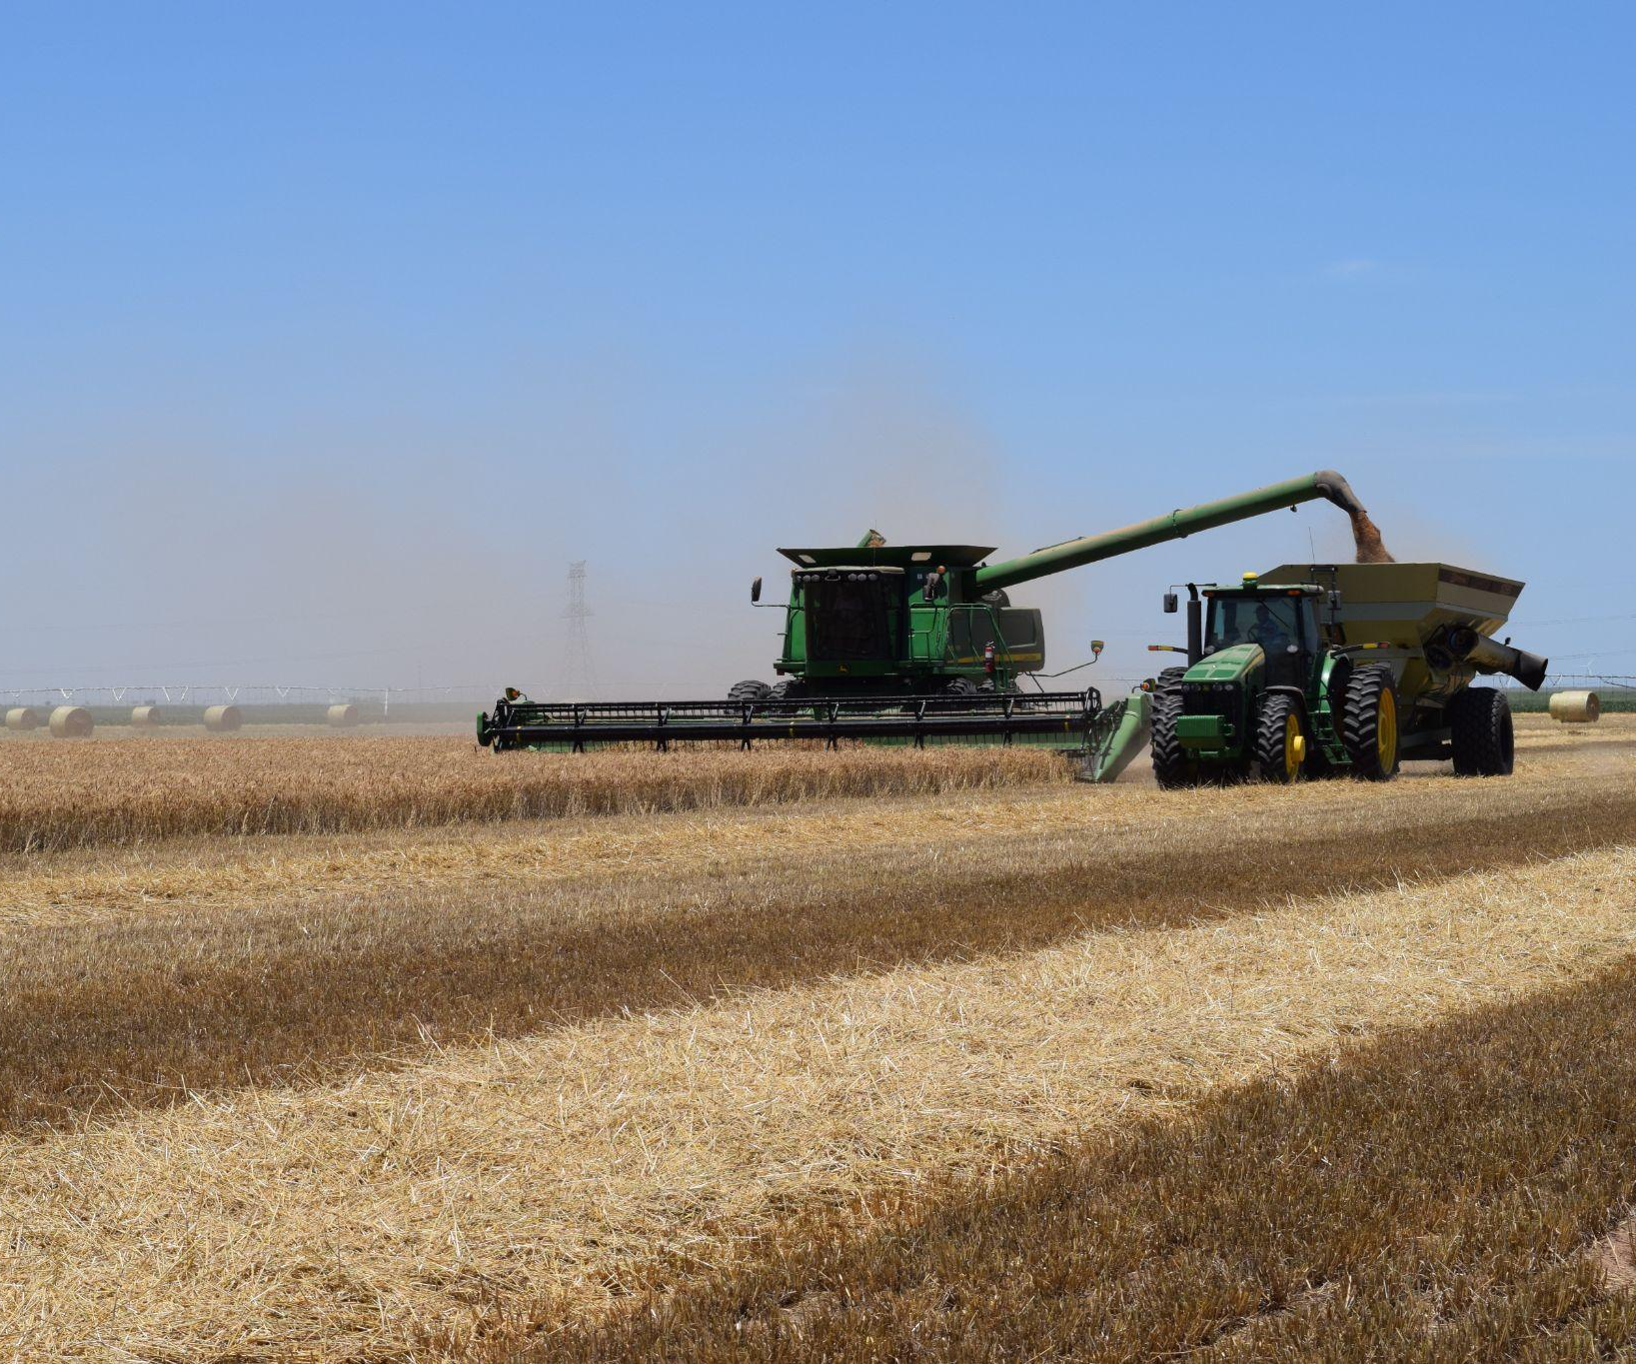
Wheat in Texas
Texas is one of the top producing wheat states in the U.S.
    - In 2025, Texas ranked 3rd in the nation for number of acres planted and 7th for bushels produced.
About 60% of the wheat grown in Texas is grazed by cattle or harvested for wheat silage (sometimes called wheatlage). The remaining 40% is harvested for grain.
Roughly half of the wheat grown in the U.S. is consumed domestically, while the other half is sold internationally.
85% of the wheat grown in Texas is hard red winter (HRW) wheat, 10% is soft red winter (SRW) wheat and 5% is other types, including hard red spring (HRS) and white wheats.
HRW wheat being harvested in Texas.

Slide 5
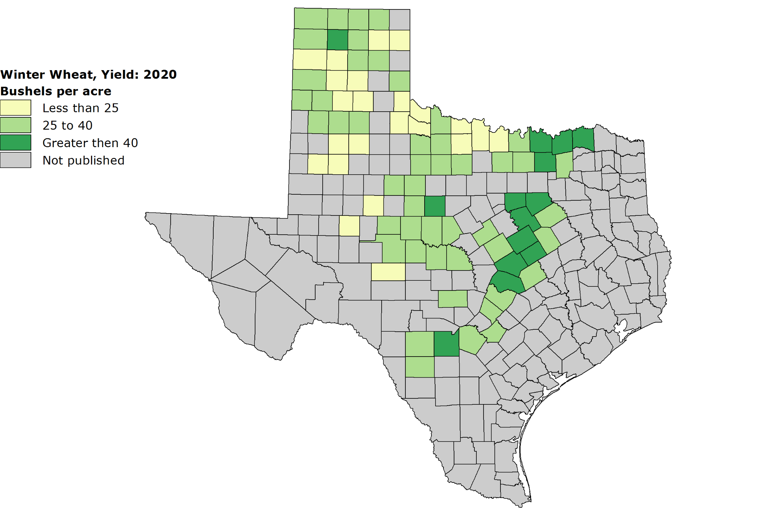
Wheat in Texas
Most wheat grown in Texas is Hard Red Winter Wheat, but farmers in the Blackland Prairies region primarily grow Soft Red Winter Wheat.
Note: 1 bushel = 60 pounds.
Image Source: USDA's National Agricultural Statistics Service
Texas Field Office

Slide 6
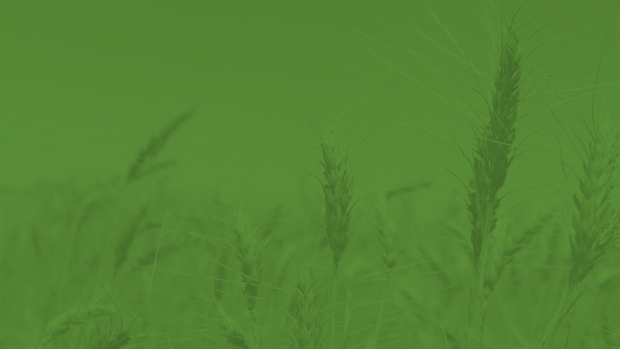
Types of Wheat

Slide 7
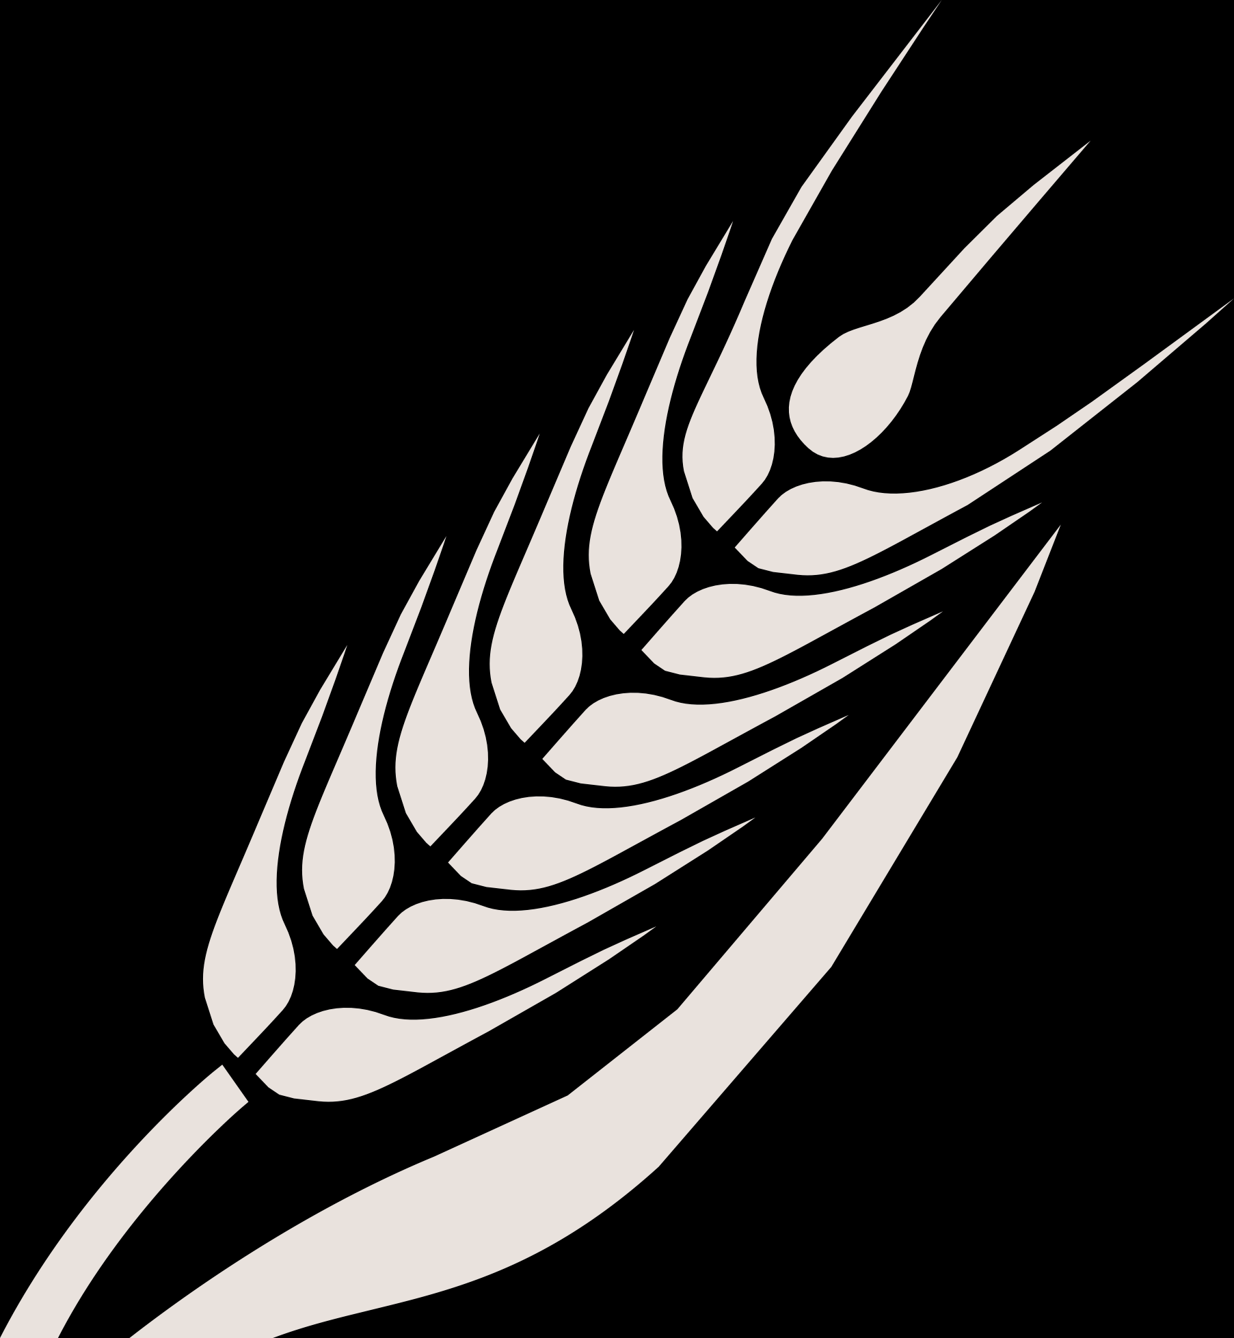
About Wheat Classes
There are six main types, or classes, of wheat grown in the United States.
Each type (or class) has different properties, purposes, kernel color and growing region/season.
The different classes of wheat are used to make different types of flour.
There are hundreds of varieties, but they all fit into the six classes.
A farmer chooses which variety to plant based on geography, moisture, temperature, soil type and market opportunity.

Slide 8
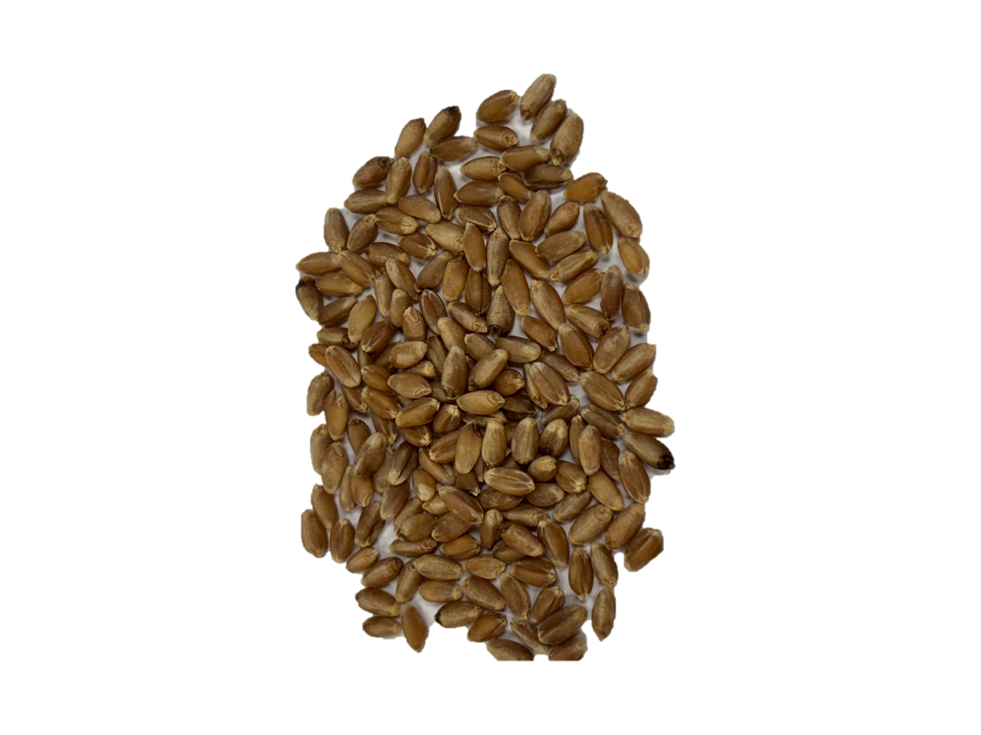
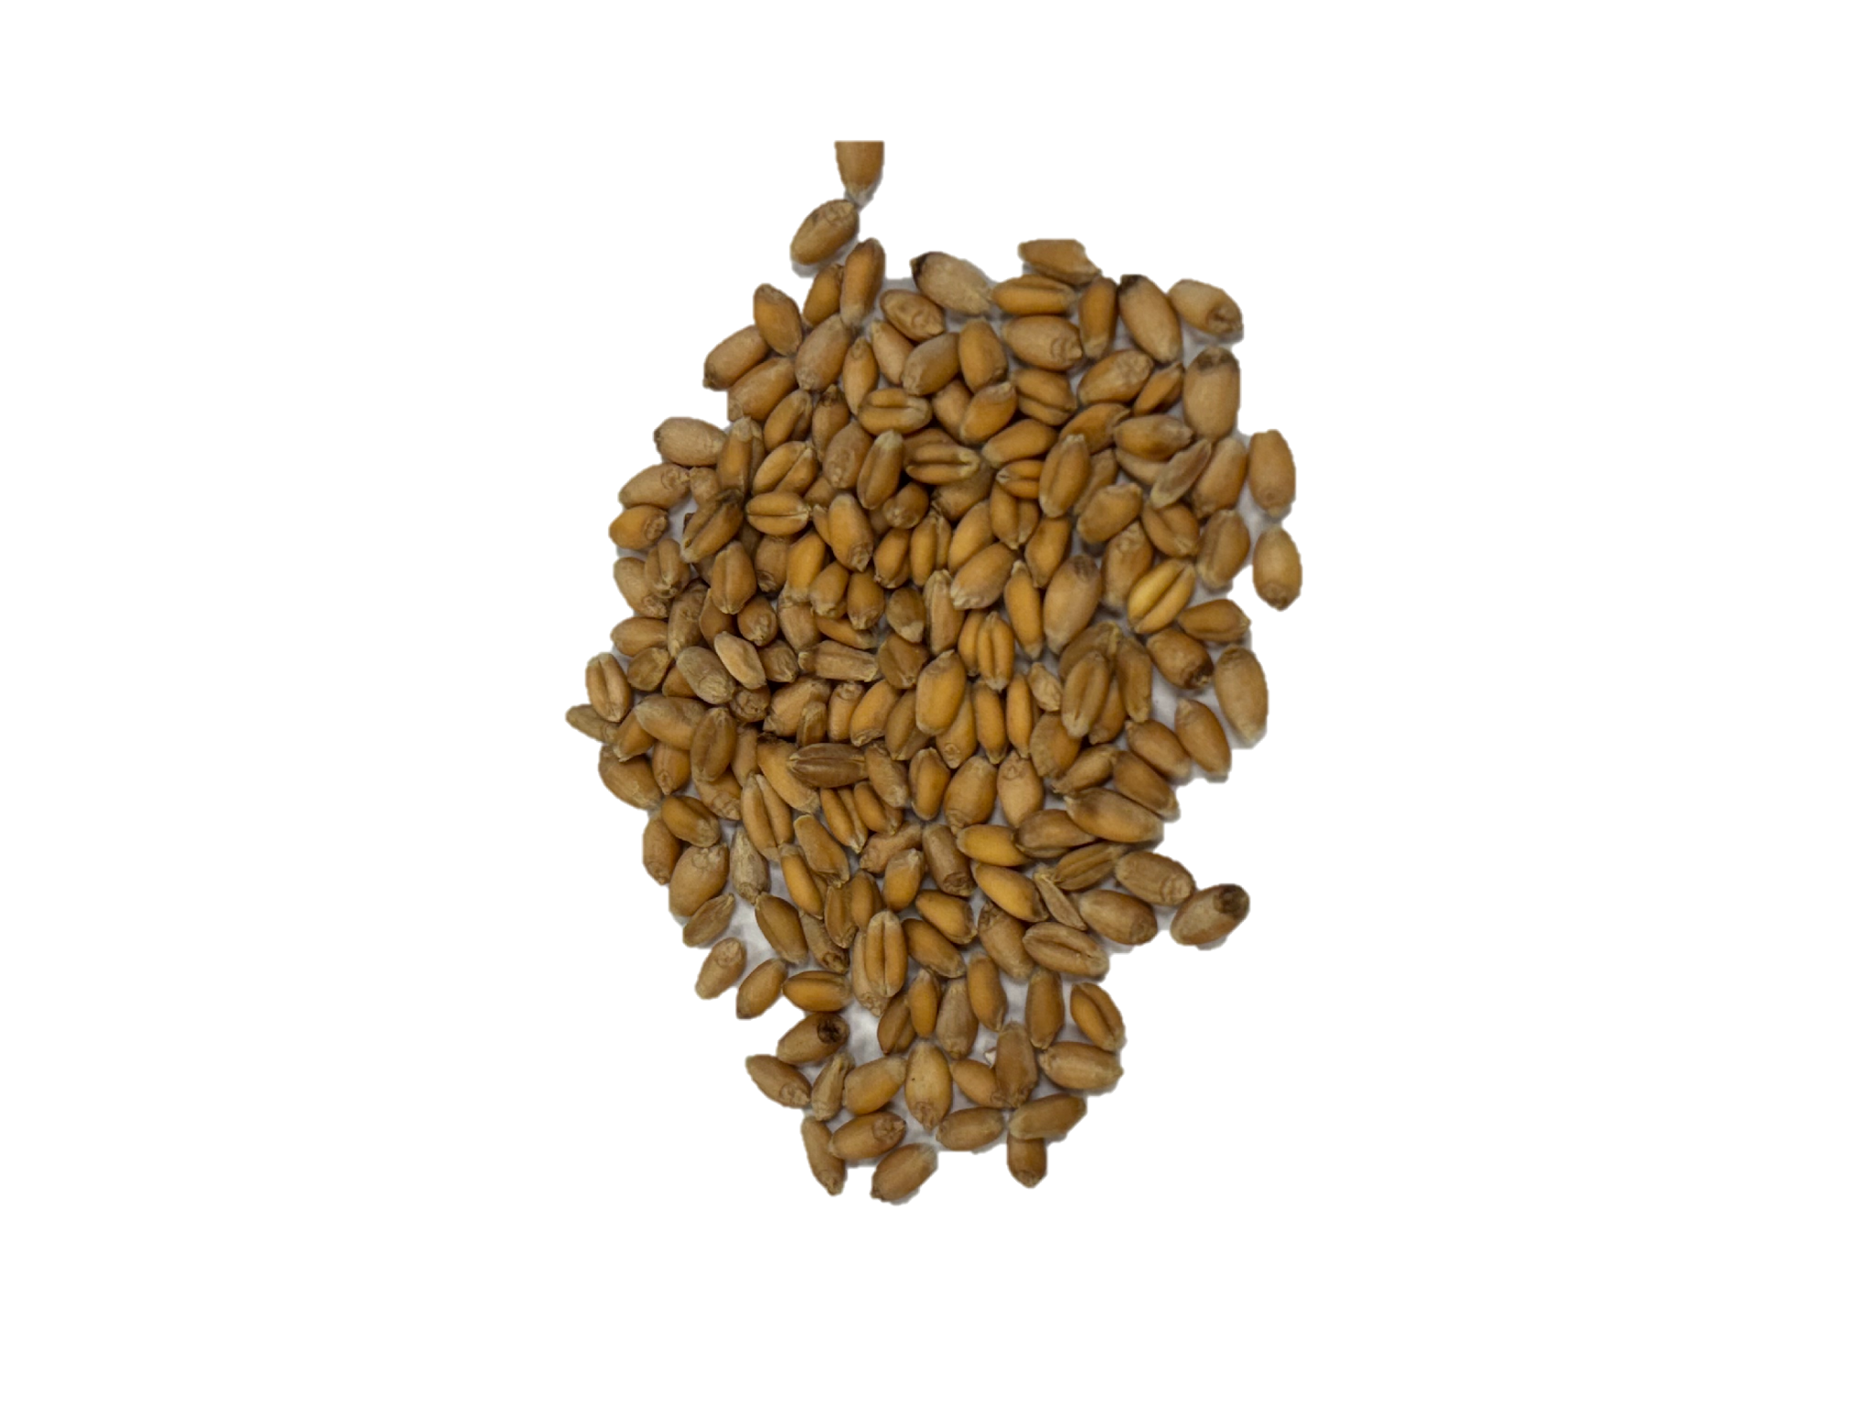
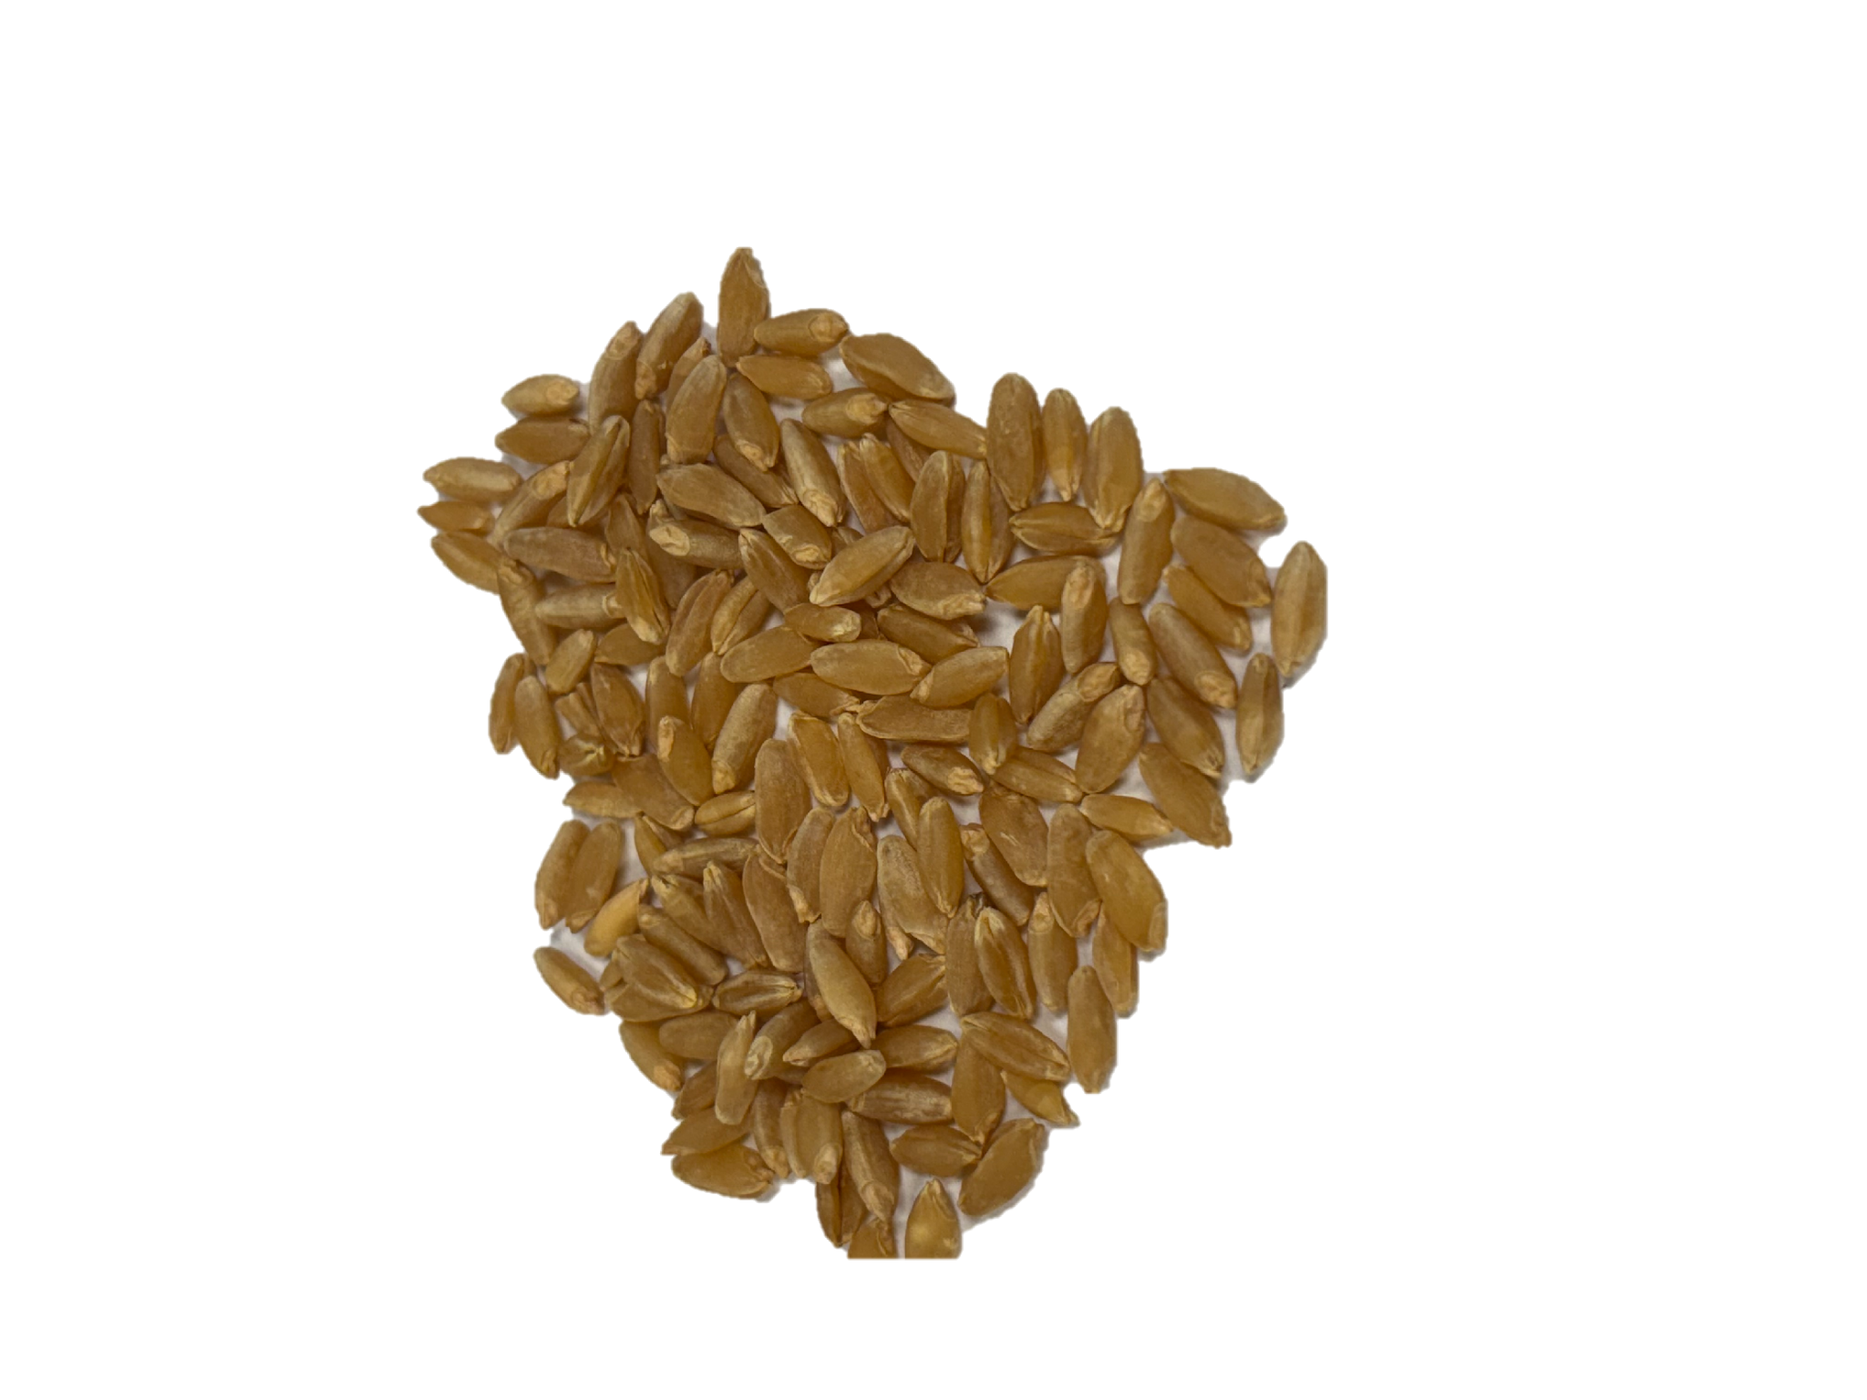
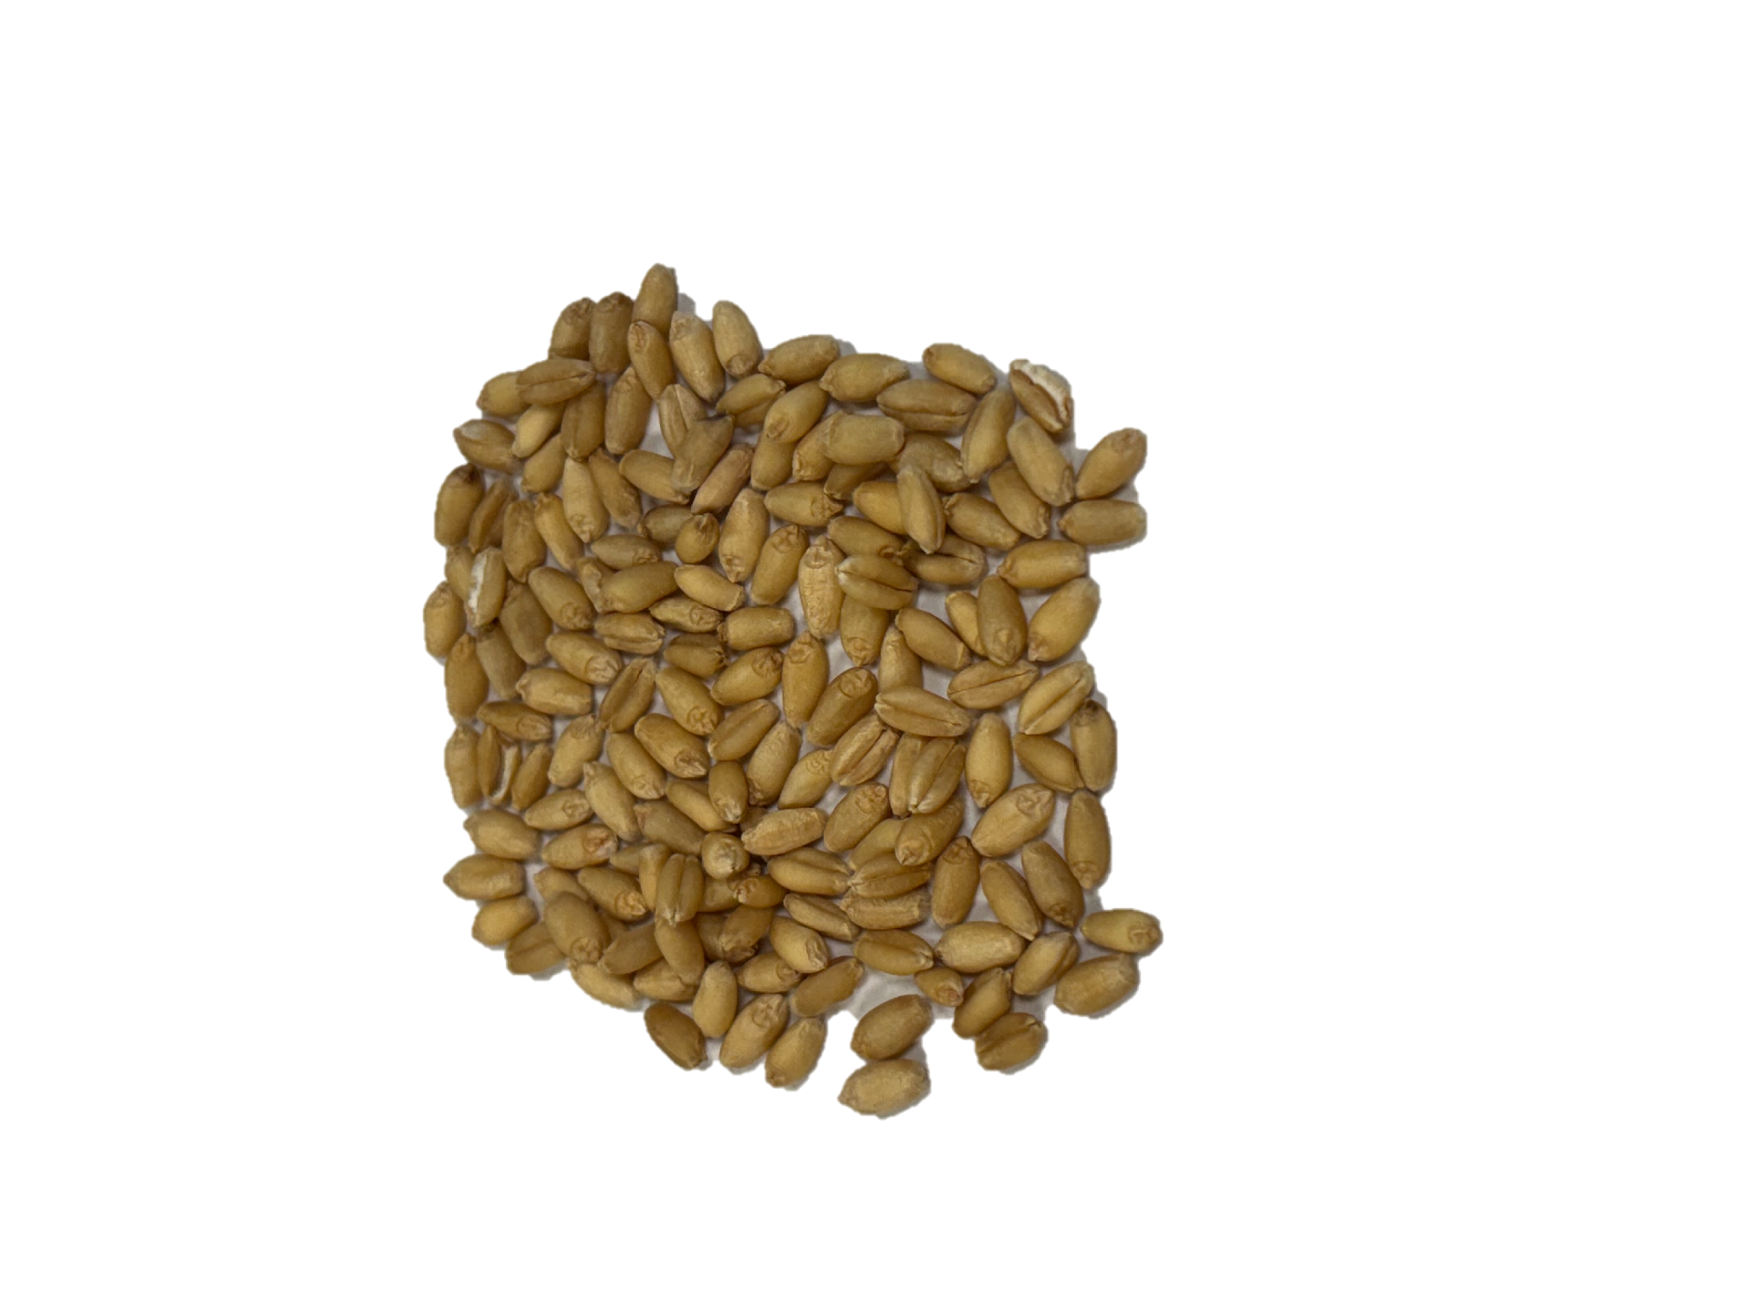
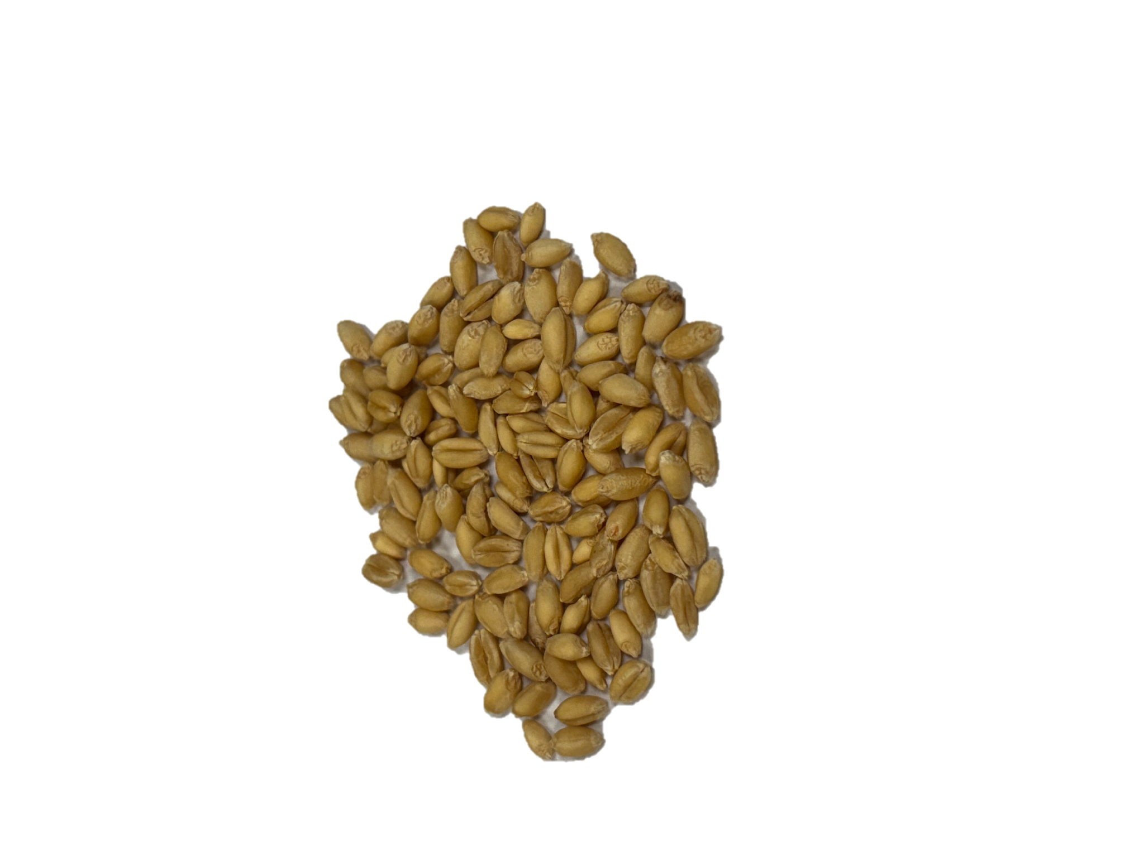
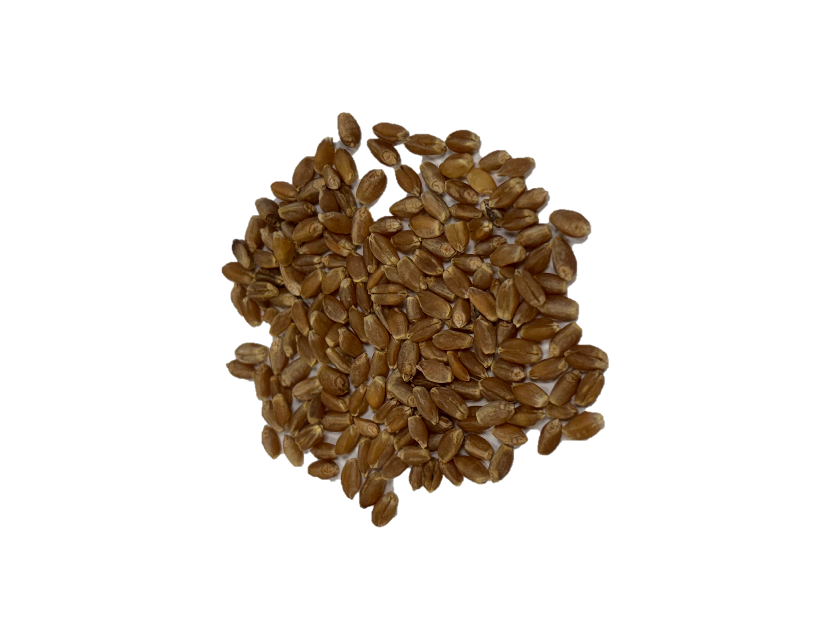
Wheat Family Tree
Wheat Class
Hard Red Winter
Soft Red Winter
Hard Red Spring
Durum
Hard White
Soft White
HRW Varieties
SRW Varieties
HRS
Varieties
Durum
Varieties
HW
Varieties
SW
Varieties

Slide 9
Why Protein Matters
Wheat, and products made from wheat, are great sources of carbohydrates, but the protein content of wheat is especially important for the baking quality of the flour.
The protein gluten gives dough its strength, elasticity and structure.
Flour made from high protein wheat has a more chewy texture (ex. bread or pasta).
Flour made from low protein wheat has a more crumbly texture (ex. cake or cookies).

Slide 10
Hard Red Winter (HRW) Wheat
Main Growing Region: Great Plains
Planting Season: Fall
Harvesting Season: Spring or summer
Characteristics: Excellent for milling and baking
Protein Level: High
HRW wheat kernels

Slide 11
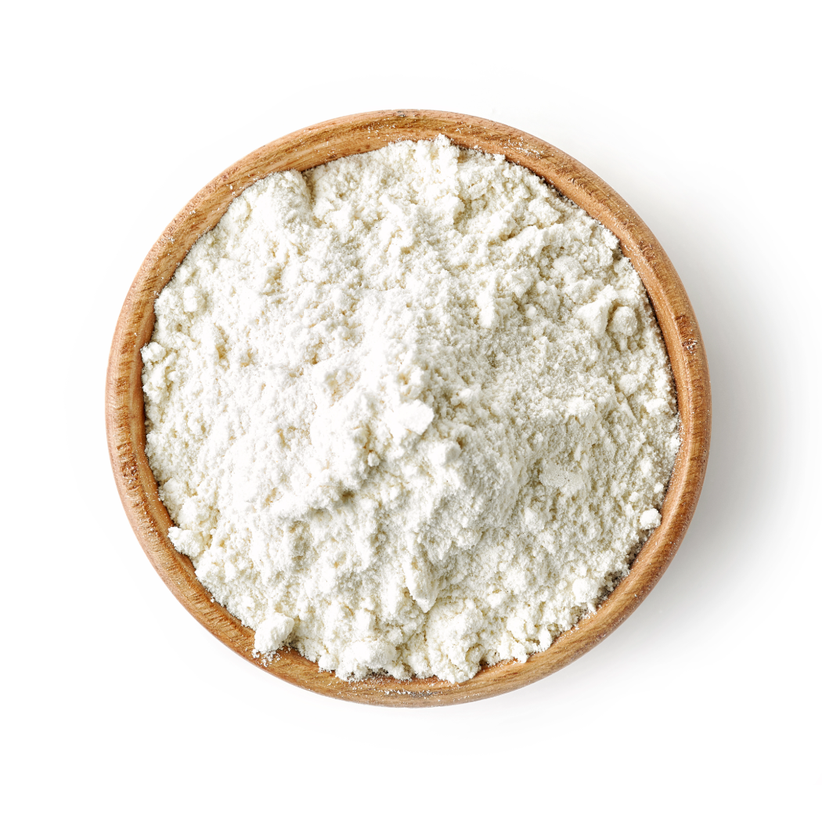
Hard Red Winter (HRW) Wheat
Used For: All-purpose flour, blending with other flours, hearth breads, croissants, hard rolls, flatbreads and Asian noodles
HRW wheat is the base of many flours due to its excellent baking qualities.

Slide 12
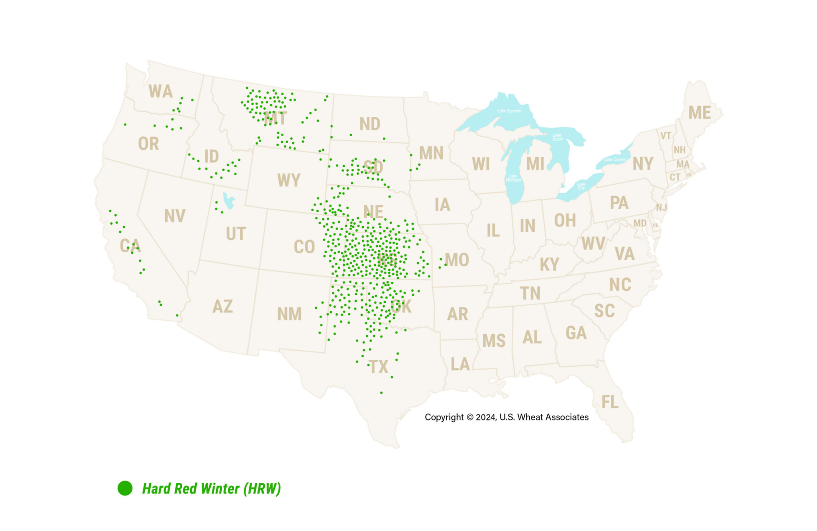
Hard Red Winter (HRW) Growing Regions
HRW is grown in other regions, but the green dots represent the main growing area.

Slide 13
Soft Red Winter (SRW) Wheat
Main Growing Region: Midwest
Planting Season: Fall
Harvesting Season: Spring or summer
Characteristics: Low gluten content
Protein Level: Low
SRW wheat kernels

Slide 14

Soft Red Winter (SRW) Wheat
Used For: Confectionery goods like cookies, crackers, cakes and blending for baguettes and other breads
SRW wheat is used for confectionery products because of its low protein (gluten) content.

Slide 15
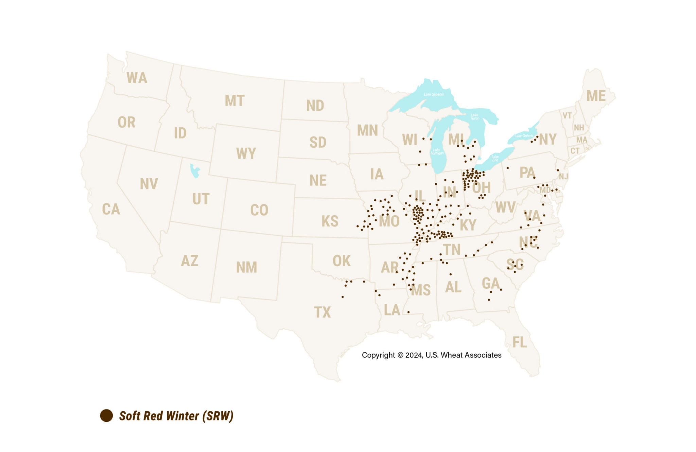
Soft Red Winter (SRW) Growing Regions
SRW is grown in other regions, but the brown dots represent the main growing area.

Slide 16
Hard Red Spring (HRS) Wheat
Main Growing Region: Northern U.S.
Planting Season: Spring
Harvesting Season: Summer or fall
Characteristics: Superior for milling and baking
Protein Level: High
HRS wheat kernels

Slide 17

Hard Red Spring (HRS) Wheat
Used For: “Designer” breads like hearth breads, rolls, croissants, bagels, pizza crust and blending with other flours
HRS wheat is ideal for croissants and other designer breads because of its milling and baking qualities.

Slide 18
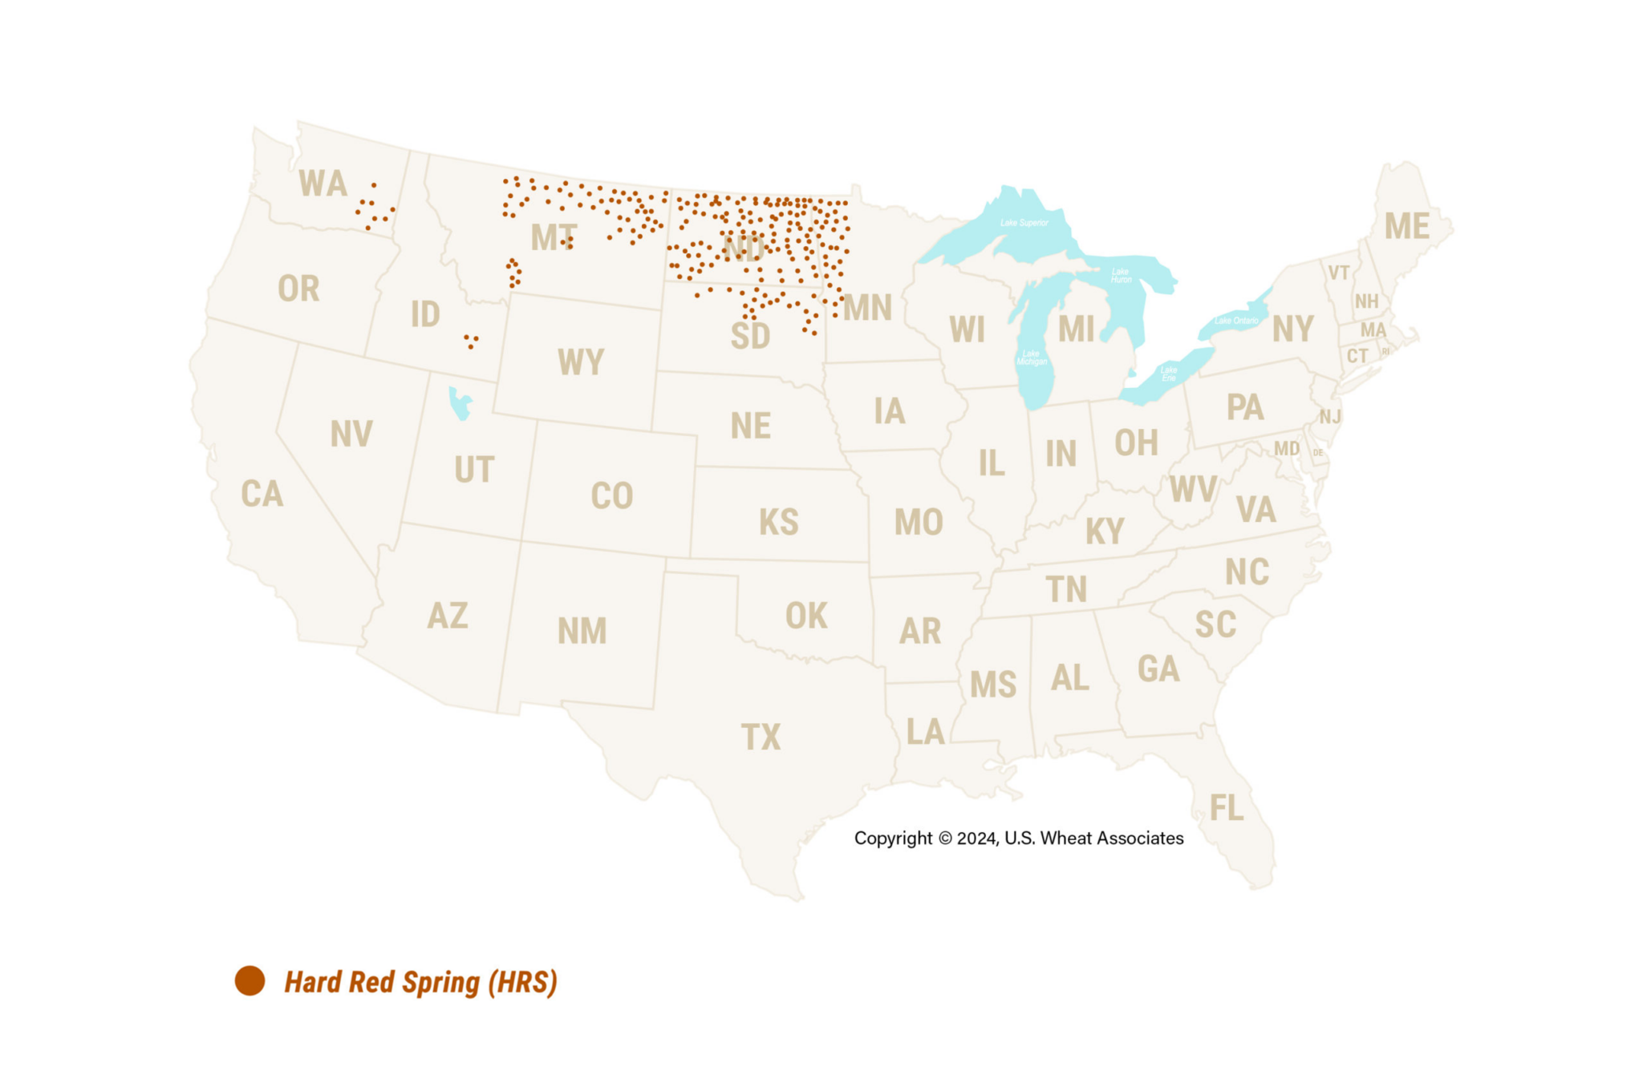
Hard Red Spring (HRS) Growing Regions
HRS is grown in other regions, but the orange dots represent the main growing area.

Slide 19
Durum Wheat
Main Growing Region: Southwest & Northern U.S.
Planting Season: Depends on growing region
Harvesting Season: Depends on growing region
Characteristics: Hardest class of all wheat with high gluten content
Protein Level: High
Durum wheat kernels

Slide 20
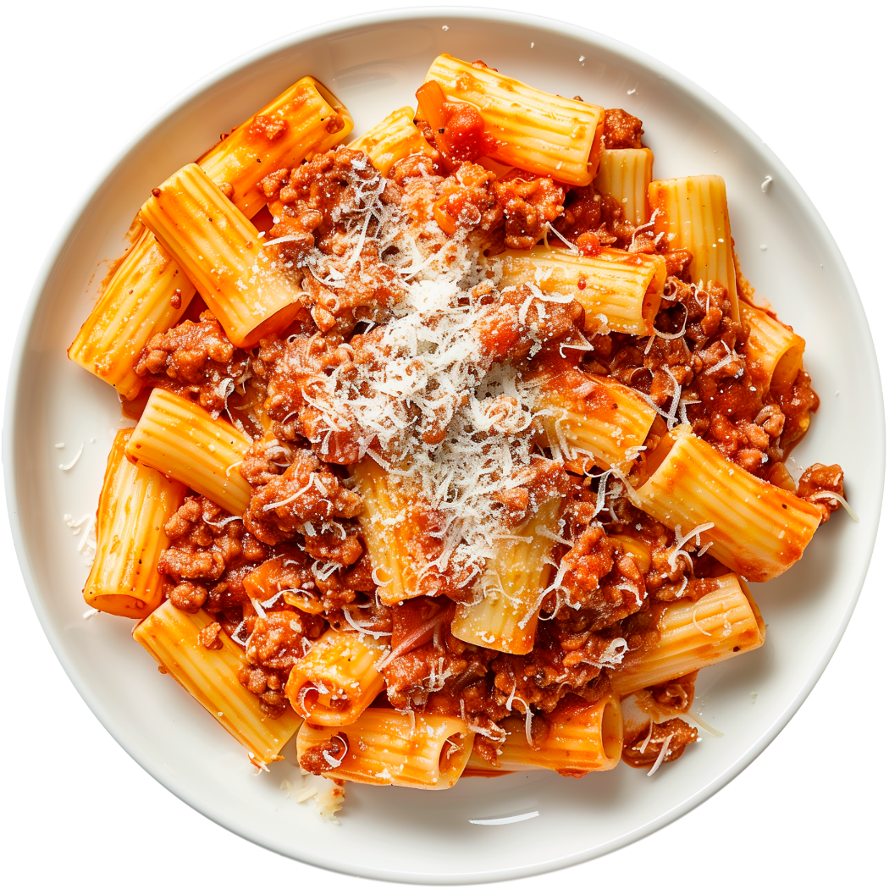
Durum Wheat
Used For: Semolina flour, pasta, couscous and some Mediterranean breads
Durum wheat is used for pasta because of its high protein (gluten) content.

Slide 21
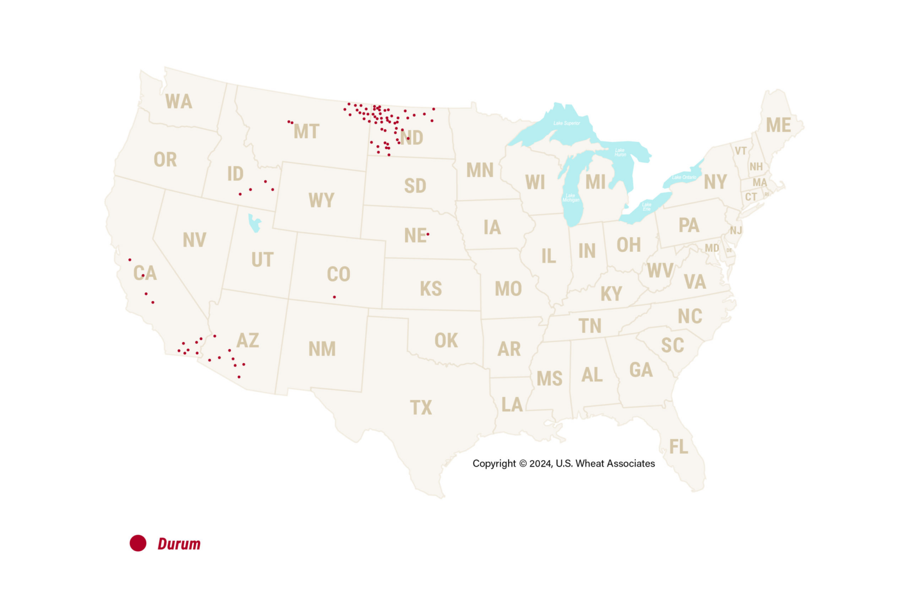
Durum Growing Regions
Durum is grown in other regions, but the red dots represent the main growing area.

Slide 22
Hard White (HW) Wheat
Main Growing Region: Diverse growing region
Planting Season: Depends on growing region
Harvesting Season: Depends on growing region
Characteristics: Milder, sweeter taste
Protein Level: High
HW wheat kernels

Slide 23
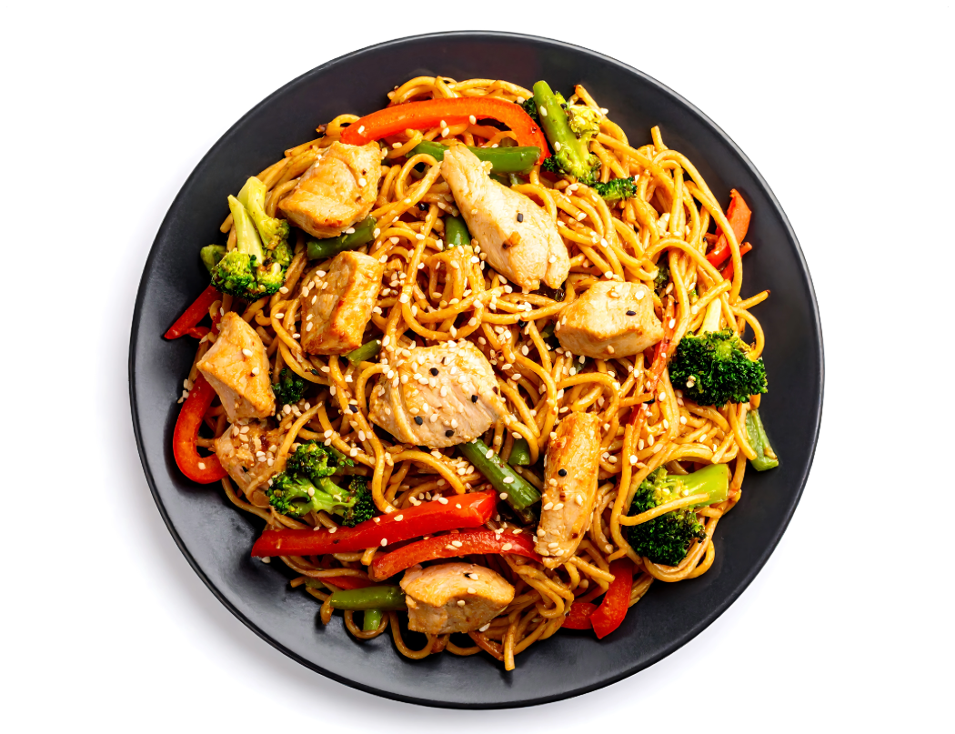
Hard White (HW) Wheat
Used For: Asian noodles, pan breads or flatbreads
HW wheat is ideal for Asian noodles because of the high protein (gluten) content and mild taste.

Slide 24
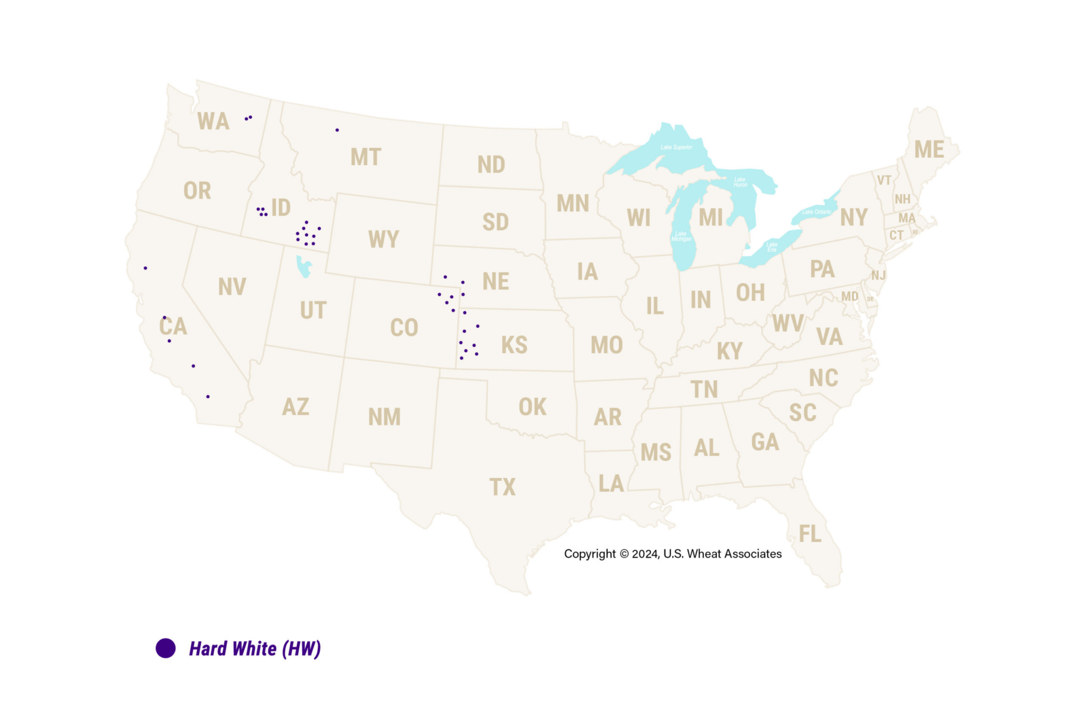
Hard White (HW) Growing Regions
HW is grown in other regions, but the purple dots represent the main growing area.

Slide 25
Soft White (SW) Wheat
Main Growing Region: Pacific Northwest
Planting Season: Depends on growing region
Harvesting Season: Depends on growing region
Characteristics: Low moisture content with excellent milling properties
Protein Level: Low
SW wheat kernels

Slide 26
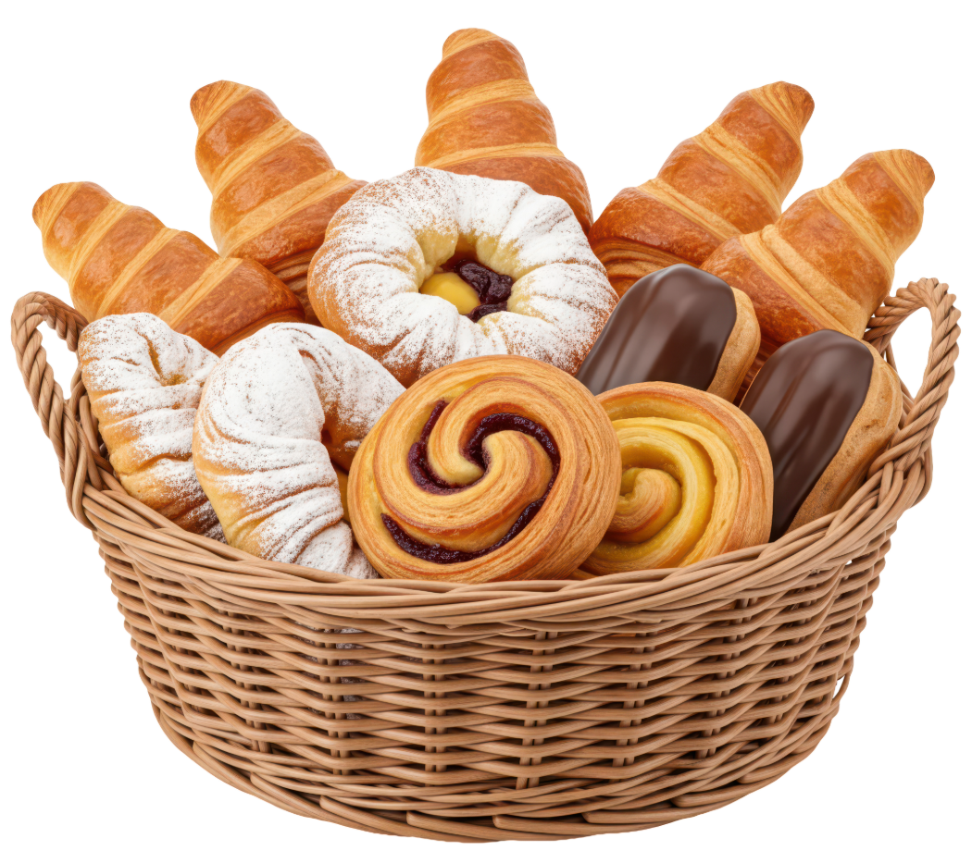
Soft White (SW) Wheat
Used For: Asian noodles, cakes and pastries
SW wheat is used for pastries because its low moisture content and low protein (gluten) levels.

Slide 27
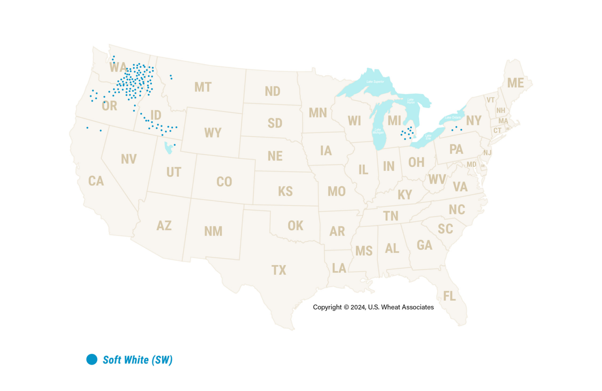
Soft White (SW) Growing Regions
SW is grown in other regions, but the blue dots represent the main growing area.

Slide 28

Flour

Slide 29
The Milling Process at a Glance
Once the wheat arrives at the flour mill, it is cleaned to remove rocks, dirt, straw, other types of seeds or anything else that would impact the quality of the flour.
Next, the kernels are soaked in water to make them softer and easier to break apart.
Rollers crack the kernels open and separate the bran and germ from the endosperm (when milling white flour).
    - If whole wheat flour is being milled, the bran and germ are also ground into flour.
    - The bran and germ are saved and used for animal feed and other products.
The endosperm is ground into tiny particles until the texture is soft, smooth and consistent.
Depending on the type of flour being made, additives and agents may be added after milling is complete to bleach, enrich and/or fortify the flour.

Slide 30
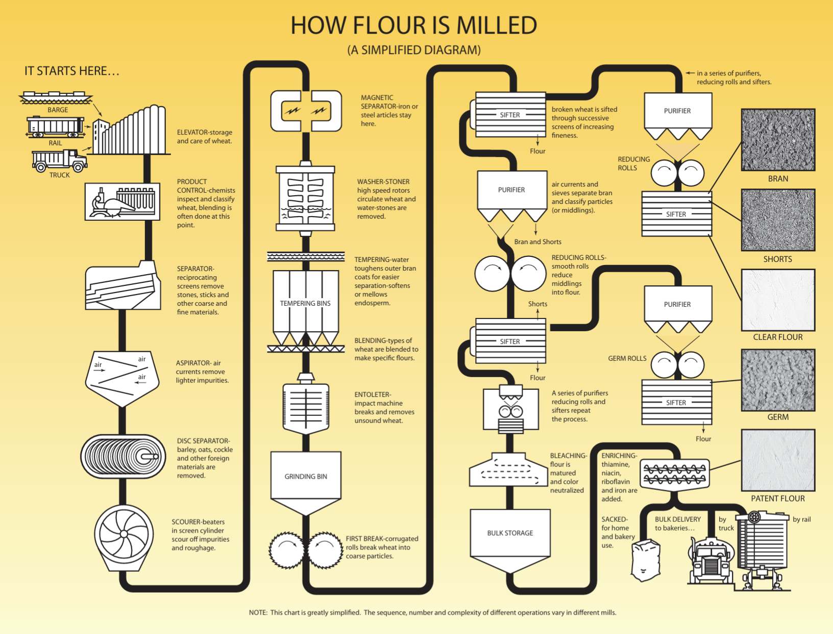
How Flour is Milled
Photo courtesy of Wheat Foods Council

Slide 31
From the Mill to the Table
Once the flour is milled, it is packaged and sold to grocery stores for consumers to use.
Or, if the flour is produced for food production purposes, it is sold to bakers and food manufacturing companies to make into store bought goods or used in bakeries or restaurants.
Consumers often purchase 2, 5 or 10 lb bags of flour at the grocery store, while professional bakers, chefs and food manufacturers buy bulk bags of 50 or 100 lbs (or more).

Slide 32
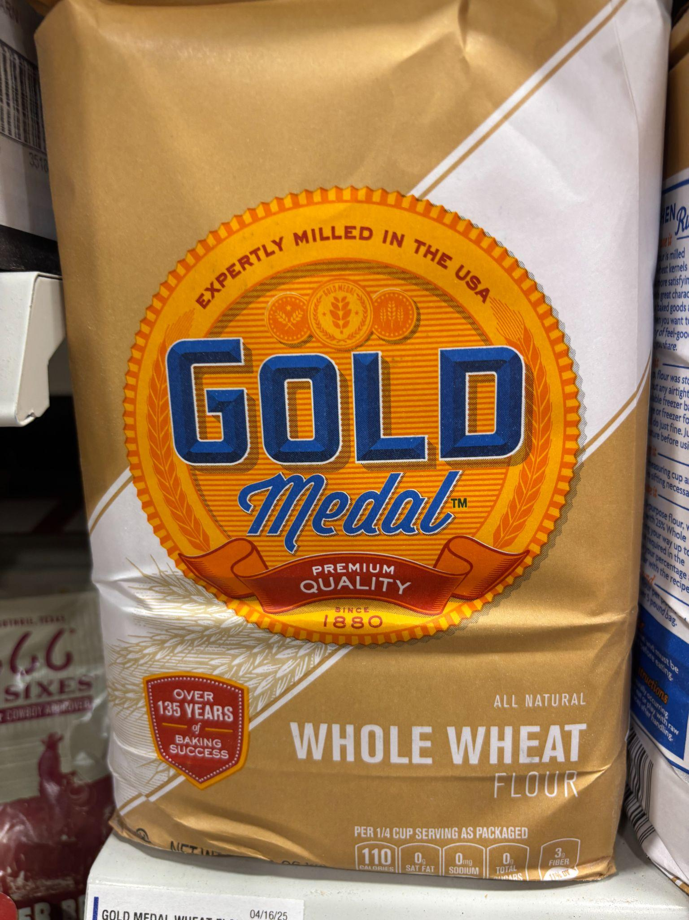
Whole Wheat vs. Refined Flour
Whole Wheat Flour: Flour made from the entire wheat kernel of red wheat varieties, including the bran, endosperm and germ.
White Whole Wheat Flour: Flour made from the entire wheat kernel of white wheat varieties, including the bran, endosperm and germ.
Refined Flour: Flour made from the endosperm part of the wheat kernel.

Slide 33
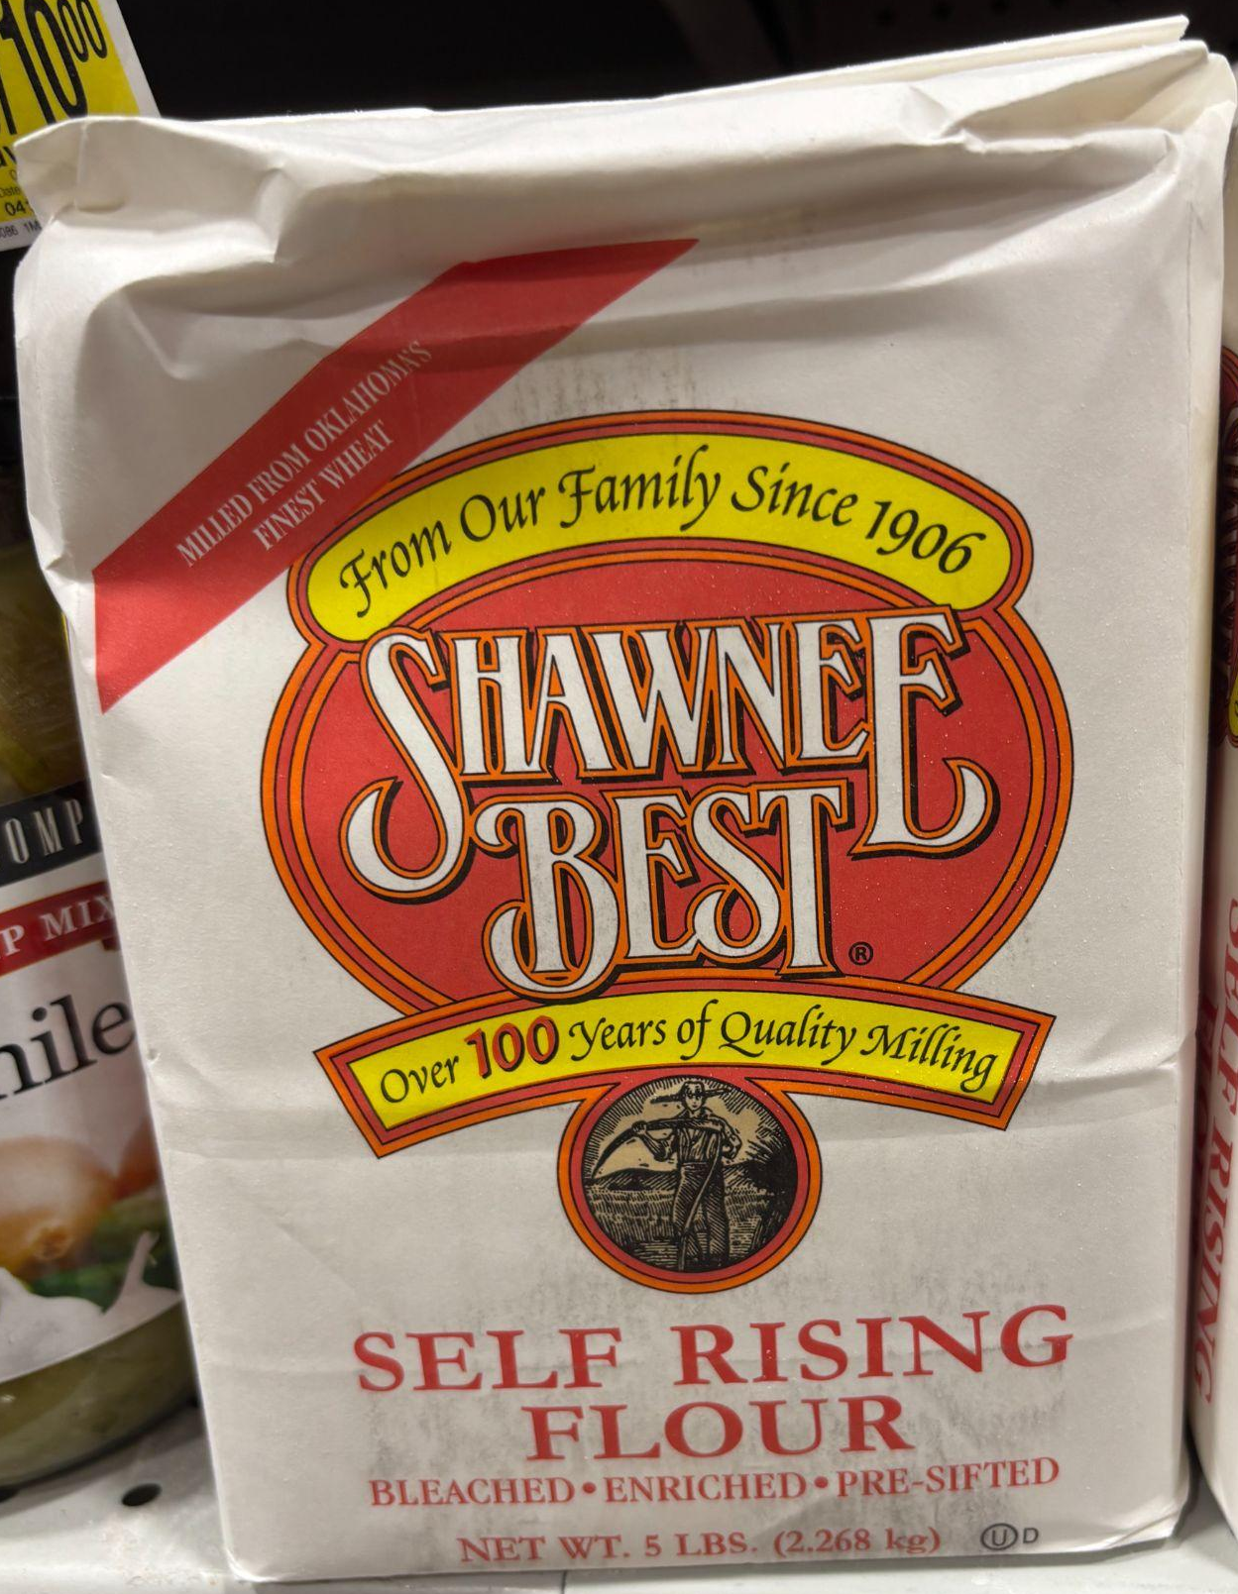
Enriched vs. Fortified Flour
Enriched Flour: Refined flour that has nutrients (B vitamins and iron) added back into the flour that have been lost during the milling process, while preserving shelf stability.
    - Flour enrichment dates back to the early 1900s due to the high rates of diseases from vitamin B deficiencies.
Fortified Flour: A step beyond enriched flour, fortified flour contains additional nutrients (folic acid) at a higher level than those originally in the wheat.
    - The fortification of flour began in the 1980s and 90s when the medical community connected folic acid deficiency to neural tube defects (NTDs), such as spina bifida and anencephaly.

Slide 34
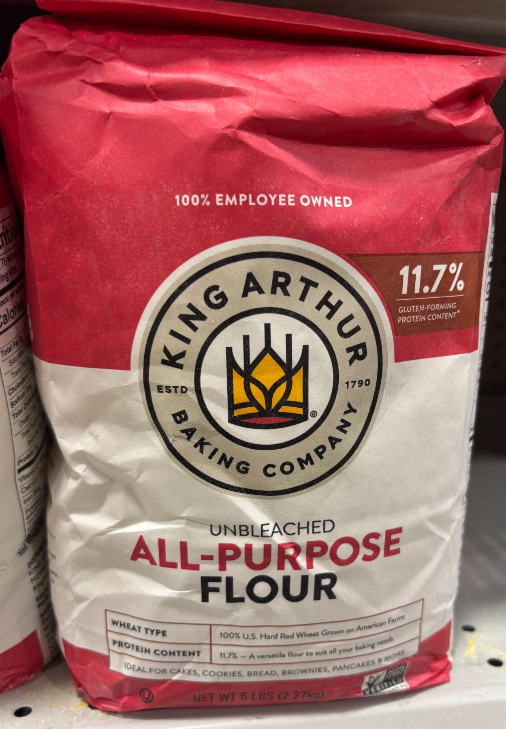
Bleached vs. Unbleached Flour
Bleached Flour: Bleached flour is whitened using chemicals (usually chlorine gas or benzoyl peroxide) to speed up the whitening process.
    - This treatment also makes the flour softer than unbleached flour and slightly reduces the protein content.
    - The use of these chemical agents is heavily regulated by the Food & Drug Administration and does not impact the safety of bleached flour.
Unbleached Flour: Flour naturally becomes more white as it ages. Unbleached flour has been allowed to naturally whiten.
    - Because it takes longer to produce unbleached flour, it is often more expensive.

Slide 35
Flour Characteristics
Each type of flour has different characteristics and purposes.
The protein content and gluten formation of the flour impacts the structure of the baked good.
    - High protein flours have more gluten, which makes them chewier.
    - Lower protein flours have less gluten, which makes them more flaky.
The consistency of the flour affects the texture of the baked good.
    - Finely milled flours create smoother textures.
    - Course flours lead to more substance in the baked good.
The flavor of the flour is dependent on the type of wheat and how it is milled.
    - Specialty flours can add unique flavor profiles and baking characteristics.

Slide 36
Types of Flour

Slide 37
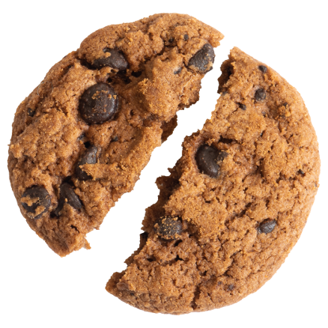
All Purpose Flour
All purpose flour is white flour blended from the endosperm of hard and/or soft wheats and can be used for any type of baked good. It is the most commonly used flour, especially for home baking.

Slide 38
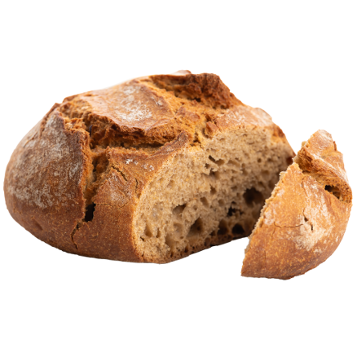
Whole Wheat Flour
Whole wheat flour is milled from the bran, endosperm and germ of the wheat kernel. It can be used for any type of baked goods, and is often a replacement for all purpose flour. White whole wheat flour is also available in some stores.

Slide 39
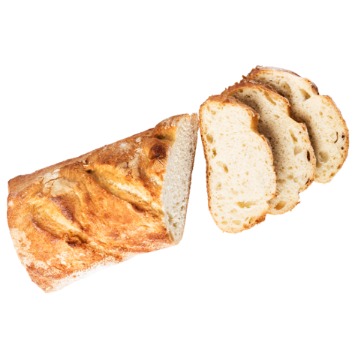
Bread Flour
Bread flour is a blend of hard, high-protein wheats with a high gluten content. It is best used for baguettes, sourdough, dinner rolls, bagels, pretzels, etc.

Slide 40

Cake Flour
Cake flour is a fine-textured flour milled from soft wheat with low protein content. Cake flour is ideal for cakes, cupcakes, doughnuts, brownies, pancakes, etc.

Slide 41

Pastry Flour
Pastry flour is milled from soft wheat that has a fine texture for croissants, cookies, crackers, pies, tarts, cinnamon rolls, etc.

Slide 42
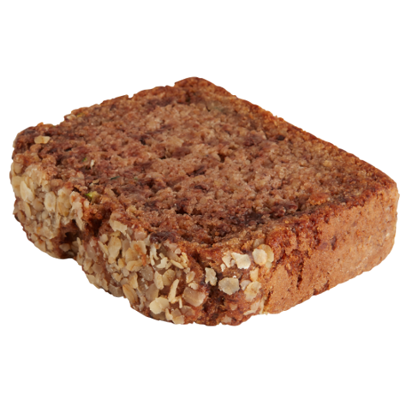
Self Rising Flour
Self-rising flour is all-purpose flour with added salt and leavening agents. It is used for quick breads, biscuits, scones, muffins, etc.

Slide 43

Semolina Flour
Semolina flour is made from coarsely milled Durum wheat and is most commonly used for pasta and couscous.

Slide 44

00 Flour
00 flour is an Italian flour made from finely milled Durum wheat. The high gluten content is ideal for pizza dough, pasta, etc.

Slide 45
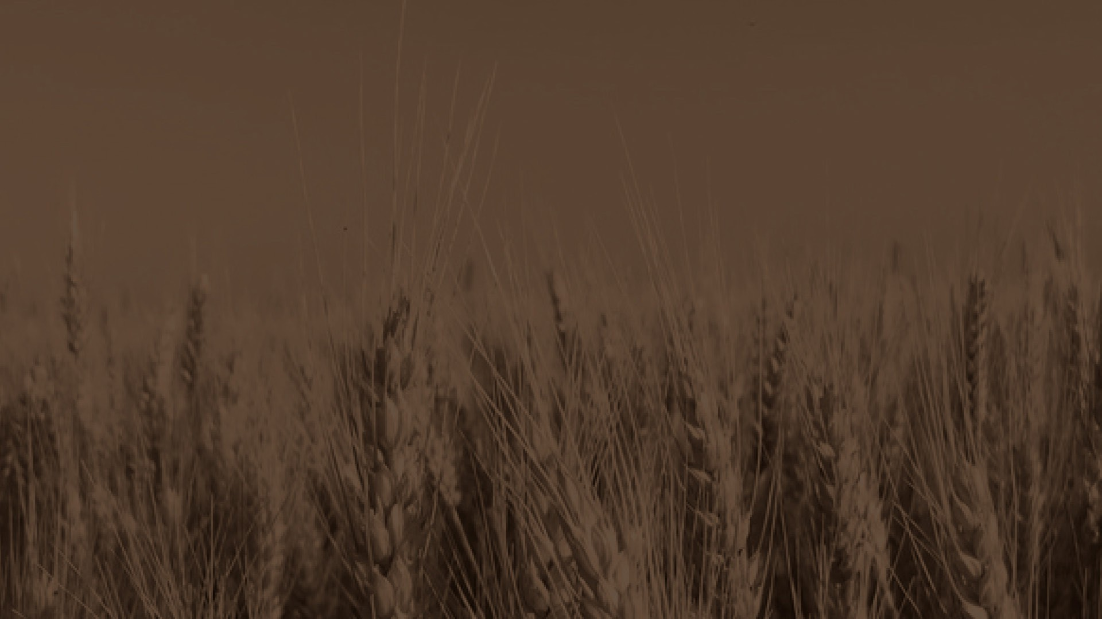

Sources:
National Geographic
  https://education.nationalgeographic.org/resource/grain/
Wheat Foods Council
  https://www.wheatfoods.org/wp-content/uploads/2024/03/What-Is-Wheat-1.jpg
U.S. Wheat Associates
  https://uswheat.org/working-with-buyers/wheat-classes/
Wheat Foods Council
  https://www.wheatfoods.org/wheat-101/classes-of-wheat/
USDA's National Agricultural Statistics Service Texas Field Office
  https://www.nass.usda.gov/Statistics_by_State/Texas/Publications/County_Estimates/ce_maps/ce_whea.php
Pastry Class
  https://www.pastryclass.com/articles/types-of-flour-for-baking
Baker Bettie
  https://bakerbettie.com/varieties-flour/
Wheat Foods Council
  https://www.wheatfoods.org/how-flour-is-milled/

Slide 46
Reviewers:
Ben Scholz
  Wheat Farmer & Texas Wheat Producers Board Director
Jordan Trees Waddle
  Agricultural Science Teacher, Medina Valley High School, Medina Valley ISD
Kyle Miller
  Family & Consumer Science Teacher, Mackenzie Middle School, Lubbock ISD
Rhonda Cantrell
  Retired Elementary Teacher, Texline ISD
Dr. Calvin Trostle
  Professor & Extension Agronomist, Texas A&M AgriLife Extension Service
Cater Wands
  Manager of Technical Sales, Miller Milling

Slide 47
Types of Wheat Matching Activity
(Optional)

Slide 48
Name the Type of Wheat
This type of wheat is mainly grown in the northern United States.
Notes:
Hard Red Spring

Slide 49
Name the Type of Wheat
What type of wheat is known for its milder, sweeter taste?
Notes:
Hard White

Slide 50
Name the Type of Wheat
__________ and __________ are both used for Asian noodles.
Notes:
Hard White and Soft White

Slide 51
Name the Type of Wheat
What type of wheat is planted in the spring and harvested in the summer or fall.
Notes:
Hard Red Spring Wheat

Slide 52
Name the Type of Wheat
__________ and __________ are both known for milling and baking qualities.
Notes:
Hard Red Winter and Hard Red Spring

Slide 53
Name the Type of Wheat
What type of wheat is grown throughout the Great Plains?
Notes:
Hard Red Winter

Slide 54
Name the Type of Wheat
What type of wheat is used for Semolina flour, pasta, couscous and some Mediterranean breads.
Notes:
Durum

Slide 55
Name the Type of Wheat
The planting and harvesting seasons for __________, __________ and __________ depend on the growing region.
Notes:
Durum, Hard White and Soft White

Slide 56
Name the Type of Wheat
This type of wheat is used for all purpose flour, blending with other flours, hearth breads, croissants, hard rolls, flatbreads and Asian noodles.
Notes:
Hard Red Winter

Slide 57
Name the Type of Wheat
Durum wheat is grown in the _____________ and _________ U.S.
Notes:
Southwest and Northern

Slide 58
Name the Type of Wheat
__________ is planted in the spring and harvested in the summer or fall.
Notes:
Spring Wheat

Slide 59
Name the Type of Wheat
This type of wheat is known as the hardest class of wheat with the highest level of gluten.
Notes:
Durum

Slide 60
Name the Type of Wheat
This type of wheat is used for all purpose flour, blending with other flours, hearth breads, croissants, hard rolls, flatbreads and Asian noodles.
Notes:
Hard Red Winter

Slide 61
Name the Type of Wheat
This type of wheat is primarily grown in the Midwest but is also grown in parts of Texas.
Notes:
Soft Red Winter

Slide 62
Name the Type of Wheat
This type of wheat is known for its low gluten content.
Notes:
Soft Red Winter

Slide 63
Name the Type of Wheat
This type of wheat is often grown in the Pacific Northwest.
Notes:
Soft White

Slide 64
Name the Type of Wheat
__________ is used for “designer” breads like hearth breads, rolls, croissants, bagels, pizza crust and blending with other flours.
Notes:
Hard Red Spring

Slide 65
Name the Type of Wheat
What type of wheat is known for its low moisture content and milling properties?
Notes:
Soft White

Slide 66
Name the Type of Wheat
This type of wheat is used for confectionery goods like cookies, crackers, cakes and blending for baguettes and other breads.
Notes:
Soft Red Winter

Slide 67
Name the Type of Wheat
__________ and __________ are planted in the fall and harvested in the spring or summer.
Notes:
Hard Red Winter and Soft Red Winter

